Slide 1
Dynamic Binary Translators and Instrumenters
By Brian McClannahan

Slide 2
Static Compilation
Compile program before running it
Link code before run time
Optimize code before run time
Do everything before run time

Slide 3
Static Compilation Challenges
Hard to predict dynamic behavior
Difficult to get profiling information
  Phase changes are not indicated during static compilation
OOP
  Runtime bindings

Slide 4
Solution
Compile program dynamically
Profile program as its run

Slide 5
DynamoRio
Released in 2002
Current version: 7.1
  Released February 2019
Works on Linux and Windows
Created as a collaboration between HP and MIT
Open-sourced in 2009

Slide 6
Code Cache
Translates code into code cache one block at a time.
  Return control to dynamorio after block is executed
Blocks don’t end at direct jumps.
Call instructions are walked into.
  Block ends at any other control transfer

Slide 7
New Code
When a fragment targets code not in the code cache.
Jump to dynamorio control.
Compile new fragment
Link previous fragment to new fragment.

Slide 8
Self-Modifying Code
Not allowed
Uncommon in large-scale applications

Slide 9
Threads
Each thread has its own code cache
Cache is split into basic block cache and trace cache
Enables thread-specific optimizations

Slide 10
Traces
A group of consecutive blocks of code
Trace can be exited at joins of basic blocks
Indirect jumps are inlined in traces but a comparison is made to guarantee execution drops out if the target of the indirect branch does not match the recorded target from creation
Trace head is a basic block fragment that is either:
  Target of a backwards branch
  Target of an exit from an existing trace

Slide 11
Trace Creation
Each trace head has a counter
Create trace starting from initial trace head until backwards branch or another trace is reached
New trace represents a commonly executed grouping of fragments
Targets of all exits from new trace become trace heads

Slide 12
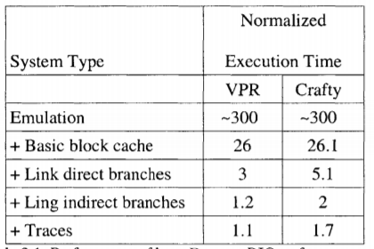
Trace Efficiency

Slide 13
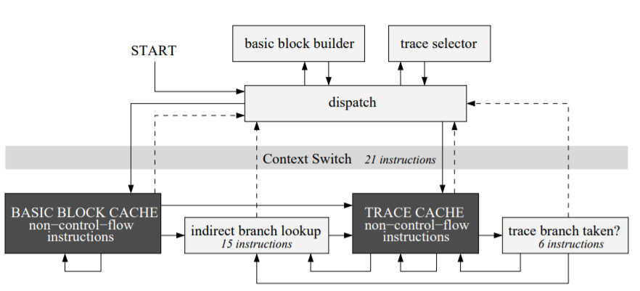
Execution Flow

Slide 14
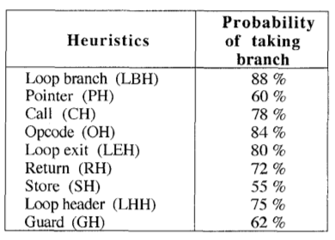
Branch Prediction

Slide 15
Decode-Dispatch Interpreters
Hard to create traces on switch statements

Slide 16
DynamoRio with Log PC
Define new PC as a pair of a native PC and Logical PC
Allow Dynamorio to track information about jumps
Create traces for the interpreted program and not the interpreter

Slide 17
Interpreter Optimizations
Call Return Matching
Constant Propagation
Dead Code Removal
Stack Cleanup

Slide 18
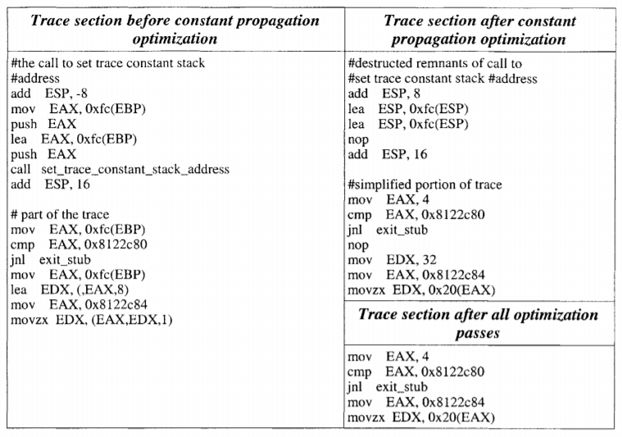
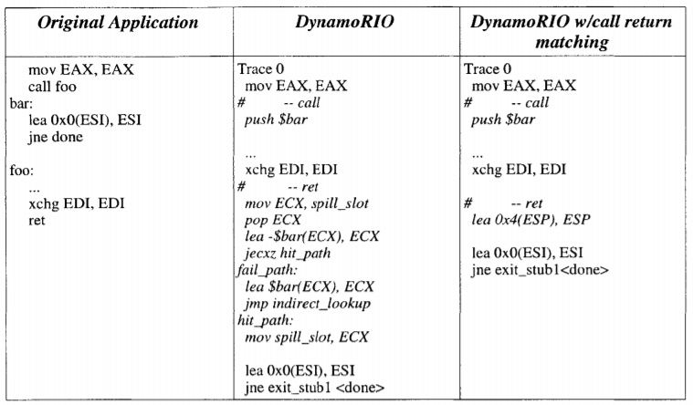
Optimizations

Slide 19
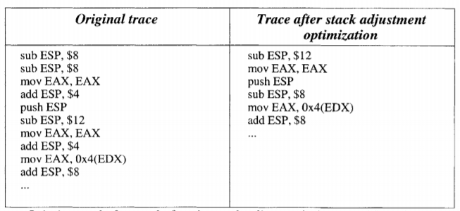
Optimizations

Slide 20
Valgrind
Created in 2000
Initially created to be a free memory debugger on linux
Expanded to be a dynamic instrumenter
Divided into a core system and skins
Comes with some default skins:
  Memcheck
  Addrcheck
  Cachegrind
  Helgrind
  Nulgrind

Slide 21
Coverage
Manages all code and libraries
  Even if source code is unavailable
Can’t control system calls but they can be observed
Uses a JIT compiler

Slide 22
Ucode
Intermediate language used in valgrind
Two-address language
JIT compiler translates code from x86 to Ucode back to x86

Slide 23
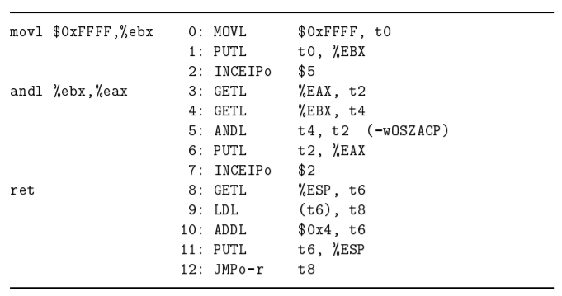
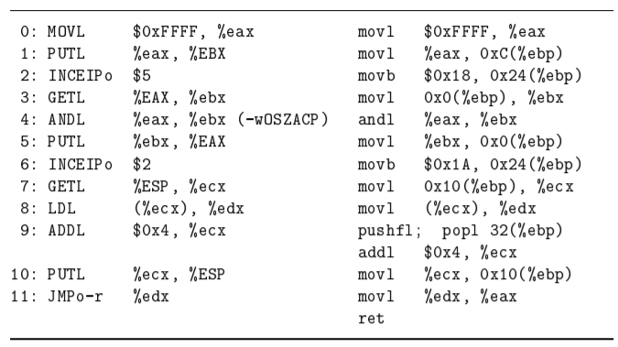
Ucode cont.

Slide 24
Base Block
Stores the simulated CPU
Registers for simulated CPU tracked in memory

Slide 25
Basic Blocks
Translation
  Disassembly
  Optimization
  Instrumentation
  Register Allocation
  Code Generation

Slide 26
Basic Block Jumps
If known at compile time, insert direct jump
Otherwise return to dispatcher and check small address cache.
If not in cache, check entire table.
Drop out to valgrind scheduler and translate new target
Control is returned to valgrind scheduler if a system call or client request needs to be handled

Slide 27
Signal Processing
Instruction is added at the beginning of every block to decrement a signal counter
When counter hits 0, drop back to valgrind scheduler
In valgrind scheduler process any signals and thread switches that are necessary

Slide 28
System Call Procedure
Save valgrind stack pointer
Copy simulated registers except PC into real registers
Execute system call
Copy real registers back into simulated registers
Restore stack pointer

Slide 29
Floating Point Operations
The FPU is not simulated like the CPU
When a floating point instruction needs to be run:
  Move simulated registers to real registers
  Match integer registers on the simulated CPU to the real CPU if needed
  Copy results back into simulated CPU

Slide 30
Client Requests
A signal or query sent from a client program to a skin.
When a client request is made, valgrind inserts a no-op sequence into the code.
When valgrind sees this sequence, it drops out and processes the request.
Arguments can be passed to the client requests and the request can return a value to the client.

Slide 31
Self-Modifying Code
Not supported by valgrind
Does allow for code regions to be ignored

Slide 32
Signals
Valgrind does not allow programs to interact with signals directly.
  If it did it’s possible it could lose control of the program permanently
Instead valgrind intercepts the system calls used to register signals.
Every few thousand basic blocks, any pending signals are processed.

Slide 33
Threading
Valgrind supports the pthreads model.
  Provide replacement for the libpthread library
Threads exist in user space.
All threads run on a single kernel thread.

Slide 34
Execution Spaces
User Space
  Vast majority of operations happen here
  Covers all JIT compiled code
Core Space
  Signal handling
  Pthread operations
  Scheduling
Kernel Space
  System calls
  Process Scheduling

Slide 35
Skins
Needs – core services a skin wishes to use
Trackable Events – core space events a skin wishes to be notified about
Instrumentation – read and modify Ucode

