Slide 1
JIT Compiler Design Maxine Virtual Machine Dhwani Pandya

Slide 2
Outline
Background
Introduction
Scheme layout - architecture
Features
Boot image generation
Maxine inspector

Slide 3
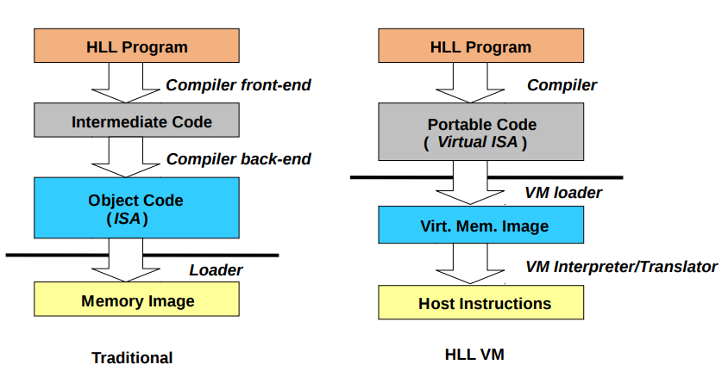
Background

Slide 4
Problem statement
Need for modular architecture to make VM hardware independent.
Exploit all benefits of high level language such as type safety, memory safety, GC and JIT compilation.
Reuse of language-independent modules.

Slide 5
Introduction – Maxine VM
Virtual machine written in Java.
Metacircular VM
Open source code base and open research topic.
Architecture is modular and it demonstrates “system programming in Java”.
Code base is compatible with Java IDEs.
-> Eclipse, Netbeans, Intellij
Robust and fast enough to serve as a base for research.
Support multiple architectures and operating systems.
-> X86, ARM
-> Linux, macOS

Slide 6
Jikes RVM
Major components like JIT and GC, are written in java.
Difference between Maxine and Jikes
-> Maxine improves approachability and developer efficiency.
-> Jikes requires a preprocessor to generate source code depending on various configuration properties while Maxine allows entire code base to be editable and navigable in an IDE.
-> Debugging in Jikes requires low-level tools such as gdb which is unaware about the internal details.

Slide 7
System structure
Modular, structured around set of components that collaborate via public interfaces.
Provide abstractions over the lower-level implementation details.
Allow interaction between subsystems and the rest of the system.
VM is written in Java, except substrate which is written in C.
-> Implements native launcher of the VM.
-> Encapsulates native operating system services such as virtual memory operation, native thread support, and signal handling.
Exploits standard java language features as much as possible.

Slide 8
Strucutre

Slide 9
Structure(contd.)
Layout scheme :
Object representation in memory.
First header word points to hub.
Second header word stores locking and GC information.
Memory representation in Maxine heap : Tuple, array and hybrid representations.
Reference scheme :
Default is direct reference scheme.
Relieves developer from using explicit handles.

Slide 10
Structure(Contd.)
Heap allocation and GC :
Provides memory management, object allocation and garbage collection.
Memory management for objects and malloc data.
Default GC is stop-the-world collector.
Implementation of generational garbage collector is also included.
Thread synchronization :
Lock information is stored in object header.
OS mutex functions to handle contention.
Additional Biased locking feature.

Slide 11
Structure(Contd.)
Run scheme :
Invoked after VM starts basic services.
Starts up with JDK and then loads and runs user-specified Java class.
Compilation Broker :
Dynamic compilation-only strategy.
Initial compilation with T1X, on the first method invocation.
Frequently used methods are then recompiled with C1X the optimizing compiler.

Slide 12
T1X Baseline Compiler
Maxine’s first line of execution.
The goal is to produce machine code faster.
Template-based design.
-> Adding segments of binary code, which at runtime can be combined and completed with the values of registers, stack offset and constants.
Templates are written with annotations which are used by optimizing compiler.
Approachability
-> It is easy to modify and experiment with the translation of bytecodes.

Slide 13
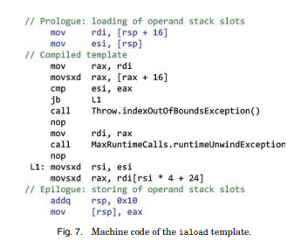
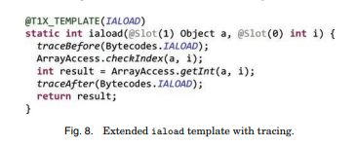
T1X (contd.)

Slide 14
Optimizing compiler C1X
Compiles optimizing compiler itself, the templates used by T1X, and the methods needed to start up the VM.
Safe points and reference maps support GC and deoptimization.
Deoptimized code is key for recovering and debugging optimized code.
Uses same architecture and intermediate representations as the client compiler of HotSpot VM.
Difference is the introduction of XIR(assembler-like API) into C1X, which enables the separation of compiler from the VM.

Slide 15
Boot image generation
Boot image is a executable image of the running VM
Compilation of VM ahead of time.
Runs on pre-existing Hotspot VM.
@HOSTED_ONLY annotation to differentiate between boot image generation and normal VM execution mode.
The static host VM fields are accessed using reflection.
End result is executable and necessary runtime details required to have a stand alone bootstrapped VM.

Slide 16
Boot image generation(Contd.)

Slide 17
Debugging
Main challenge is circularity.
Inspector is the tool for debugging.
Visualizing aspects of VM state that are elusive and widely distributed in other system.
It is possible to debug the VM with a single tool, specialized for this purpose.
Tracing safepoints to support Deoptimization.
Advantage is code reusability.

Slide 18
Maxine Inspector

Slide 19
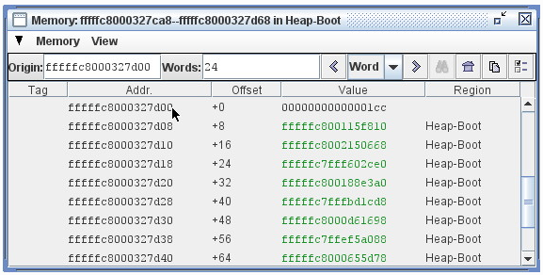
Maxine inspector(Contd.)
Memory inspector :

Slide 20
Maxine Inspector(Contd.)
Can visualize
State of static boot image.
Halted process during debugging session.
Core dump
Sets breakpoints and watchpoints.
Predefined breakpoints.
Complexity derives from circularity.

Slide 21
Summary
Metacircular VM – for and in Java.
Approachable design :
- Modular structure.
- Debugging tool.
Heavy use of annotations.

Slide 22
References
https://maxine-vm.readthedocs.io/en/latest/index.html
Maxine: An approachable virtual machine for, and in, Java
http://www.se-radio.net/2009/09/episode-144-the-maxine-research-virtual-machine-with-doug-simon/
Christian Wimmer, Stefan Brunthaler, Per Larsen, and Michael Franz. Finegrained modularity and reuse of virtual machine components. In Proceedings of the 11th annual international conference on Aspect-oriented Software Development, 2012

Slide 23
Questions?

