Slide 1
Garbage Collectors
Continuously and Compacting
By Lyndon Meadow

Slide 2
Presentation Contents
Why do we want Garbage Collectors (GCs)?
What is a Garbage Collector (GC)?
What are our Basic Collector Models?
Our Unique and Modern Problem
Solution: Continuously Compacting Real-Time GCs
What is means to be Stopless?
Bring me my CoCo
Playing Chicken
Picking Clovers
Endgame of Modern GCs

Slide 3
Why do we want Garbage Collection (GCs)?
Primarily we want reliable and secure software that is quick an cheap to develop.
Specifically we want the rapid development of applications with:
High Responsiveness
Meeting Short Deadlines

Slide 4
What is a Garbage Collector (GC)?
Objects may be freely created, in object oriented languages.
We’d like someway to keep track:
Such as a root set of pointers
Must detect when object is no longer referenced by the program.
“Garbage” – Objects that are no longer accessible and hence need collection to free memory and avoid overflows.

Slide 5
What is a just a Compacting Solution?
We want a continuous space in memory for optimal new object creation.
Dead objects are deleted, and then all living objects made into a continuous region on the heap.
First Pass Marks Dead Objects
Further Passes Calculate/Move/Update Live Object References
Handle Pools might be used as method of pointer consolidation.
But subsequently adds a level of indirection to each object access
“Stop the World” Collector – pauses program execution as GC runs

Slide 6
Compacting GC Model

Slide 7
What is a just a Concurrent Solution?
We want to avoid execution delays from GC operation
Useful when can only use limited resources/ time
Useful when system has a spare CPU thread to dedicate
Solving problem of a partially collected heap in a state of flux
Uses a form a synchronization to avoid referencing marked objects
Write Barriers are standard choice for protection
Check for when a pointer in an already marked object is overwritten
On occurrence, remark object and put it back in object queue
But memory isn’t defragmented!

Slide 8
Concurrent GC Model

Slide 9
Our Unique and Modern Problem
Desire both a system that collects dead objects without significant delays.
And a system that makes the heap continuous for the creation of new live objects.
Specifically for modern multithreaded applications, that must operate in real time.

Slide 10
Solution: Continuously Compacting Real-Time GCs – i.e. Stopless
On-the-fly lock-free mark sweep collector, which reclaims dead objects concurrently
Concurrent (Partial) Compaction mechanism that supports said parallel and lock-free multithreaded applications
Additionally consider barrier costs in further optimizations as well as those by alternative Stopless implementations

Slide 11
Basics of Stopless GCs: “Lock free”
Will some thread complete an operation after the system has run a finite number of steps?
Yes, by extension of typical single-thread requirements.
A thread is required to complete an operation after some constant steps.

Slide 12
Basics of Stopless GCs: “Real Time”
In the strictest terms:
Robustness to worst case almost zero probability events such as:
Worst case memory fragmentations
Unassured collector terminations
Etc…
Stopless is soft real time, in other words we let entropy into our system for hopeful performance gains in most usage cases.
Worst case, the program fails in the middle of operation and hits bare metal.

Slide 13
Basics of Stopless: “Concurrent Compaction”
Most solutions to shifting threads and multiple copies of an object may usually be tolerated in most memory coherence models.
However, this isn’t the case for “Real Time” which require atomic operations.
Creating ordering constraints that don’t allow much reordering.
CoCo system is first practical realization of these goals.

Slide 14
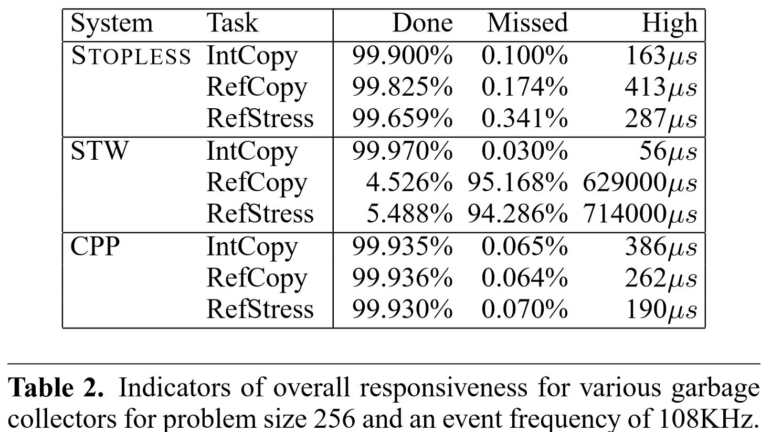
Guide
Stopless - Stock model
STW – Stop the World
CPP – Manual C++ memory management

Slide 15
Bringing the CoCo
Moves objects in the heap concurrently with program executions
Allows parallel threads coordinated via atomic operations on shared memory
Supporting program semantics/ lock-freedom guarantees.
Satisfies Linearizability and Sequential Consistency memory models.
Basically, uses a wide object to transition from the original object to the copied object.

Slide 16
Wide Object Model

Slide 17
Solution is found, the Problems Continue
We have achieved up to this point faster responsiveness for real time systems that require deadlines at the microseconds level.
Even have obtained powerful scalability for larger programs.
But, is it possible to reduce time even further?
Below the newfound average of 10 micro seconds?
What may be adjusted in the compaction algorithm?

Slide 18
What does Failure Mean?
With the Stopless implementation we already have accepted some soft balling of real time requirements.
We ignore problems that always can happen such as a hardware failure, memory corruption, page-faults, software-bugs, or even just odd cache behaviors.
Not known what distribution space is, so relaxed attituded is justified.

Slide 19
Playing Chicken
Assumes that a race between the Program and the GC won’t occur.
Will at some cost, gracefully abort a move if such a conflict occurs.
Maintains the invariant that all threads agree on if an object is copied or not.
Maintains the invariant that all threads always use the correct object to load and store values.

Slide 20
Benefits of Being a Chicken
Objects are copied as a whole
Lets all program threads switch to new location
Avoids sluggish per-field read checks that Stopless and Clover use.
Writing is a wait-free operation
If fully copied then write to to-space
If not tagged for copying then write to from-space
Else Chicken must Abort using compare and swap

Slide 21
Benefits of Being a Chicken Continued
Soft-Handshake occurs before copying starts
Each object that is meant to be copied is tagged first
Waits until all threads acknowledge the compaction phase
The copying process is wait-free
Objects are flipped from from-space to to-space individually.
If a program writes to an object before flipped, tag cleared, object not copied.
If flipped, object is copied, then program threads read/write to-space.

Slide 23
Picking Clovers
Doesn’t block data races between collector and program threads
If a value ‘v’ is chosen from a space of ‘2^l’ values ‘V’
Then probability of being stored any given store execution is ‘2^-l’
If forbidden value is written to, opened locks need to be re-locked.

Slide 24
Benefits of Picking Clovers
Just like Chicken the simpler implementation reduces complexity
Allocated a random alpha to a single space in the heap, which probably won’t get overwritten.
Odds of failure are essentially impossible on most modern 64 bit architectures
Similar to both Chicken and Stopless, soft-handshakes also used.

Slide 25
Stopless/Chicken/Clover
Heap Access
Chicken: all heap access are wait free, except on compare swaps which are still lock free.
Clover: Heap write might get stalled until compaction completes
Stopless: Provides Lock Free writes, Branches for reads

Slide 26
Stopless/Chicken/Clover
Aborting
Chicken: Aborts eagerly since has strictest requirments
Clover: Never aborts unless user requests it
Stopless: Aborts when multiple mutator threads write into same field simultaneously as compaction occurs.

Slide 27
Stopless/Chicken/Clover
Termination
Chicken: Guaranteed to complete, but may not copy all objects
Clover: Doesn’t have a guarantee, but can be modified to include it
Stopless: Never guarantees termination

Slide 29
Distributions Of Transaction Times

Slide 30
Endgame of Modern GCs
Several Implementations that crushed IBM’s Java Collector as of 2008.
Several new implementations and further research still being conducted.
Notably C4 introduced generational aspect to this process.
Near native binary efficiency and response times, approaching.

