Slide 1
Hardware Virtualization
Naveed Mahmud
University of Kansas (KU)
EECS 768: Virtual Machines
Friday, April 12th, 2019

Slide 2
Outline
Introduction
x86 Virtualization
Hardware Accelerated Virtualization
Virtualizing using Reconfigurable HW

Slide 3
Introduction
What is hardware virtualization?
Underlying technology supporting virtual servers ESX, Xen, and Hyper-V.
Different from operating system virtualization.
OS provides weak isolation. Need for hypervisor or VMM.
VMM manages virtual machines (Guest OS + applications) like an OS manages processes and threads.

Slide 4
Introduction
Virtualization challenge in the past
Trap-and-emulate virtualization on mainframes, IBM 370
x86 virtualization impossible?
Inherited architectural quirks
Retains compatibility with legacy code
Solution in 1998
Binary translation based VMM
Trap-and-emulate virtualization of x86
2005: Intel hardware support for ISA virtualization, VT-X
2007: AMD hardware support for memory virtualization, RVI

Slide 5
Introduction
Hardware Virtualization provides
Server consolidation
Fault tolerance
Security and resource management
OS development and deployment
Cloud computing

Slide 6
Outline
Introduction
x86 Virtualization
Hardware Accelerated Virtualization
Virtualizing using Reconfigurable HW

Slide 7
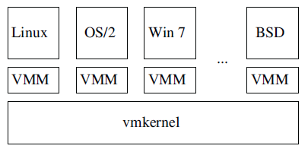
x86 Virtualization
Hypervisor and VMM narrower definitions
VMM: and entity specifically virtualizing a given architecture (ISA, memory, interrupts, I/O)
Hypervisor: combines an OS with a VMM
Virtualizes the x86 architecture
boot loader
HW abstraction layer
I/O stacks
Schedulers
Figure 1: The ESX hypervisor: one vmkernel per host,
and one VMM per virtual machine.
Image source: Agesen, et al [1]

Slide 8
x86 Virtualization
Virtualizing x86
General approach: trap-and-emulate
Guest code runs directly on CPU with reduced privilege
Guest executing privileged instr. generates trap
CPU transfers control to VMM
VMM emulates instruction using interpreter
Resumes execution of guest code
x86 initially considered non-virtualizable
POPF instruction: stack -> %eflags
Guest kernel trying to clear interrupt flag using POPF

Slide 9
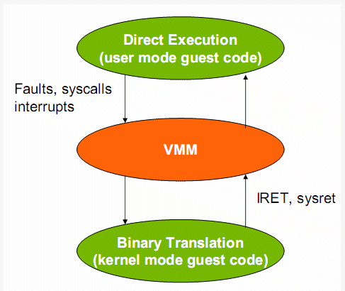
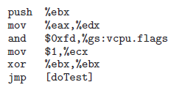
x86 Virtualization
Binary translation
Handle entire x86 ISA (x86 to x86 translator)
Intercept sensitive instructions without requiring trap semantics.
Translate privileged instructions to safer user-mode code.
Replaces sensitive code with code that manipulates virtual HW.
Maintain translation caches for speedup.
Image source: Agesen, et al [1]

Slide 10
x86 Virtualization
Memory Management
Support for virtual memory : HW TLB and page table walker.
VMM’s MMU
Maintains isolation.
Mapping guest virtual address (gVA) to guest physical address (gPA).
Mapping guest physical address (gPA) to host physical address (hPA).
Provide native-speed memory access for direct execution
Mapping from gVA → hPA must reside in HW TLB.
Point page table root control register (%CR3) to a shadow page table

Slide 11
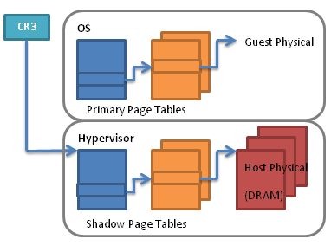
x86 Virtualization
Memory Management
Shadow page tables translate the virtual addresses of the guest OS into the real physical pages
Most used parts of the page table are cached in the TLBs.
Shadow page table adjustment costs performance.
Takes 3 to 400 (!) times more cycles than in the native situation.
Memory intensive applications suffer.
MMU needs to detect when the guest modifies a page table entry → Traced faults
Image source: Gelas [2]
Notes:
The naive approach would be to let the OS freely modify its page tables, e.g., in response to a page fault. The hypervisor would only intercept the privileged instruction INVLPG that the OS uses to invalidate a TLB entry. At that point the hypervisor would make a corresponding change to its shadow page tables, substituting the guest physical address with the corresponding host physical address (possibly allocating a physical page from its own pool). Unfortunately, this doesn’t work because some operating systems (I won’t be pointing fingers) occasionally forget to invalidate TLB entries.
The fallback approach is for the hypervisor to write-protect all guest page tables. Whenever the OS tries to modify them, a page fault occurs — the so called tracing fault — which is vectored into the hypervisor. That gives the hypervisor the opportunity to immediately update its shadow page tables. In this scheme the two structures always mirror each other (modulo physical addresses) but at the cost of a large number of page faults.
A common optimization is to allow shadow page tables to be lazily updated. This is possible if not all primary page tables are write protected. If an entry is present in the primary page table but is missing from the shadow page table, a page fault will occur when the hardware walks it for the first time. This is a so called hidden page fault and it’s serviced by the hypervisor, which at that point creates an entry in its shadow page tables based on the entry in the primary page tables.

Slide 12
Outline
Introduction
x86 Virtualization
Hardware Accelerated Virtualization
Virtualizing using Reconfigurable HW

Slide 13
Hardware Accelerated Virtualization
Idea is to fix the problem that x86 cannot be virtualized without BT
Trap all exceptions and privileged instructions
Transition between guest OS ⬅➔ VMM (Vmexit/Vmentry)
Does not reduce the overheads
Advantage
VMM privilege level > Guest OS privilege level.
System calls are not always intercepted.
So guest OS can provide kernel services to applications.

Slide 14
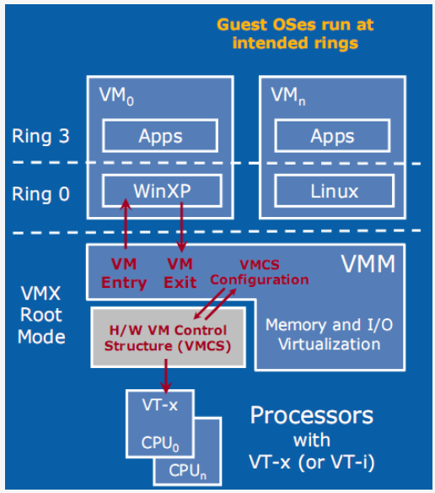
Hardware Accelerated Virtualization
Problem: transition requires large number of CPU cycles. (2-3 orders)
Intel VT-x or AMD-V (first gen)
Intel added Extended Page Tables (EPT)
AMD added Rapid Virtualization Indexing (RVI)
System calls overhead less impacted
Simpler interceptions cost more
Creating processes
Context switches
Page table updates
BT and para-virtualization faster!
Image source: Gelas [2]

Slide 15
Hardware Accelerated Virtualization
Instruction Set Virtualization: VT-x and AMD-V
Virtual machine control block (VMCB)
In-memory data structure
Combines control state with a subset of the guest VCPU state
Guest mode
Guest OS can run without interference from VMM
Less-privileged execution mode
Supports direct execution of guest code + guest privileged code
vmrun
HW loads guest state from VMCB
Continues execution in guest mode
Stop condition set by control bits of VMCB
HW performs exit operation

Slide 16
Hardware Accelerated Virtualization
Instruction Set Virtualization: VT-x and AMD-V
vmexit
Guest state is saved to the VMCB
VMM state is loaded
Execution resumes in host mode in the VMM
Guest mode allows VM
To issue system calls
Switch between kernel and user mode
Use segmentation
Run sensitive instructions like POPF
Take faults without causing exits to VMM

Slide 17
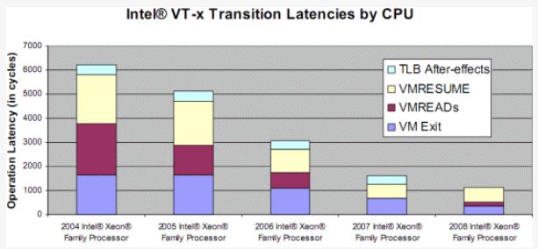
Hardware Accelerated Virtualization
Instruction Set Virtualization: VT-x and AMD-V
Performance
Early implementations had high overhead (exit costs)
Improved with later generation of processors
SW cost of handling exit.
Overhead function of exit frequency and average cost of handling an exit
Optimization: reduce frequency of exits
Image source: Gelas [2]

Slide 18
Hardware Accelerated Virtualization
Instruction Set Virtualization: VT-x and AMD-V
Exit frequency optimization
Certain types of exits can be buffered in the VMCB
Example: POPF
Guest mode execution of POPF would trigger exits
High frequency of POPF, unacceptable exit rate
VMCB keeps HW-maintained shadow of the guest %eflags register
Instructions changing %eflags operate on the shadow

Slide 19
Hardware Accelerated Virtualization
Memory Virtualization: RVI and EPT
VMM must write protect primary page tables
VMM must request exits on page faults to distinguish between hidden faults and true faults
VMM must request exits on guest context switch to update page table
Second generation of HW support targeting memory opt.

Slide 20
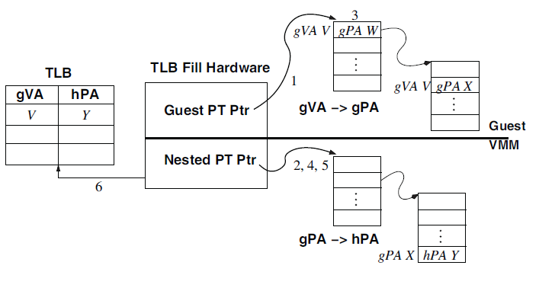
Hardware Accelerated Virtualization
Memory Virtualization: RVI and EPT
The VMM maintains a hardware-controlled nested page table
Translates gPAs to hPAs
"super" TLB that keeps track of both the Guest OS and the VMM memory management.
Image source: Agesen, et al [1]
Notes:
1. The hardware uses the guest page table pointer %cr3
to locate the top level of the guest’s hierarchical page
table.
2. The guest’s %cr3 contains a gPA, which must be translated
to a hPA before dereferencing. The hardware
walks the nested page table for the guest’s %cr3 value
to obtain the hPA of the top level of the guest’s page
table hierarchy.
3. The hardware reads the guest page directory entry corresponding
to gVA V yielding a gPA W.
The gPA read from the page table entry in step 3 must
now be translated via the nested page table before proceeding.
Steps 3 and 4 repeat once for each level in
the guest page table (up to four levels for a long mode
guest).
5. Having discovered the hPA of the final level of the
guest page table hierarchy, the hardware reads the
guest page table entry corresponding to V . In our example,
this page table entry points to gPA X, which
is translated via a final walk of the nested page table,
e.g. to hPA Y .
6. The translation is complete: gVA V maps to hPA Y .
The page walker can now fill the TLB with an appropriate
entry (V, Y ) and resume guest execution, all
without VMM intervention.

Slide 21
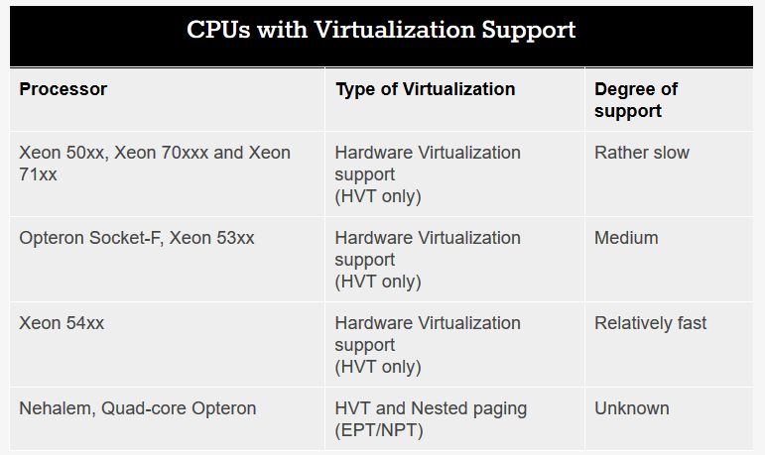
Hardware Accelerated Virtualization
CPUs with virtualization support
Processor list: https://ark.intel.com/content/www/us/en/ark.html
Image source: Gelas [2]

Slide 22
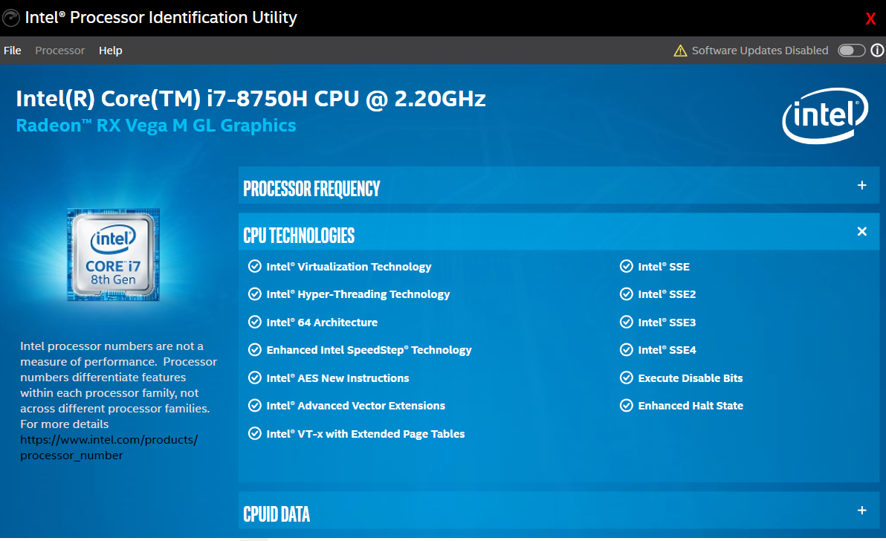
Hardware Accelerated Virtualization
Intel Processor Indentification Utility
https://downloadcenter.intel.com/download/28539

Slide 23
Outline
Introduction
x86 Virtualization
Hardware Accelerated Virtualization
Virtualizing using Reconfigurable HW

Slide 24
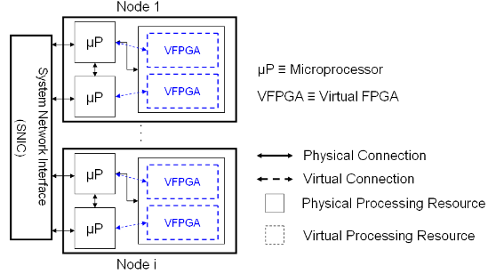
Virtualizing using Reconfigurable HW
Heterogeneous architecture
Image source: El-Araby [3]

Slide 25
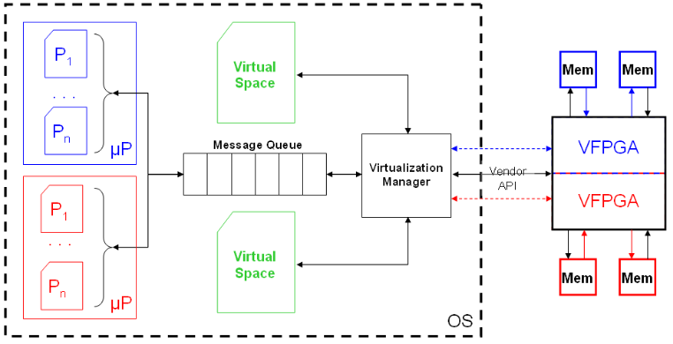
Virtualizing using Reconfigurable HW
Virtualization Infrastructure
Image source: El-Araby [3]
Notes:
Run-Time virtualization layer consists of three major components: a virtualization manager (VM), a request queue, and a virtual memory space. The VM is responsible for partitioning the physical resource, i.e. FPGA, into multiple virtual resources, i.e. VFPGAs

Slide 26
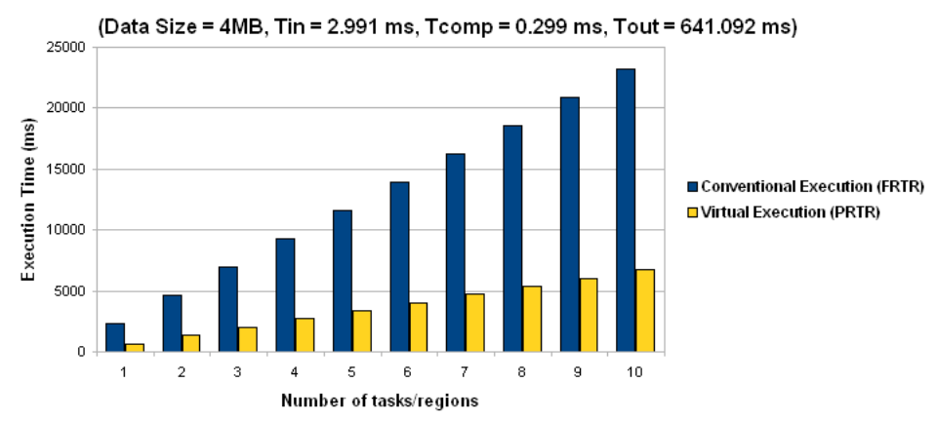
Virtualizing using Reconfigurable HW
Speedup using Partial Runtime Reconfiguration (PRTR)
Image source: El-Araby [3]
Notes:
Run-Time virtualization layer consists of three major components: a virtualization manager (VM), a request queue, and a virtual memory space. The VM is responsible for partitioning the physical resource, i.e. FPGA, into multiple virtual resources, i.e. VFPGAs

Slide 28
References
[1] Ole Agesen, Alex Garthwaite, Jeffrey Sheldon, and Pratap Subrahmanyam. 2010. The evolution of an x86 virtual machine monitor. SIGOPS Oper. Syst. Rev. 44, 4 (December 2010), 3-18. DOI: https://doi.org/10.1145/1899928.1899930
[2] J. D. Gelas. Hardware Virtualization: the Nuts and Bolts. Anandtech. March 17, 2008. Available online: https://www.anandtech.com/show/2480
[3] El-Araby, E., Gonzalez, I., & El-Ghazawi, T. (2008). Virtualizing and Sharing Reconfigurable Resources in High-Performance Reconfigurable Computing Systems. In Second International Workshop on High-Performance Reconfigurable Computing Technology and Applications (HPRCTA’08), held in conjunction with SC’08, Austin, TX, USA, November, 2008.

