Slide 1
Experimental Demonstration of Single Pulse
Imaging (SPI)
David G. Felton, Christian C. Jones, Daniel B. Herr, Lumumba A. Harnett, Shannon D. Blunt, Christopher T. Allen
Radar Systems Lab (RSL), University of Kansas, Lawrence, KS, USA
This work was supported by the Office of Naval Research under Contract #N00014-20-C-1006 DISTRIBUTION STATEMENT A. Approved for Public Release; Distribution Unlimited

Slide 2
Motivation
At higher frequencies (e.g. mm-wave) the associated shorter wavelengths incur greater sensitivity to Doppler
  Thus, fast-time Doppler shifts can invalidate “stop-and-hop” assumption and produce a mismatch for the zero-Doppler matched filter
Doppler-tolerant waveforms (e.g. LFM) provide robustness to mismatch, but ambiguities arise from range-Doppler coupling
Conversely, Doppler-selective waveforms have a thumbtack ambiguity function that enhances range-Doppler separability, but at the cost of a higher range-Doppler sidelobe pedestal
  And a fast-time Doppler-shifted matched filter bank is required
Here, a reiterative minimum means-square error (RMMSE) framework is combined with Doppler-selective waveforms to perform robust range-Doppler imaging with a single pulse
Notes:
Mention stop-and-hop

Slide 3
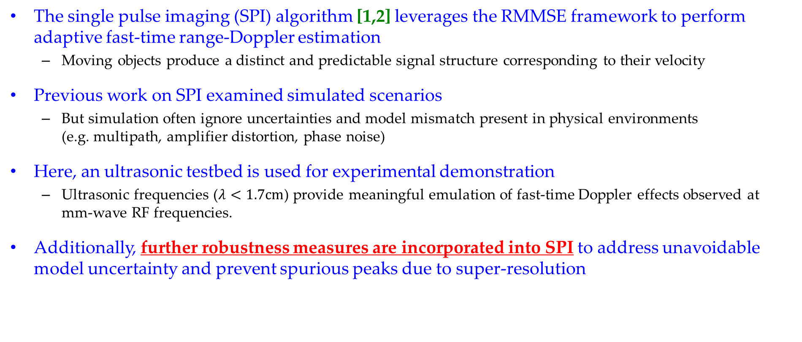
Single Pulse Imaging
The single pulse imaging (SPI) algorithm [1,2] leverages the RMMSE framework to perform adaptive fast-time range-Doppler estimation
  Moving objects produce a distinct and predictable signal structure corresponding to their velocity
Previous work on SPI examined simulated scenarios
  But simulation often ignore uncertainties and model mismatch present in physical environments (e.g. multipath, amplifier distortion, phase noise)
Here, an ultrasonic testbed is used for experimental demonstration
  Ultrasonic frequencies ($λ<1.7cm$) provide meaningful emulation of fast-time Doppler effects observed at mm-wave RF frequencies.
Additionally, further robustness measures are incorporated into SPI to address unavoidable model uncertainty and prevent spurious peaks due to super-resolution
[1] S.D. Blunt, A. Shackelford, K. Gerlach, “Single pulse imaging,” Intl. Waveform Diversity & Design Conf., Lihue, HI, Jan. 2006.
[2] S.D. Blunt, A. Shackelford, K. Gerlach, K.J. Smith, "Doppler compensation & single pulse imaging via adaptive pulse compression," IEEE Trans. Aerospace & Electronic Systems, vol. 45, no. 2, pp. 647-659, Apr. 2009.

Slide 4
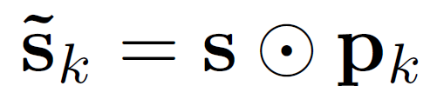
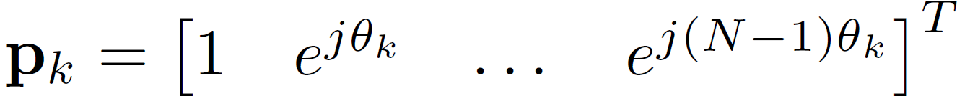
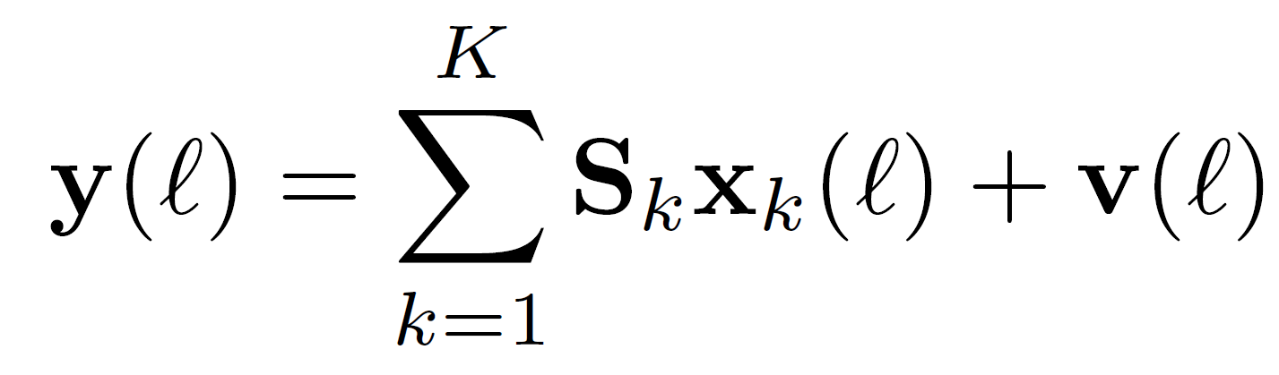
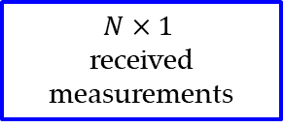

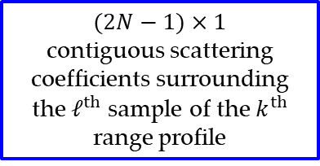
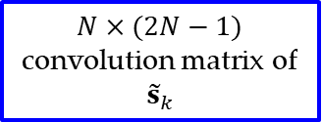
Receive Signal Model
A fast-time Doppler-shifted replica of a N-length discretized waveform s can be represented as
where p_{k} imposes a Doppler phase progression on s for $θ_{k}$ within a $[π$, +$π$] span.
The received signal is treated as a superposition of distinct scattering induced by Doppler-shifted waveforms
$(2N−1)×1$
contiguous scattering coefficients surrounding the $ℓ^{th}$ sample of the $k^{th}$ range profile
$N×$ $(2N−1)$ convolution matrix of ${\tilde{s}}_{k}$
$$N×1$$
received measurements
$N×1$
additive noise
Notes:
Superposition of distinct scattering being illuminated by unique Doppler-shifted waveforms

Slide 5
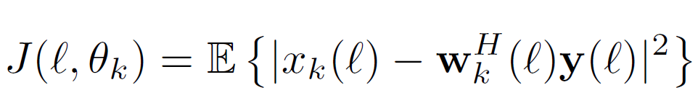
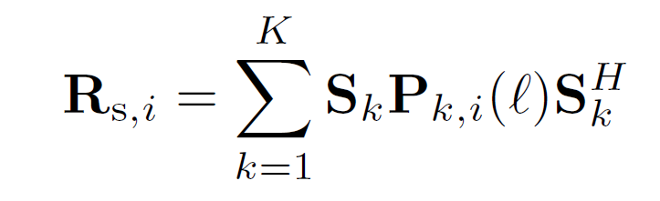
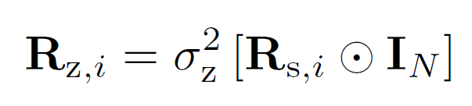
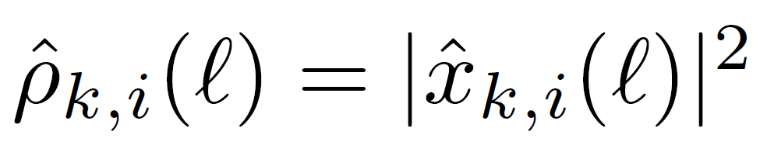
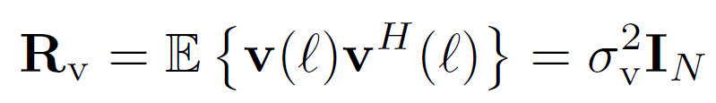
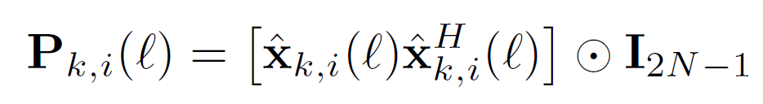

SPI Filters
Scattering in each range-Doppler cell is iteratively estimated by a filter that minimizes MSE
which for the $i^{th}$ iteration of RMMSE takes the form
$i^{th}$ power estimate for $ℓ^{th}$ sample of $k^{th}$ range profile
structured signal covariance
model uncertainty covariance
noise covariance
Estimate source covariance
with the algorithm instantiated by the normalized matched filter (i.e.,${ w}_{k,i=0}\left(ℓ\right)=\frac{{\tilde{s}}_{k}}{{\left\|{\tilde{s}}_{k}\right\|}^{2}}$)

Slide 6
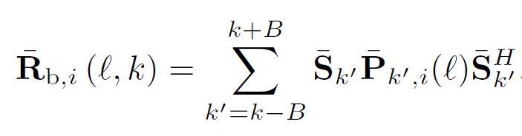



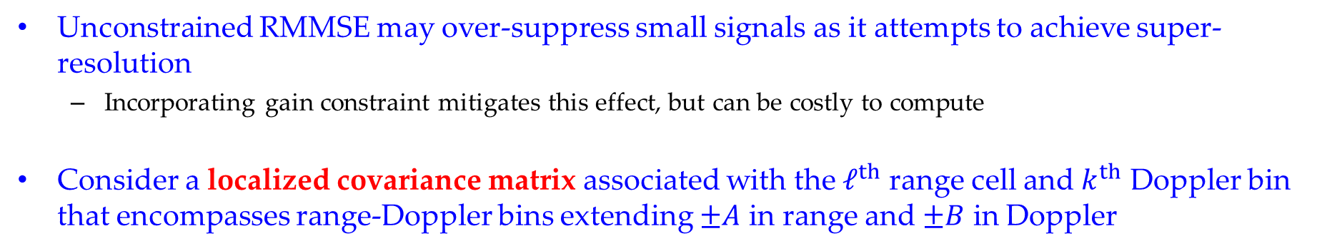



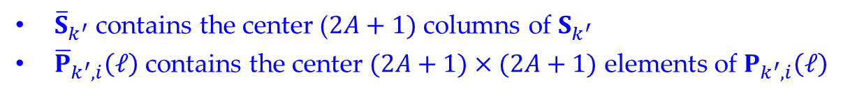


Dynamic Beamspoiling
Unconstrained RMMSE may over-suppress small signals as it attempts to achieve super-resolution
  Incorporating gain constraint mitigates this effect, but can be costly to compute
Consider a localized covariance matrix associated with the $ℓ^{th}$ range cell and $k^{th}$ Doppler bin that encompasses range-Doppler bins extending $±A$ in range and $±B$ in Doppler
Localized Covariance
$$A=2$$
$$θ_{k+1}$$
$$B=1$$
$$θ_{k}$$
$$θ_{k−1}$$
${\overline{S}}_{k^{′}}$ contains the center ($2A+1)$ columns of $S_{k^{′}}$
${\overline{P}}_{k^{′},i}\left(ℓ\right)$ contains the center $(2A+1)×(2A+1)$ elements of $P_{k^{′},i}\left(ℓ\right)$
0
$$ℓ−2$$
$$ℓ$$
$$ℓ+2$$

Slide 7
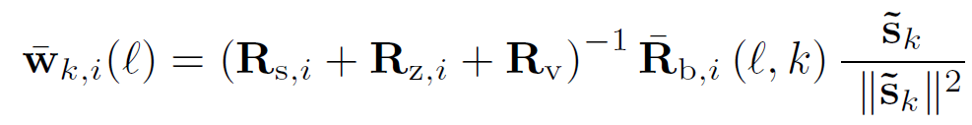
Dynamic Beamspoiling
This localized covariance is incorporated into the RMMSE filter to “spoil” excessive super-resolution of components in the localized covariance
By selecting A and B to correspond to the matched filter response mainlobe in range & Doppler, we prevent collapse of the estimated response into non-physical point scatterers
Ambiguity function mainlobe
Localized Covariance
$$A=2$$
$$θ_{k+1}$$
$$B=1$$
$$θ_{k}$$
Beamspoiled SPI filter
$$θ_{k−1}$$
0
$$ℓ−2$$
$$ℓ$$
$$ℓ+2$$

Slide 8

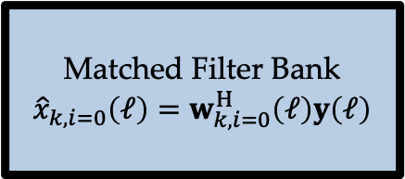
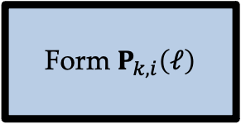


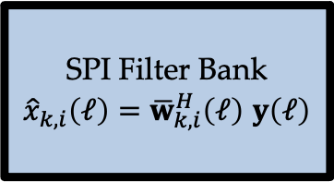
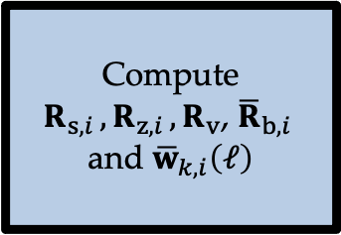

Filter Recursion
Matched Filter Bank
$${\hat{x}}_{k,i=0}\left(ℓ\right)=w_{k,i=0}^{H}\left(ℓ\right)y\left(ℓ\right)$$
Compute $R_{s,i },R_{z,i },R_{v}$, ${\overline{R}}_{b,i }$ and ${\overline{w}}_{k,i}\left(ℓ\right)$
SPI Filter Bank
${\hat{x}}_{k,i}\left(ℓ\right)=$ ${\overline{w}}_{k,i}^{H}\left(ℓ\right)$ $y\left(ℓ\right)$
$$y\left(ℓ\right)$$
$$i=1$$
$${\hat{x}}_{k}\left(ℓ\right)$$
$$i←i+1$$
Form $P_{k,i}\left(ℓ\right)$

Slide 9
Experimental Demonstration

Slide 10
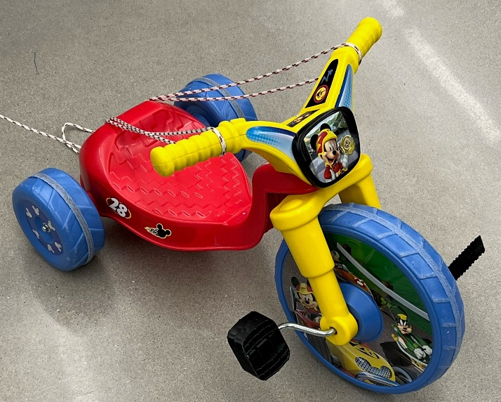
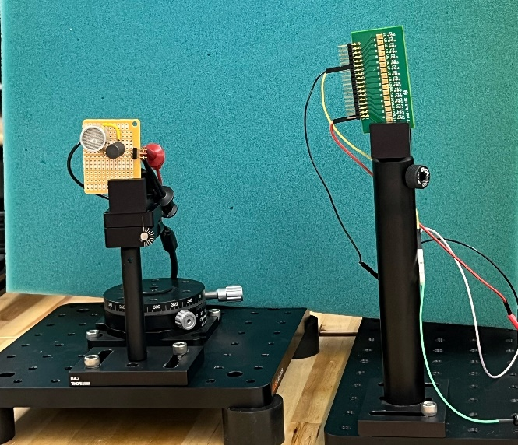
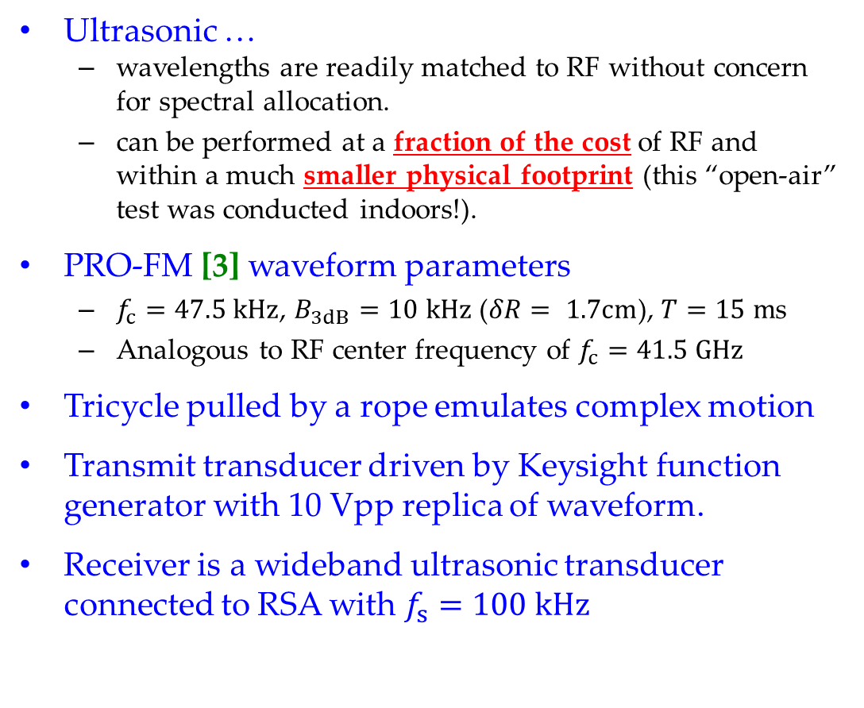
Ultrasonic Test Setup
Ultrasonic …
  wavelengths are readily matched to RF without concern for spectral allocation.
  can be performed at a fraction of the cost of RF and within a much smaller physical footprint (this “open-air” test was conducted indoors!).
PRO-FM [3] waveform parameters
  $f_{c}=47.5 kHz$, $B_{3dB}=10 kHz$ ($δR= 1.7cm$), $T=15 m$s
  Analogous to RF center frequency of $f_{c}=41.5 GHz$
Tricycle pulled by a rope emulates complex motion
Transmit transducer driven by Keysight function generator with 10 Vpp replica of waveform.
Receiver is a wideband ultrasonic transducer connected to RSA with $f_{s}=100 kHz$
“high-speed” tricycle
receiver
transmitter
[3] J. Jakabosky, S.D. Blunt, B. Himed, "Spectral-shape optimized FM noise radar for pulse agility," IEEE Radar Conf., Philadelphia, PA, May 2016.

Slide 11
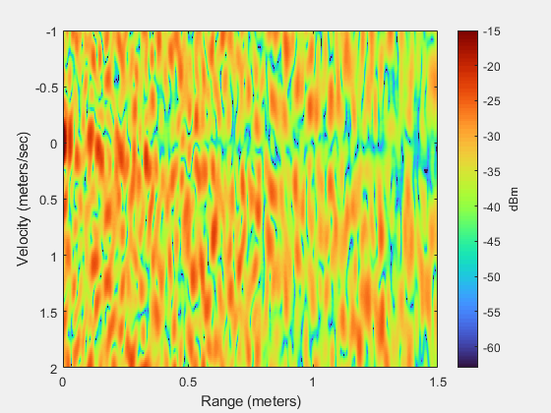
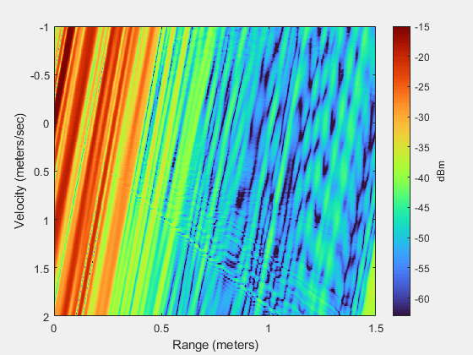
Experimental Results
First, compare the matched filter responses of Doppler-selective PRO-FM to Doppler-tolerant LFM
  LFM has delay/Doppler ambiguity ridge while PRO-FM has higher sidelobe pedestal
  Tricycle is not visible
PRO-FM w/ Matched Filter
LFM w/ Matched Filter
Direct path
Model Mismatch

Slide 12
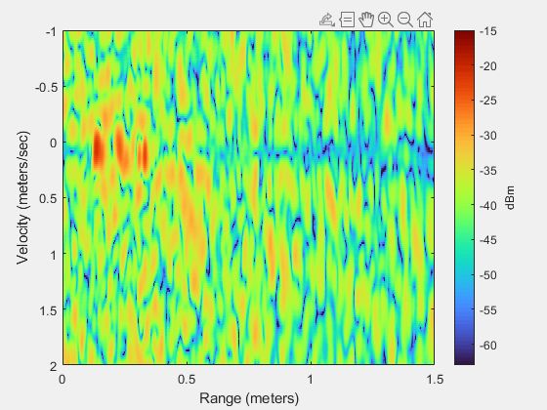
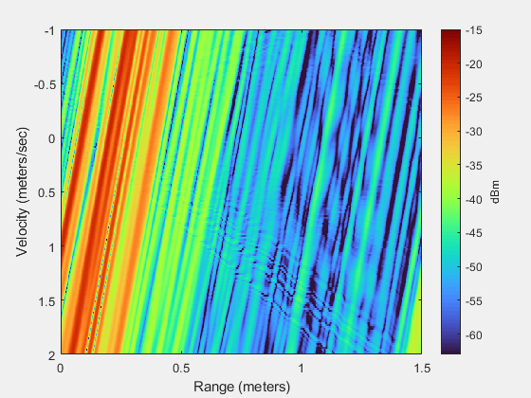
Experimental Results
Using estimate of static background scattering (w/o tricycle), perform background subtraction
  Not realistic in practical, but employed here for illustrative purpose
  Difficult to discern tricycle in LFM case even with background subtraction (due to ridge)
  Can begin to see some crude tricycle structure in PRO-FM case
PRO-FM w/ Matched Filter + background subtraction
LFM w/ Matched Filter + background subtraction
Direct path removed

Slide 13
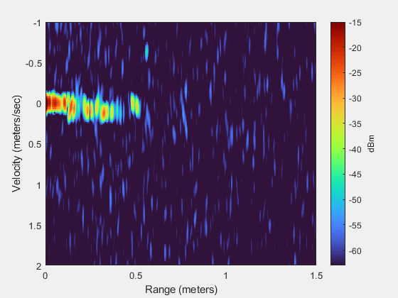
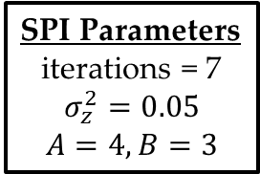
Experimental Results
Now consider PRO-FM alone and w/o background subtraction, comparing the Matched Filter to SPI
  Direct path still present, but SPI provides far greater detail on tricycle structure/motion
SPI Parameters
iterations = 7
$$σ_{z}^{2}=0.05$$
$$A=4,B=3$$
PRO-FM w/ Matched Filter
PRO-FM w/ SPI

Slide 14
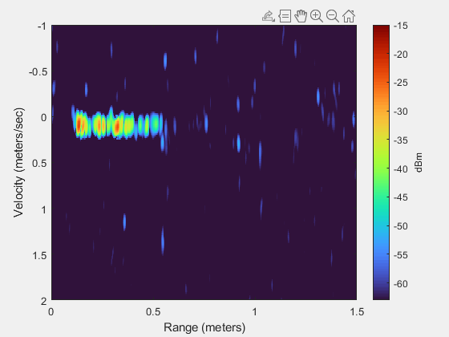
Experimental Results
Same MF vs. SPI comparison when background subtraction is performed
  SPI + background subtraction almost completely leaves a clear silhouette of the tricycle
  Reveals oscillatory behavior that are presumed to be the pedal motion
SPI Parameters
iterations = 7
$$σ_{z}^{2}=0.05$$
$$A=4,B=3$$
PRO-FM w/ Matched Filter + background subtraction
PRO-FM w/ SPI + background subtraction

Slide 15
Experimental Results
Finally, compare SPI results with & w/o background subtraction
While a few persistent scatterers remain, e.g. student movement, non-uniform acoustical interference (RSA fans), and model imperfections
SPI Parameters
iterations = 7
$$σ_{z}^{2}=0.05$$
$$A=4,B=3$$
Persistent scattering centers likely authors
PRO-FM w/ SPI + background subtraction
PRO-FM w/ SPI

Slide 16
RMS Response (MF/PRO-FM + subtraction)
A root-mean-square (RMS) operation across the entire time interval provides an average indication of visibility
Even after background subtraction, the RMS matched filter response is still quite blob-like
The Doppler-selective nature of PRO-FM provides some range-Doppler localization, but at the expense of an overall higher sidelobe floor from ambiguity spread
RMS average of Matched Filter result using PRO-FM + background subtraction

Slide 17
RMS Response (SPI/PRO-FM)
Even without background subtraction, SPI greatly improves visibility of scattering from motion
Due to the test setup, a large direct path component is still present, along with other scattering in the room, that still limits visibility
The use of dynamic beamspoiling also clearly prevents collapse into point-like results, thereby yielding more physically meaningful results
RMS average of SPI result using PRO-FM

Slide 18
RMS Response (SPI/PRO-FM + subtraction)
To emulate true open-air application, background subtraction yields the type of performance we can expect from SPI
Now the direct path and other stationary scattering is largely removed, permitting focus on the motion behavior
The complex motion of the pedals/wheels relative to the body of the tricycle could conceivably now be discerned
RMS average of SPI result using PRO-FM + background subtraction

Slide 19
Conclusions
The single pulse imaging (SPI) algorithm, originally conceived in 2006 to generalize RMMSE-based processing for fast-time Doppler, has now been made sufficiently robust for use on measured data
Model uncertainty and dynamic beamspoiling are incorporated to prevent super-resolution over-suppression and collapse into point-like scatterers, thereby yielding physically meaningful estimation
Experimental results using an ultrasonic testbed show that SPI provides enhanced range/Doppler estimation of scattering in motion

Slide 20
Thank you!

