Slide 1

Real-Time Experimental Demonstration and Evaluation of Open-Air
Sense-and-Notch Radar
Jonathan Owen¹, Charles Mohr¹, Brandon Ravenscroft¹, Shannon Blunt¹, Benjamin Kirk², Anthony Martone²
¹ Radar Systems & Remote Sensing Lab (RSL), University of Kansas
² Sensors & Electron Devices Directorate, Army Research Laboratory (ARL)
This work was sponsored by the US Army Research Office (ARO) under grant #W911NF-20-2-0271.
DISTRIBUTION STATEMENT A. Approved for Public Release.

Slide 2
Motivation
The RF spectrum is becoming increasingly congested due to repeated spectrum auctions and subsequent 4G/5G roll-out
→ Radar must become more agile to contend with this dynamic environment
  In [1], spectrally-notched random FM (RFM) waveforms shown to maximize bandwidth utilization for open-air MTI in the presence of frequency-hopping RF interference (RFI), though notched waveform generation was not yet real-time.
  In [2], real-time sense-and-notch radar was implemented on low-cost software-defined radio (SDR), though not yet for open-air operation.
[1] B. Ravenscroft, J.W. Owen, J. Jakabosky, S.D. Blunt, A.F. Martone, K.D. Sherbondy, “Experimental demonstration and analysis of cognitive spectrum sensing and notching for radar,” IET Radar, Sonar & Navigation, vol. 12, no. 12, pp. 1466-1475, Dec. 2018.
[2] J.W. Owen, C.A. Mohr, B.H. Kirk, S.D. Blunt, A.F. Martone, K.D. Sherbondy, “Demonstration of real-time cognitive radar using spectrally-notched random FM waveforms,” IEEE Intl. Radar Conf., Washington, DC, Apr. 2020.
Notes:
Results presented here are a culmination of a multi-year effort to achieve a real-time sense-and-notch radar capability that can contend with highly dynamic spectrum users.
It consequently involves the intersection of practical waveform design, a novel method for efficient spectral notch generation, RF systems engineering for physical deployment, field-programmable gate array (FPGA) implementation for real-time processing, and assessment of a performance vs. computation trade-space.

Slide 3
Motivation
The RF spectrum is becoming increasingly congested due to repeated spectrum auctions and subsequent 4G/5G roll-out
→ Radar must become more agile to contend with this dynamic environment
  In [1], spectrally-notched random FM (RFM) waveforms shown to maximize bandwidth utilization for open-air MTI in the presence of frequency-hopping RF interference (RFI), though notched waveform generation was not yet real-time.
  In [2], real-time sense-and-notch radar was implemented on low-cost software-defined radio (SDR), though not yet for open-air operation.
Here these attributes are combined to demonstrate full sense-and-notch functionality in real-time for an open-air MTI application.
[1] B. Ravenscroft, J.W. Owen, J. Jakabosky, S.D. Blunt, A.F. Martone, K.D. Sherbondy, “Experimental demonstration and analysis of cognitive spectrum sensing and notching for radar,” IET Radar, Sonar & Navigation, vol. 12, no. 12, pp. 1466-1475, Dec. 2018.
[2] J.W. Owen, C.A. Mohr, B.H. Kirk, S.D. Blunt, A.F. Martone, K.D. Sherbondy, “Demonstration of real-time cognitive radar using spectrally-notched random FM waveforms,” IEEE Intl. Radar Conf., Washington, DC, Apr. 2020.
Notes:
Results presented here are a culmination of a multi-year effort to achieve a real-time sense-and-notch radar capability that can contend with highly dynamic spectrum users.
It consequently involves the intersection of practical waveform design, a novel method for efficient spectral notch generation, RF systems engineering for physical deployment, field-programmable gate array (FPGA) implementation for real-time processing, and assessment of a performance vs. computation trade-space.

Slide 4
Cognitive Radar 101
While many forms of cognitive radar exist, here cognition is applied to the non-cooperative spectrum sharing problem
Two spectrum sharing approaches include:
“sense & avoid”: change location and extent of radar bandwidth based on sensed RFI
Sense the spectrum environment
Ascertain where interference is located
Generate physically realizable waveforms to mitigate mutual interference
“sense & notch”: places notches in the radar spectrum based on sensed RFI
Notes:
While cognitive radar has been defined in terms of many forms in respect to the perception-action-cycle (shown on the left), here we consider mutual interference mitigation by way of sensing the RF spectrum and determining which spectral bands are unoccupied. An appropriate radar waveform is generated in response.
Here, two approaches are considered.
First, there is the “sense-and-avoid” concept, where the radar waveform “moves out of the way” of the interferer. For the plot in the top-right corner, one can see the interferer in red and the radar waveforms in blue. The radar waveform is adjusted according to the observed interferer to sit in widest available band by modifying the radar waveform’s center frequency and bandwidth. One down-side to the sense-and-avoid approach is that it doesn’t use all of the available spectral sub-bands, though typically fewer computational resources are needed to implement this approach.
Second, there is the “sense-and-notch” concept, where a notch is incorporated into the radar waveform that is collocated with the interferer, as demonstrated by the plot in the bottom right corner. The significant advantage to the sense-and-notch approach is that the radar is now utilizing as much bandwidth as possible while avoiding mutual interference between itself another RF user.
Before covering how these approaches are implemented on hardware, first, various foundations regarding how to perform each step of the perception-action cycle need to be established.

Slide 5
Let’s see it in action, then discuss how it works …
Notes:
While cognitive radar has been defined in terms of many forms in respect to the perception-action-cycle (shown on the left), here we consider mutual interference mitigation by way of sensing the RF spectrum and determining which spectral bands are unoccupied. An appropriate radar waveform is generated in response.
Here, two approaches are considered.
First, there is the “sense-and-avoid” concept, where the radar waveform “moves out of the way” of the interferer. For the plot in the top-right corner, one can see the interferer in red and the radar waveforms in blue. The radar waveform is adjusted according to the observed interferer to sit in widest available band by modifying the radar waveform’s center frequency and bandwidth. One down-side to the sense-and-avoid approach is that it doesn’t use all of the available spectral sub-bands, though typically fewer computational resources are needed to implement this approach.
Second, there is the “sense-and-notch” concept, where a notch is incorporated into the radar waveform that is collocated with the interferer, as demonstrated by the plot in the bottom right corner. The significant advantage to the sense-and-notch approach is that the radar is now utilizing as much bandwidth as possible while avoiding mutual interference between itself another RF user.
Before covering how these approaches are implemented on hardware, first, various foundations regarding how to perform each step of the perception-action cycle need to be established.

Slide 6
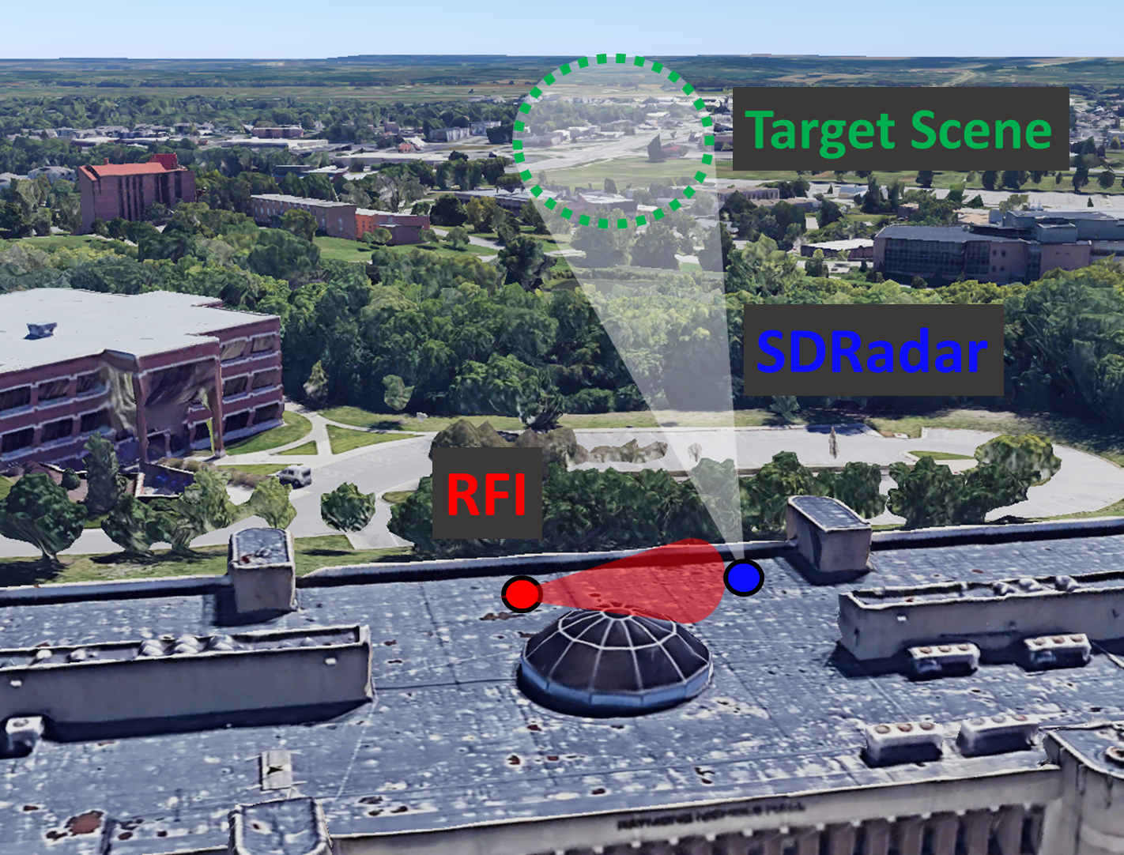
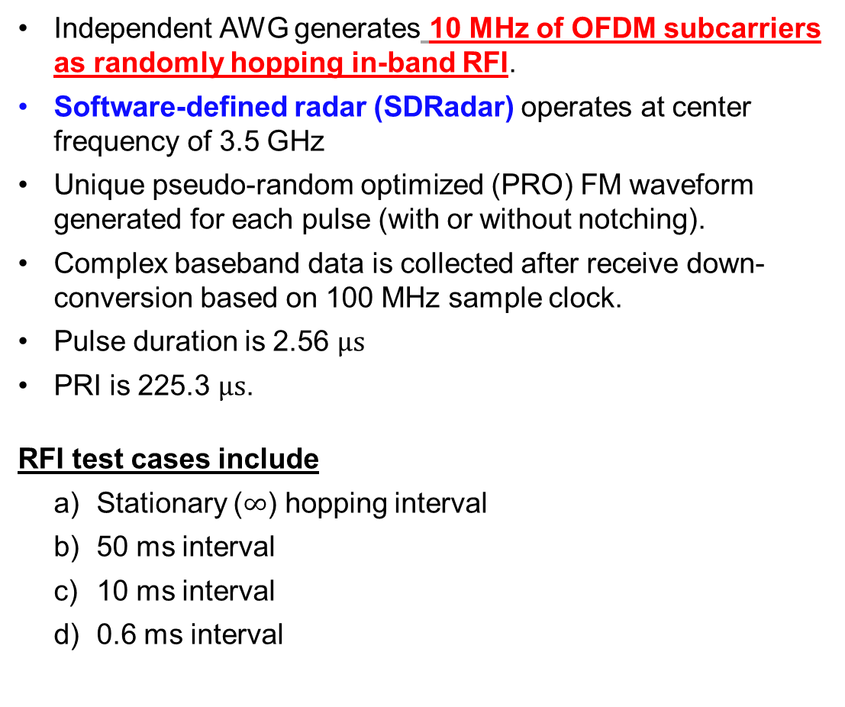
Experimental Test Setup
Independent AWG generates 10 MHz of OFDM subcarriers as randomly hopping in-band RFI.
Software-defined radar (SDRadar) operates at center frequency of 3.5 GHz
Unique pseudo-random optimized (PRO) FM waveform generated for each pulse (with or without notching).
Complex baseband data is collected after receive down-conversion based on 100 MHz sample clock.
Pulse duration is 2.56 $μs$
PRI is 225.3 $μs$.
RFI test cases include
  Stationary ($∞$) hopping interval
  50 ms interval
  10 ms interval
  0.6 ms interval
Notes:
INTERFERENCE HOPS, RADAR RESPONDS

Slide 7
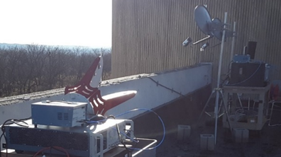
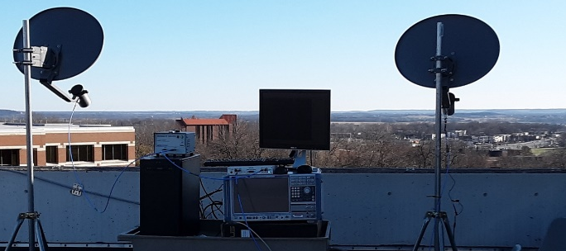
Experimental Test Setup

Slide 8
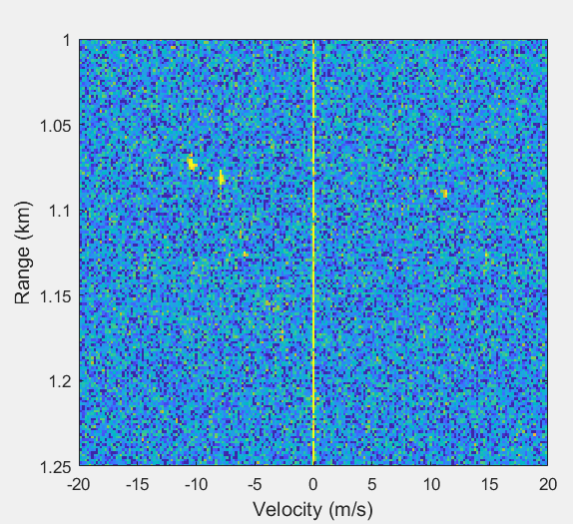
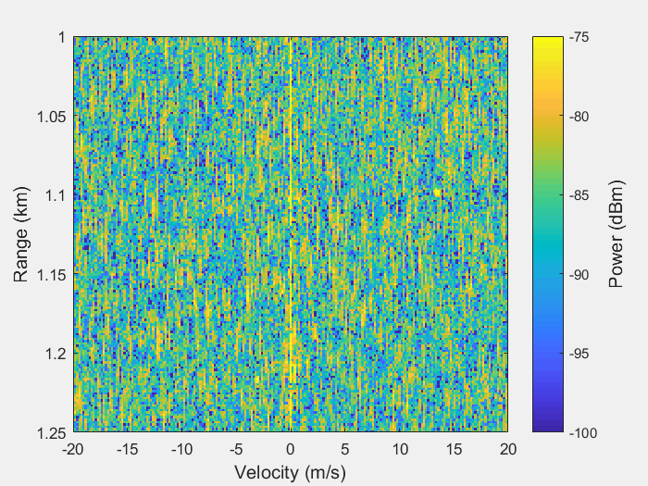
Baseline (full-band)
Full-band PRO-FM, without RFI
Full-band PRO-FM, with stationary RFI
Movers are clearly visible for the full-band/RFI-free case (left)
Stationary RFI obfuscates all movers when using full-band waveforms (right)
Notes:
OPEN AIR MEASUREMENTS

Slide 9
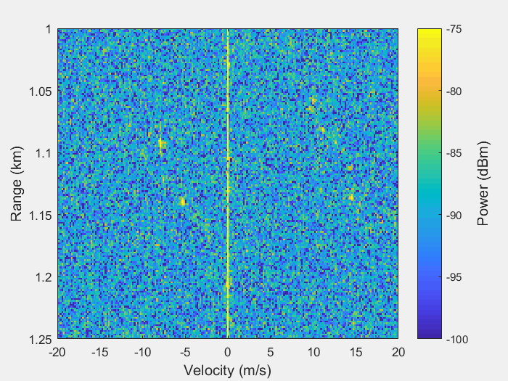
Case A) Stationary Interference
Full-band PRO-FM, without RFI
Sense-and-notch SDRadar, with stationary RFI
RFI now mitigated by spectral notches in each waveform and corresponding matched filtering.
Some RFI leakage due to 25 dB notch depth → trade-off for real-time responsiveness

Slide 10
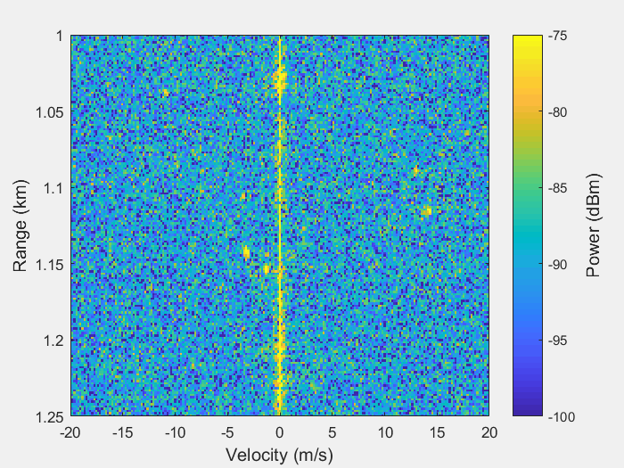
Case B) Hopping RFI @ 50 ms interval
Full-band PRO-FM, without RFI
Sense-and-notch SDRadar, RFI hopping every 50 ms
RFI changing slowly enough that clutter modulation effects remain low (below noise floor)

Slide 11
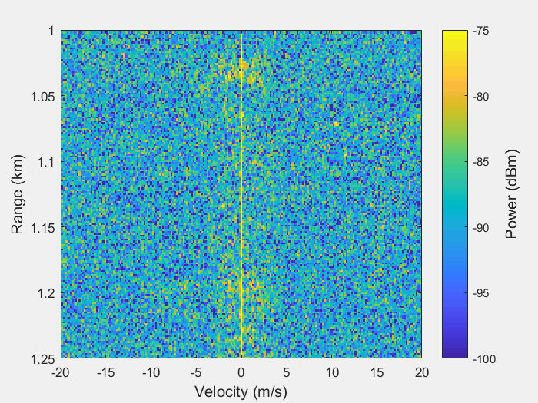
Case C) Hopping RFI @ 10 ms interval
Full-band PRO-FM, without RFI
Sense-and-notch SDRadar, RFI hopping every 10 ms
Now RFI changing rapidly enough that clutter modulation starts to become visible

Slide 12
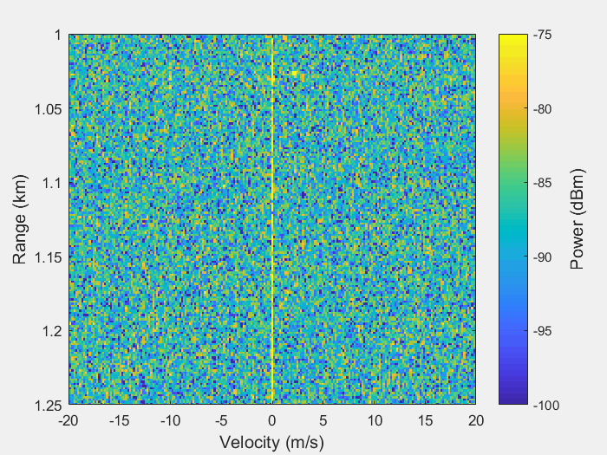
Case D) Hopping RFI @ 0.6 ms interval
Full-band PRO-FM, without RFI
Sense-and-notch SDRadar, RFI hopping every 0.6 ms
RFI changing so fast that many radar pulses are colliding with interference (i.e. cannot update notch locations in time), causing significant leakage

Slide 13
Full Comparison
Full-band PRO-FM, without RFI
Full-band PRO-FM, with stationary RFI
Sense-and-notch, with stationary RFI
Sense-and-notch, RFI hopping every 50 ms
Sense-and-notch, RFI hopping every 10 ms
Sense-and-notch, RFI hopping every 0.6 ms

Slide 14
So how does it work?
Notes:
While cognitive radar has been defined in terms of many forms in respect to the perception-action-cycle (shown on the left), here we consider mutual interference mitigation by way of sensing the RF spectrum and determining which spectral bands are unoccupied. An appropriate radar waveform is generated in response.
Here, two approaches are considered.
First, there is the “sense-and-avoid” concept, where the radar waveform “moves out of the way” of the interferer. For the plot in the top-right corner, one can see the interferer in red and the radar waveforms in blue. The radar waveform is adjusted according to the observed interferer to sit in widest available band by modifying the radar waveform’s center frequency and bandwidth. One down-side to the sense-and-avoid approach is that it doesn’t use all of the available spectral sub-bands, though typically fewer computational resources are needed to implement this approach.
Second, there is the “sense-and-notch” concept, where a notch is incorporated into the radar waveform that is collocated with the interferer, as demonstrated by the plot in the bottom right corner. The significant advantage to the sense-and-notch approach is that the radar is now utilizing as much bandwidth as possible while avoiding mutual interference between itself another RF user.
Before covering how these approaches are implemented on hardware, first, various foundations regarding how to perform each step of the perception-action cycle need to be established.

Slide 15
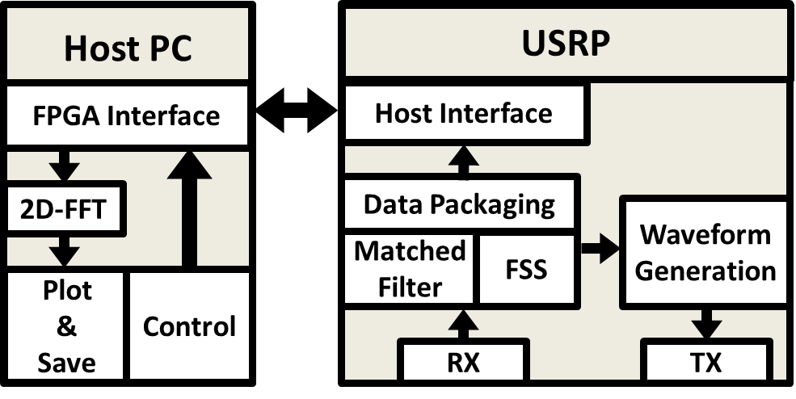
Foundations
1) Fast Spectrum Sensing (FSS) [3]
Identified RF interferer
Performs rapid band-aggregation & decision making to identify usable subbands among RFI
We leverage the real-time implementation of FSS deployed on the SDR by Penn State & ARL [4]
[3] A. Martone, K. Ranney, K. Sherbondy, K. Gallagher, S. Blunt, “Spectrum allocation for non-cooperative radar coexistence,” IEEE Trans. Aerospace & Electronic Systems, vol. 54, no. 1, pp. 90-105, Feb. 2018.
[4] B.H. Kirk, R.M. Narayanan, K.A. Gallagher, A.F. Martone, K.D. Sherbondy, "Avoidance of time-varying radio frequency interference with software-defined cognitive radar," IEEE Trans. Aerospace & Electronic Systems, vol. 55, no. 3, pp. 1090-1107, June 2019.
Notes:
First, the fast-spectrum sensing (or FSS) algorithm was developed to identify significant RF interferers and correspondingly select usable spectral sub-bands, as shown in the plot in the upper-right hand corner.
A version of the FSS algorithm was implemented on a software-defined radio, wherein based on the FSS output, the center frequency and bandwidth of a standard chirp waveform was modified to mitigate mutual interference. The general architecture of that “sense-and-avoid” system is shown in the bottom-left hand figure.
To modify the cognitive software defined radar to perform the “sense-and-notch” approach for the sake of maximizing bandwidth efficiency, we focused in on the waveform generation aspect, outlined in red.
As mentioned before, the waveforms under consideration are notched Random FM waveforms.

Slide 16




Foundations
2) Nonrepeating spectrally notched FM waveforms
Various methods have recently been experimentally demonstrated to realize spectrally shaped forms of nonrepeating random FM (RFM) waveforms [5]
Notched versions of RFM shown to achieve > 50 dB notch depth, while preserving transmitter-amenable FM structure [6]
Initially relying on use of high-fidelity (i.e. expensive) arbitrary waveform generation (AWG) capability [6]
Linear
FM
$$s(t)$$
$$t$$
Random
FM (RFM)
$$s(t)$$
$$t$$
[5] S.D. Blunt, J.K. Jakabosky, C.A. Mohr, P.M. McCormick, J.W. Owen, B. Ravenscroft, C. Sahin, G.D. Zook, C.C. Jones, J.G. Metcalf, T. Higgins, “Principles & applications of random FM radar waveform design,” IEEE Aerospace & Electronic Systems Magazine, vol. 35, no. 10, pp. 20-28, Oct. 2020.
[6] C.A. Mohr, S.D. Blunt, “Analytical spectrum representation for physical waveform optimization requiring extreme fidelity,” IEEE Radar Conf., Boston, MA, Apr. 2019.
Notes:
There has been recent research on notched random FM waveforms, which are non-repeating and have been experimentally demonstrated.
One benefit of these waveforms, due to their non-repeating nature, is that when M range profiles are coherently averaged, an improvement factor of M in the effective time-bandwidth product of the overall waveform set is observed. The corresponding sidelobe reduction is shown in the plot in the top-right corner.
Greater than 50 dB spectral depths have been incorporated into these random FM waveforms.
Originally, all notched random FM waveforms were created while considering the use of a high-fidelity arbitrary waveform generator.

Slide 17
Foundations
In addition to the flexibility of RFM waveforms, their per-pulse uniqueness realizes an incoherent sidelobe averaging benefit [5]
Of course, range sidelobe modulation (RSM) also occurs, which can become more pronounced for dynamic spectral notching due to more drastic changes in waveform spectral shape.
Consequently, compensation methods have been developed (but not yet deployed in real-time) [7-9]
Improvement Factor based on # of pulses (M)
[7] J. Owen, B. Ravenscroft, S.D. Blunt, “Devoid clutter capture and filling (DeCCaF) to compensate for intra-CPI spectral notch variation,” Intl. Radar Conf., Toulon, France, Sept. 2019.
[8] B.H. Kirk, A.F. Martone, K.D. Sherbondy, R.M. Narayanan, “Mitigation of target distortion in pulse-agile sensors via Richardson-Lucy deconvolution,” Electronics Letters, vol. 55, no. 23, pp. 1249-1252, Nov. 2019.
[9] B. Ravenscroft, J.W. Owen, B.H. Kirk, S.D. Blunt, A.F. Martone, K.D. Sherbondy, R.M. Narayanan, “Experimental assessment of joint range-Doppler processing to address clutter modulation from dynamic radar spectrum sharing," IEEE Intl. Radar Conf., Washington, DC, Apr. 2020.
Sidelobes of random waveforms combine incoherently
(while mainlobes still combine coherently)
Notes:
There has been recent research on notched random FM waveforms, which are non-repeating and have been experimentally demonstrated.
One benefit of these waveforms, due to their non-repeating nature, is that when M range profiles are coherently averaged, an improvement factor of M in the effective time-bandwidth product of the overall waveform set is observed. The corresponding sidelobe reduction is shown in the plot in the top-right corner.
Greater than 50 dB spectral depths have been incorporated into these random FM waveforms.
Originally, all notched random FM waveforms were created while considering the use of a high-fidelity arbitrary waveform generator.

Slide 18


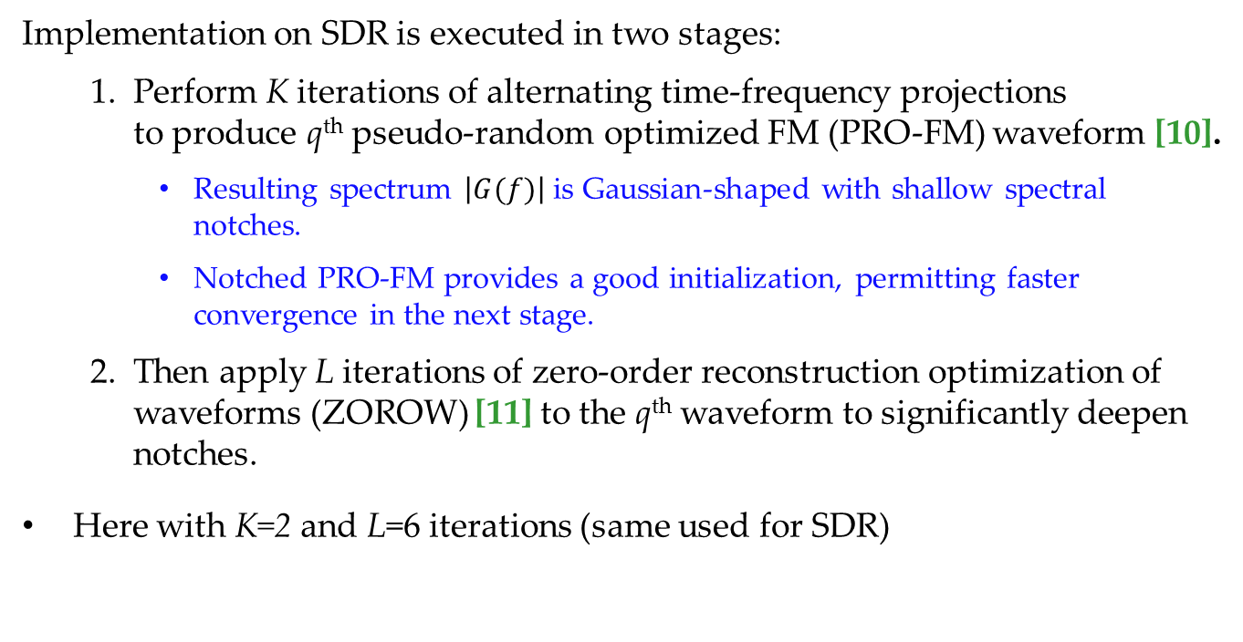
Notched FM Waveform Generation
3) Real-time generation of nonrepeating notched FM waveforms
Implementation on SDR is executed in two stages:
  Perform K iterations of alternating time-frequency projections to produce q^{th} pseudo-random optimized FM (PRO-FM) waveform [10].
    Resulting spectrum $\left|G(f)\right|$ is Gaussian-shaped with shallow spectral notches.
    Notched PRO-FM provides a good initialization, permitting faster convergence in the next stage.
  Then apply L iterations of zero-order reconstruction optimization of waveforms (ZOROW) [11] to the q^{th} waveform to significantly deepen notches.
Here with K=2 and L=6 iterations (same used for SDR)
$${\overline{r}}_{q}^{(k+1)}=F^{−1}\left\{\overline{g} ⊙exp\left(j∠F\left\{{\overline{s}}_{q}^{(k)}\right\}\right)\right\}$$
$${\overline{s}}_{q}^{(k+1)}=\overline{u} ⊙exp\left(j∠{\overline{r}}_{q}^{(k+1)}\right)$$
[10] J. Jakabosky, S.D. Blunt, B. Himed, “Spectral-shape optimized FM noise radar for pulse agility,” IEEE Radar Conf., Philadelphia, PA, May 2016.
[11] C. Mohr, J.W. Owen, S.D. Blunt, “Zero-order reconstruction optimization of waveforms (ZOROW) for modest DAC-rate systems,” IEEE Intl. Radar Conf., Washington, DC, Apr. 2020.
Notes:
Of particular importance for real-time cognitive radar operation is that the waveform optimization must be rapid and flexible in order to quickly react to dynamic RF interferers.
The notched Random FM waveform generation considered here consists of a two-stage optimization.
First, K iterations of alternating time-frequency projections are used to produce the q’th pseudo-random-optimized FM (or PROFM) waveform
The waveform spectral template G(f) applied is Gaussian shaped with shallow spectral notched incorporated.
This initial waveform optimization converges quickly to provide a good spectral shape with shallow notches, and acts as a good initialization to allow for the spectral notches to be deepened in the second stage.
In the second stage, the zero-order reconstruction optimization of waveforms (or ZOROW) algorithm is applied to significantly deepen the PROFM spectral notches while maintaining good spectral containment.
The ZOROW algorithm was developed quite recently for the sake of deepening spectral notched in FM waveforms when using lower fidelity hardware, such as an SDR.

Slide 19
ZOROW
Zero-order reconstruction optimization of waveforms (ZOROW) deepens waveform spectral notches by using an analytical Fourier representation that accounts for the zero-order hold model of the digital-to-analog converter (DAC) on the SDR [11]
radar waveform spectrum
sinc spectral mask
The zero-order-hold DAC produces a sinc roll-off for spectral images
The DAC interpolates the digital data to push these images higher in frequency, which are then suppressed by the analog reconstruction filter.
[11] C. Mohr, J.W. Owen, S.D. Blunt, “Zero-order reconstruction optimization of waveforms (ZOROW) for modest DAC-rate systems,” IEEE Intl. Radar Conf., Washington, DC, Apr. 2020.
19
Notes:
The ZOROW algorithm applies an analytical Fourier representation to account for the zero-order hold model of the digital-to analog converter (or DAC) of the SDR in order to significantly deepen the spectral notches of a given FM waveform.
The plot shown demonstrates a sinc-spectral mask corresponding to the rectangular zero-order-hold output of the SDRs DAC, which is overlaid onto the analytical spectrum of the designed waveform. Spectral images of the baseband radar waveform can be seen in adjacent spectral Nyquist zones. The DAC on the SDR will interpolate the waveform to push these images away from the baseband waveform, and an analog reconstruction filter will attenuate these images.
These considerations (amongst others detailed in citation 7) had to be carefully accounted for in the design and implementation of the notched waveforms for reliable reconstruction.

Slide 20
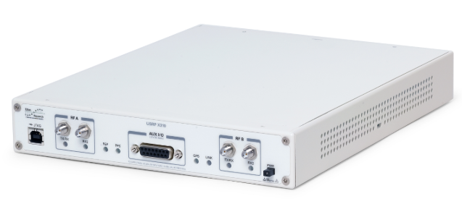
ZOROW
Zero-order reconstruction optimization of waveforms (ZOROW) deepens waveform spectral notches by using an analytical Fourier representation that accounts for the zero-order hold model of the digital-to-analog converter (DAC) on the SDR [11]
“Transmitted” by SDR (in loopback), received on spectrum analyzer
At least −57 dB notches are achievable!
(given sufficient time to iterate)
[11] C. Mohr, J.W. Owen, S.D. Blunt, “Zero-order reconstruction optimization of waveforms (ZOROW) for modest DAC-rate systems,” IEEE Intl. Radar Conf., Washington, DC, Apr. 2020.
Notes:
Of most significant importance, transmitting waveforms created via ZOROW on the SDR and receiving them on an independent spectrum analyzer, at least 57 dB notch depths were achievable.
However, note that to achieve 57 dB notch depths, many iterations of ZOROW are required.

Slide 21

ZOROW
ZOROW uses the cost function where for
and
that is summed over frequency interval(s) where notching is required. Gradient-descent optimization of φ_{q} is performed per [11] according to the gradient
$$g_{q}^{(ℓ)}=2ℑ\left\{{\tilde{A}}^{H}\left({\tilde{s}}_{f,q}^{(ℓ)}⊙\tilde{w}\right)⊙s_{q}^{∗(ℓ)}\right\}$$
[11] C. Mohr, J.W. Owen, S.D. Blunt, “Zero-order reconstruction optimization of waveforms (ZOROW) for modest DAC-rate systems,” IEEE Intl. Radar Conf., Washington, DC, Apr. 2020.
Notes:
An important facet of the ZOROW optimization is that the gradient can be computed efficiently with fast fourier transforms, which can be implemented on the FPGA of an SDR.
Note that while very deep notch depths are achievable with ZOROW, for the sense-and-notch SDR implementation, only 6 iterations of ZOROW will be used to satisfy timing constraints and achieve a “good enough” notch depth.

Slide 22
ZOROW
ZOROW uses the cost function where for
and
that is summed over frequency interval(s) where notching is required. Gradient-descent optimization of φ_{q} is performed per [11] according to the gradient
$$g_{q}^{(ℓ)}=2ℑ\left\{{\tilde{A}}^{H}\left({\tilde{s}}_{f,q}^{(ℓ)}⊙\tilde{w}\right)⊙s_{q}^{∗(ℓ)}\right\}$$
Gradient can be computed efficiently with FFTs & IFFTs !!!
[11] C. Mohr, J.W. Owen, S.D. Blunt, “Zero-order reconstruction optimization of waveforms (ZOROW) for modest DAC-rate systems,” IEEE Intl. Radar Conf., Washington, DC, Apr. 2020.
Notes:
An important facet of the ZOROW optimization is that the gradient can be computed efficiently with fast fourier transforms, which can be implemented on the FPGA of an SDR.
Note that while very deep notch depths are achievable with ZOROW, for the sense-and-notch SDR implementation, only 6 iterations of ZOROW will be used to satisfy timing constraints and achieve a “good enough” notch depth.

Slide 23
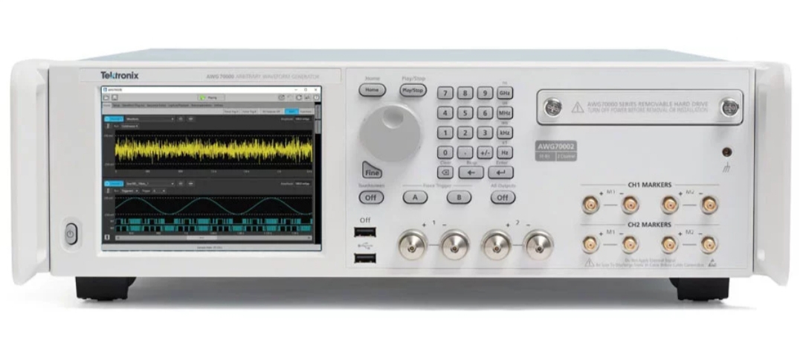
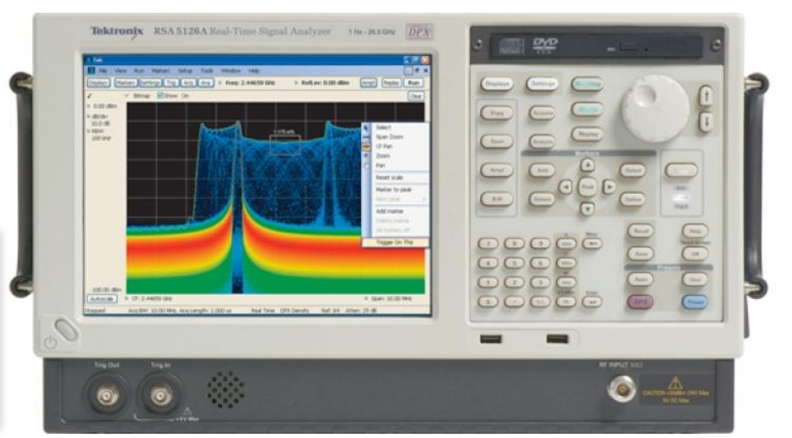
Implementation onto the SDR’s FPGA
(i.e. mapping expensive/high-fidelity to low-cost/modest-fidelity)
Notes:
Now we will examine specifically the implementation of spectrally notched random FM waveforms on the SDR’S FPGA. This represents a shift from considering waveform design for high- fidelity systems to that of modest-fidelity systems.

Slide 24
Real-Time Sense-and-Notch Random FM
Three key stages define the sense-and-notch reactivity loop and the adaptation delay T_{adapt}
Received I/Q samples of RF spectrum are streamed to Fast Spectral Sensing (FSS) algorithm
FSS (now implemented on the FPGA) is applied to identify spectral locations of RFI
RFI spectral locations used in PRO-FM & ZOROW notched waveform generator
While a new waveform is generated on a per-PRI basis, the notch locations for each waveform are updated by FSS with at most a delay of 1 PRI (but potentially within the same PRI, depending on duration)
Waveforms with sufficient notch depths (~25 dB in this demo) are generated in ~0.25 ms
  Greater notch depths could be achieved … but would alter the response time trade-space.

Slide 25
Conclusions
Spectrally-notched, random FM waveforms can be generated in real-time on COTS hardware to adapt to dynamic RFI
Enable radar spectrum sharing
Implementation on COTS hardware enables future upgrades
Supports PRFs up to 4.4 kHz
Can incorporate multiple spectral notches per waveform at low latency
Achieves notch depths of 25 dB relative to peak power
(could be more given further computational resources or higher latency).
Open-air results from [1] have been confirmed, yielding real-time sense-and-notch operation.
[1] B. Ravenscroft, J.W. Owen, J. Jakabosky, S.D. Blunt, A.F. Martone, K.D. Sherbondy, “Experimental demonstration and analysis of cognitive spectrum sensing and notching for radar,” IET Radar, Sonar & Navigation, vol. 12, no. 12, pp. 1466-1475, Dec. 2018.
Notes:
In conclusion, spectrally-notched, random FM waveforms can now be generated in real-time on commercial-off-the-shelf hardware to adapt to RFI in a sense-and-notch mode.
This system provides us the capability of spectrum sharing and potential for future upgrades.
It support PRFs up to 2.2 kHz while incorporating multiple spectral notches per waveform at a low adaptation latency.
Notch depths of 25 dB relative to peak power were achieved, with potential for even greater notch depths.
Thank you for your attention.

Slide 26
Thank You!

