Slide 1
Development & Experimental Assessment of Robust Direction Finding and Self-Calibration
Christian C. Jones¹, Zeus E. Gannon¹, Dan DePardo¹, Jonathan W. Owen¹, Shannon D. Blunt¹, Christopher T. Allen¹, Benjamin H. Kirk²
¹Radar Systems Lab (RSL), EECS Dept., University of Kansas, Lawrence, KS, USA
²U.S. Army Research Laboratory (ARL), Adelphi, MD
This work was supported by the Army Research Office under Grant #W911NF-20-2-0271. DISTRIBUTION STATEMENT A. Approved for Public Release.

Slide 2
Motivation
Increasing congestion of the radio frequency spectrum has led to growing demands for cognitive operation and spectral cohabitation
The expectation of increased dependency on space-division multiple access encourages incorporation of direction finding (DF) techniques within the cognitive framework
  must be robust to physical limitations and support low latency cognitive decision-making
Standard adaptive DF methods construct a sample covariance matrix (SCM) using temporal snapshots of the RF environment
  stationarity requirement, multipath sensitivity, and modeling errors complicate low latency operation in a dynamic environment

Slide 3
Motivation
Increasing congestion of the radio frequency spectrum has led to growing demands for cognitive operation and spectral cohabitation
The expectation of increased dependency on space-division multiple access encourages incorporation of direction finding (DF) techniques within the cognitive framework
  must be robust to physical limitations and support low latency cognitive decision-making
Standard adaptive DF methods construct a sample covariance matrix (SCM) using temporal snapshots of the RF environment
  stationarity requirement, multipath sensitivity, and modeling errors complicate low latency operation in a dynamic environment
Alternatively, use of a structured covariance matrix enables robust operation with low sample support and incorporation of model uncertainty

Slide 4
Reiterative Super Resolution
The reiterative super resolution (RISR) algorithm performs adaptive spatial processing using a structured covariance via the reiterative minimum mean square error (RMMSE) framework
Subsequent modifications to initial RISR form further enhance robustness by addressing real world factors and practical limitations
  Incorporation of model uncertainty to account for practical limitations in real systems [1]
  A tunable partial gain constraint to provide flexibility between robustness and resolution [2]
  Modeling and estimation of mutual coupling effects [3]
[1] S.D. Blunt, T. Chan, K. Gerlach, “Robust DOA estimation: the reiterative superresolution (RISR) algorithm,” IEEE Trans. Aerospace and Electronic Systems, vol. 47, no. 1, pp. 332-346, Jan. 2011.
[2] E. Hornberger, S.D. Blunt, T. Higgins, “Partially constrained adaptive beamforming for super-resolution at low SNR,” IEEE Intl. Workshop Computational Advances in Multi-Sensor Adaptive Processing, Cancun, Mexico, Dec. 2015.
[3] B.D. Cordill, S.A. Seguin, S.D. Blunt, “Mutual coupling calibration using the Reiterative Superresolution (RISR) algorithm,” IEEE Radar Conf., Cincinnati, OH, May 2014.

Slide 5
Reiterative Super Resolution
The reiterative super resolution (RISR) algorithm performs adaptive spatial processing using a structured covariance via the reiterative minimum mean square error (RMMSE) framework
Subsequent modifications to initial RISR form further enhance robustness by addressing real world factors and practical limitations
  Incorporation of model uncertainty to account for practical limitations in real systems [1]
  A tunable partial gain constraint to provide flexibility between robustness and resolution [2]
  Modeling and estimation of mutual coupling effects [3]
Here, we leverage these modifications to develop an iterative self-calibration routine that is used to demonstrate robust DF-RISR for different open-air experimental setups
[1] S.D. Blunt, T. Chan, K. Gerlach, “Robust DOA estimation: the reiterative superresolution (RISR) algorithm,” IEEE Trans. Aerospace and Electronic Systems, vol. 47, no. 1, pp. 332-346, Jan. 2011.
[2] E. Hornberger, S.D. Blunt, T. Higgins, “Partially constrained adaptive beamforming for super-resolution at low SNR,” IEEE Intl. Workshop Computational Advances in Multi-Sensor Adaptive Processing, Cancun, Mexico, Dec. 2015.
[3] B.D. Cordill, S.A. Seguin, S.D. Blunt, “Mutual coupling calibration using the Reiterative Superresolution (RISR) algorithm,” IEEE Radar Conf., Cincinnati, OH, May 2014.

Slide 6
Receive Model & Physical Compensation
The idealized single-snapshot linear model for an arbitrary array manifold with N elements can be represented as
received measurements
Additive Noise
N×1 complex amplitudes
N×M bank of steering vectors
This model can then be compensated (to some degree) to account for physical reality via
General Model Uncertainty
Manifold Uncertainty
: model uncertainty variance
Mutual Coupling
: mutual coupling model
: element position variance

Slide 7
RISR Filters
The optimized N×M bank of RISR filters W are then obtained by minimizing
which after incorporating the partial gain constraint for the mth filter yields
inverse covariance matrix
:
partial gain constraint
source correlation matrix
structured diagonal component
:
estimate of mutual coupling matrix
noise correlation matrix estimate
:
diagonal matrix with
structured off-diagonal component

Slide 8
Recursive Implementation
In practice, the source correlation matrix is not know a priori, so RISR/RMMSE iteratively refines an estimate for 2L−1 snapshots and I iterations via
repeat for I iterations
where the first iteration uses the matched filter estimate as initialization.
RISR can operate with only a single snapshot (i.e. L=0), though additional snapshots improve robustness by (noncoherent) averaging

Slide 9
DF Calibration
Regardless of the DF approach, inaccurate array calibration yields poor performance
However, the uncertainty terms and partial constraint of RISR provide a way to bootstrap an improved calibration estimate using signals of opportunity
For a given array manifold, calibration can be achieved by solving for the calibration matrix that minimizes a cost function of the form
This cost function is dependent on the estimated sources and the calibration matrix
  Thus, inaccurate source estimation leads to inaccurate calibration
While a closed-form LS solution to the calibration matrix is possible, it does not guarantee the calibration estimate matches physical reality

Slide 10
RISR Self-Calibration
To combat these possible sources of error, a constrained iterative approach is taken
First, the structure of the calibration matrix is constrained to match the expected mutual coupling structure and gain/phase errors of the array manifold
For example, the mutual coupling for a uniform linear array can be modeled as
complex symmetric (not Hermitian) Toeplitz matrix
diagonal matrix of mutual coupling gains
Minimization is then performed via some descent routine (here L-BFGS) on these auxiliary variables
This fit is still an approximation, but it brings the model closer to physical reality

Slide 11
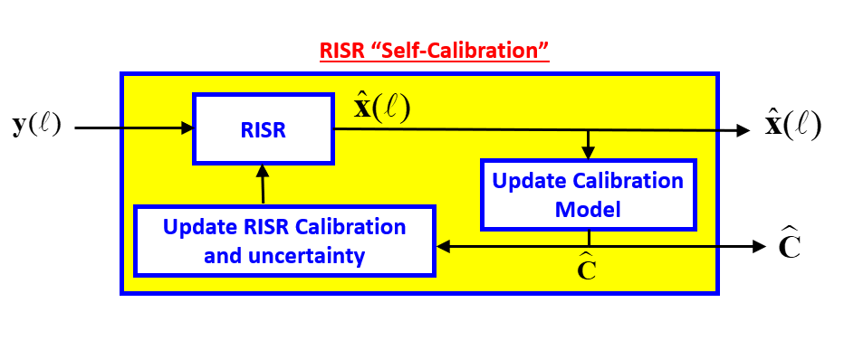
RISR Self-Calibration
The calibration model is initialized as an identity matrix
RISR is then performed on the measurements with a large model uncertainty variance ( ) and a partial constraint set to be small ( )
  This configuration emphasizes dominant signal components and suppresses low-power signals
This resulting RISR estimate is then used to update the calibration model

Slide 12
RISR Self-Calibration
The calibration model is initialized as an identity matrix
RISR is then performed on the measurements with a large model uncertainty variance ( ) and a partial constraint set to be small ( )
  This configuration emphasizes dominant signal components and suppresses low-power signals
This resulting RISR estimate is then used to update the calibration model
The RISR model uncertainty is then reduced, and the process is repeated until some calibration tolerance is met

Slide 13
RISR Self-Calibration
The calibration model is initialized as an identity matrix
RISR is then performed on the measurements with a large model uncertainty variance ( ) and a partial constraint set to be small ( )
  This configuration emphasizes dominant signal components and suppresses low-power signals
This resulting RISR estimate is then used to update the calibration model
The RISR model uncertainty is then reduced, and the process is repeated until some calibration tolerance is met
Does not require known calibration sources, though their inclusion may improve performance

Slide 14
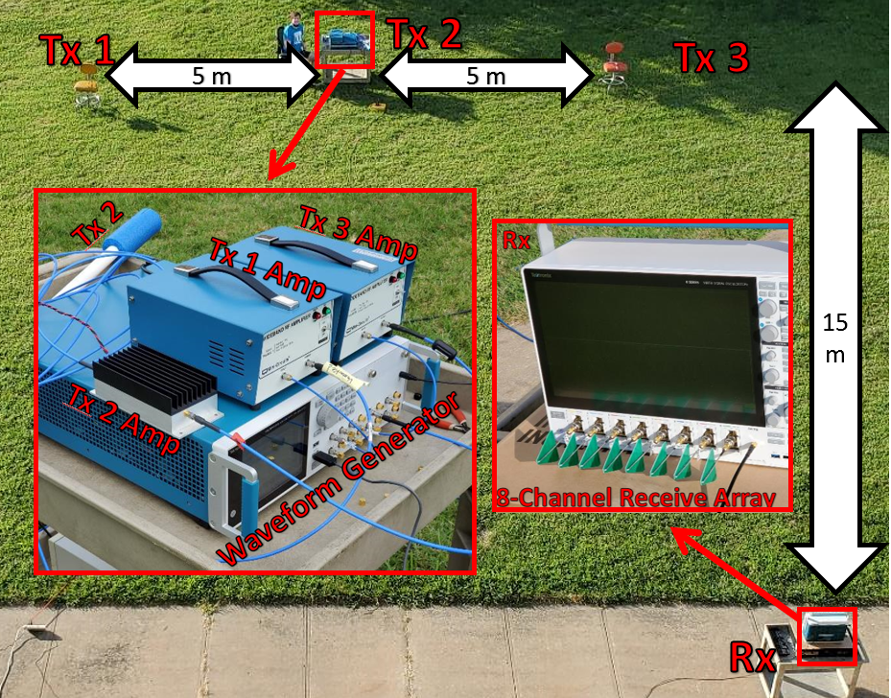
Open-Air Experiment #1: 8-Element ULA
We first demonstrate RISR capabilities using an 8-channel RF receive (Rx) ULA: nominal resolution = 22.5⸰ at 𝜆/2
Three transmit (Tx) antennas are used to generate signals of different types and powers, all with a 10MHz BW centered at 3.82 GHz
  Random FM Pulse @ 0°
  High Power LFM Pulse @ −18.4°
  Low Power OFDM @ −33.7°
Noise covariance estimated from a quiet scene (no transmission)

Slide 15
Open-Air Experiment #1: 8-Element ULA
RISR parameters:
No Calibration
Let’s first examine DF performance without calibration to establish a baseline case
MF w/ Taylor window
MVDR (15 Snapshots)
RISR (Single Snapshot)
RISR (15 Snapshots)

Slide 16
Open-Air Experiment #1: 8-Element ULA
RISR parameters:
RMS Angle Plot
No Calibration
Clearly the lack of calibration has produced multiple false signals for all methods
MF w/ Taylor window
MVDR (15 Snapshots)
RISR (Single Snapshot)
RISR (15 Snapshots)

Slide 17
Open-Air Experiment #1: 8-Element ULA
RISR parameters:
RMS Angle Plot
No Calibration
MVDR produces fewer false signals, but a smearing effect is present along with significant SNR loss
MF w/ Taylor window
MVDR (15 Snapshots)
RISR (Single Snapshot)
RISR (15 Snapshots)

Slide 18
Open-Air Experiment #1: 8-Element ULA
RISR parameters:
RMS Angle Plot
No Calibration
Now consider RISR calibration on-the-fly using no prior knowledge of emitters or their locations
MF w/ Taylor window
MVDR (15 Snapshots)
RISR (Single Snapshot)
RISR (15 Snapshots)

Slide 19
Open-Air Experiment #1: 8-Element ULA
RISR parameters:
On-the-Fly Calibration
At 5 µs intervals the calibration model was updated based on the previous RISR-DF estimates and model uncertainty was reduced
Init
Final
MF w/ Taylor window
MVDR (15 Snapshots)
RISR (Single Snapshot)
RISR (15 Snapshots)

Slide 20
Open-Air Experiment #1: 8-Element ULA
RISR parameters:
On-the-Fly Calibration
At 5 µs intervals the calibration model was updated based on the previous RISR-DF estimates and model uncertainty was reduced
The RISR 15 snapshot calibration model was also applied to the MF and MVDR results at the same interval
Init
Final
MF w/ Taylor window
MVDR (15 Snapshots)
RISR (Single Snapshot)
RISR (15 Snapshots)
Cal
Cal
Self Cal
Self Cal

Slide 21
Open-Air Experiment #1: 8-Element ULA
RISR parameters:
On-the-Fly Calibration
Initially the high model uncertainty largely suppresses all signals except for the high power LFM
While this calibration fit does not incorporate the lower power sources, we see a marked improvement for MVDR and the MF after just 5 µs
Init
Final
MF w/ Taylor window
MVDR (15 Snapshots)
RISR (Single Snapshot)
RISR (15 Snapshots)
Cal
Cal
Self Cal
Self Cal

Slide 22
Open-Air Experiment #1: 8-Element ULA
RISR parameters:
On-the-Fly Calibration
Improvement continues until the calibration model has achieved sufficient convergence after 75 µs
Init
Final
MF w/ Taylor window
MVDR (15 Snapshots)
RISR (Single Snapshot)
RISR (15 Snapshots)
Cal
Cal
Self Cal
Self Cal

Slide 23
Open-Air Experiment #1: 8-Element ULA
RISR parameters:
RMS Angle Plot (Post Cal)
On-the-Fly Calibration
After convergence RISR isolates all three signals in both single and 15 snapshot cases
15-snapshot RISR case clearly benefit from averaging compared to single snapshot
Init
Final
MF w/ Taylor window
MVDR (15 Snapshots)
RISR (Single Snapshot)
RISR (15 Snapshots)
Cal
Cal
Self Cal
Self Cal

Slide 24
Open-Air Experiment #1: 8-Element ULA
After calibration all adaptive approaches realize accurate angular estimates for the LFM and RFM sources, while the OFDM source yields a ~2° error
  Error may be due to inaccuracies in the test setup
15-Snapshot RISR produces highest SNR estimates with finest resolution
RMS Angle
RMS Angle (after Cal)

Slide 25

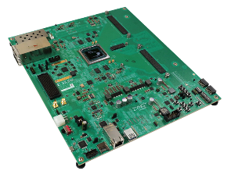

Open-Air Experiment #2: 4-Element RFSoC
A similar experiment was performed, this time using a 4-element ULA connected to an RFSoC for streaming data capture
Calibration performed with a boresight tone
Some variance with OFDM source, but overall performance improved with RISR
CW Tone
OFDM
RISR parameters:
15.9⸰
12.3⸰
20 ft
21.8 ft
MF w/ Taylor window
MVDR (9 Snapshots)
RISR (9 Snapshots)

Slide 26
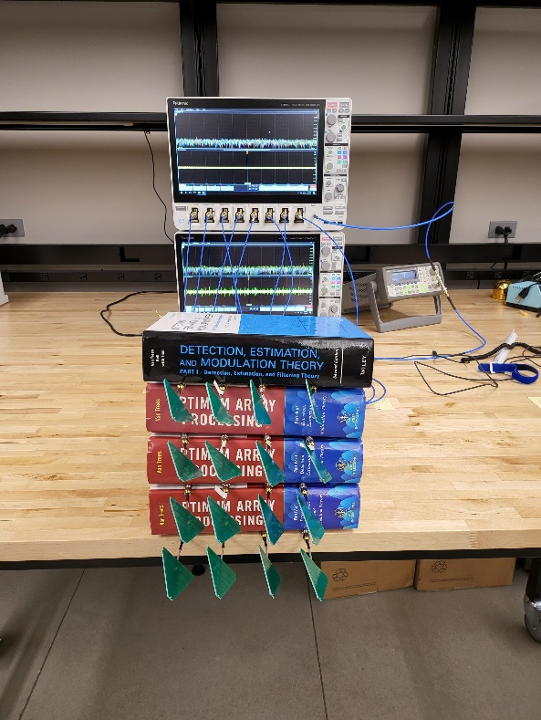
Open-Air Experiment #3: “Van Trees Array”
The Van Trees Array
Finally, an ad hoc 16-element uniform planar array was constructed using Harry Van Trees’ Optimal Array Processing book
An indoor test was conducted using three emitters at different azimuths and elevations
  CW Tone near boresight
  LFM and RFM from first ULA test at about −10° in elevation at about +6° and −6° in azimuth
  Emitters were held by an undergrad student … getting literal hands-on experience
Calibration performed with RISR using knowledge of the boresight emitter (this case was a bit too extreme for self-calibration)
Yes… this ad hoc (intentionally imprecise) structure works due to calibration and robust processing with RISR

Slide 27
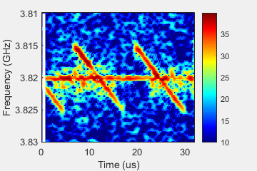
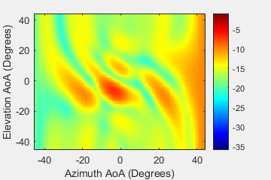
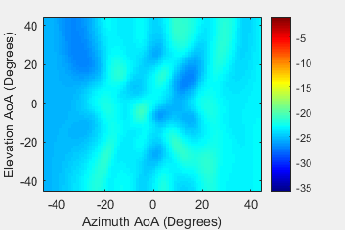
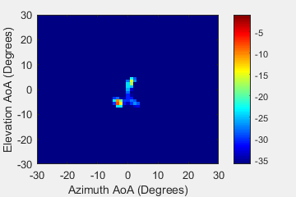
Open-Air Experiment #3: “Van Trees Array”
Spectrogram of single element
The Van Trees Array
RISR parameters:
There is observable angular variance in the RISR result, but compared to MF and MVDR it demonstrates rather robust DF capability
MF w/ Taylor window
MVDR (33 Snapshots)
RISR (33 Snapshots)
Tone
LFM
RFM

Slide 28
Conclusions
The reiterative super-resolution (RISR) algorithm, after the incorporation of a calibration procedure, has been demonstrated via three distinct experimental arrangements to provide robust DF that achieves super-resolution and enhanced dynamic range
The calibration process can be performed “on the fly” using signals of opportunity or with known sources
The resulting spatial isolation facilitates subsequent processing to realize improved signal characterization, which is demonstrated in the companion paper [4]
[4] C.C. Jones, Z.E. Gannon, S.D. Blunt, C.T. Allen, A.F. Martone, “An adaptive spectrogram estimator to enhance signal characterization” IEEE Radar Conf., New York City, NY, Mar. 2022.

