Slide 1
An Adaptive Spectrogram Estimator to Enhance Signal Characterization
Christian C. Jones^{1,3}, Zeus E. Gannon¹, Shannon D. Blunt¹, Christopher T. Allen¹, Anthony F. Martone²
¹Radar Systems Lab (RSL), EECS Dept., University of Kansas, Lawrence, KS, USA
²U.S. Army Research Laboratory (ARL), Adelphi, MD
This work was supported by the Army Research Office under Grant #W911NF-20-2-0271. DISTRIBUTION STATEMENT A. Approved for Public Release.

Slide 2
Motivation
Increasing RF congestion has led to the emergence of cognitive systems aimed at determining the spectral occupancy of the environment
  Rapid characterization of observed signals is critical for automated decision-making
A key challenge with cognitive systems is their focus on a particular optimization task which often pertains to a single dimension
  e.g., temporal, frequency, spatial, or waveform dimension
Signal characterization becomes challenging when multiple signals occupy the same decision dimension
  i.e., coincident in time, spectral cohabitation, close spatial proximity, or similar waveforms

Slide 3
Motivation
Direction finding (DF) techniques can be used to spatially isolate signals that overlap in time and occupy the same spectrum
Time-frequency (TF) analysis methods like the short-time Fourier transform (STFT) then enable instantaneous frequency characterization of the observed signals
  Trades resolution in time vs frequency to provide flexible granularity that can aid in signal identification
We develop an adaptive instantiation of the STFT to realize frequency super-resolution and suppress spectral sidelobes, thereby providing significantly refined signal characterization
The combination of adaptive direction finding and the adaptive STFT produces enhanced signal isolation and characterization

Slide 4
Re-iterative Super Resolution
The Re-iterative Super Resolution (RISR) method was developed via re-iterative minimum mean square error (RMMSE) estimation for adaptive DF [1]
It performs adaptive estimation with low sample support (even just a single snapshot) and additional developments have provided further robustness for real-world operation [2]
  Model structure likewise permits application in the time/frequency (TF) context
Thus, RISR can be used in a sequential DF then TF context to enhance signal separability and characterization for dynamic environments.
We denote these application-specific implementations as DF-RISR and Freq-RISR
[1] S.D. Blunt, T. Chan, K. Gerlach, “Robust DOA estimation: the reiterative superresolution (RISR) algorithm,” IEEE Trans. Aerospace and Electronic Systems, vol. 47, no. 1, pp. 332-346, Jan. 2011.
[2] C.C. Jones, Z.E. Gannon, D. DePardo, J.W. Owen, S.D. Blunt, C.T. Allen, B.H. Kirk, “Development & experimental assessment of robust direction finding and self-calibration” IEEE Radar Conf., New York City, NY, Apr. 2022.

Slide 5
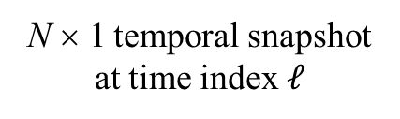
Spectrogram Signal Model
Consider continuous-time receive capture that is subsequently discretized and vectorized
continuous received signal plus noise
N × 1 temporal snapshot at time index $𝓁$
Q × 1 discretized receive vector
Ideally, the receive signal consists of tones across the short time scale, allowing it to be represented by a bank of M frequency steering vectors $a\left(ω\right)$ concatenated into matrix A as
where
Nonstationarity produces deviation that is represented by the catch-all error term b

Slide 6
Model Error Compensation
Since the additional error is signal dependent and unknown, we further alter the linear model by assuming there exists model mismatch induced by a vector of random variables z
Signal-dependent model mismatch
actual receive model
compensated receive model
model mismatch variance
We can then pose the MSE objective function using the compensated receive model as
the solution to which realizes …

Slide 7

Adaptive Spectrogram (Freq-RISR)
The partially constrained RISR filter for the mth direction and partial constraint α is
Can vary from fully constrained (=1) to unconstrained (=0) to tune robustness
where
source correlation Matrix
As the is unknown a priori, RISR iteratively refines an estimate for I iterations and with 2L−1 snapshots via
$$P\left(𝓁\right)$$
Noncoherent combination improves robustness
where L can be as small as 0 (single snapshot)

Slide 8
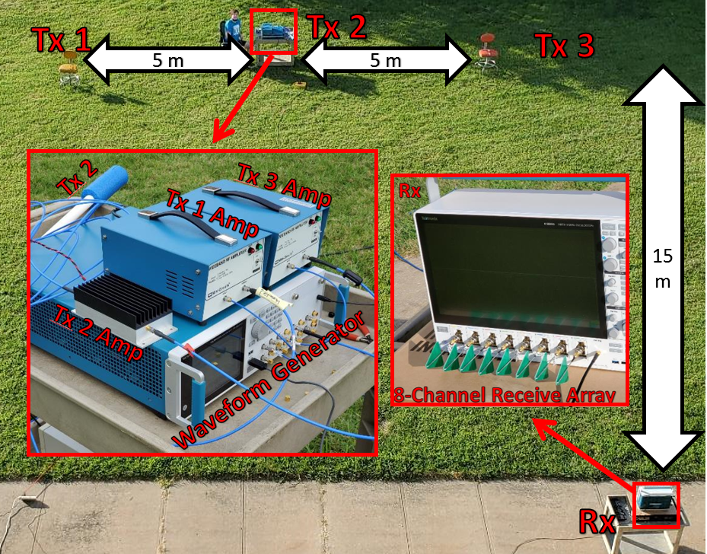
Experimental Setup: 8-Element ULA
In [2] we demonstrate RISR for DF using an 8-channel RF receive (Rx) ULA: nominal resolution = 22.5⸰ at 𝜆/2
Three transmit (Tx) antennas were used to generate signals of different types, all with a 10MHz BW centered at 3.82 GHz
Noise covariance estimated from a quiet scene (no transmission)
[2] C.C. Jones, Z.E. Gannon, D. DePardo, J.W. Owen, S.D. Blunt, C.T. Allen, B.H. Kirk, “Development & experimental assessment of robust direction finding and self-calibration” IEEE Radar Conf., New York City, NY, Apr. 2022.

Slide 9
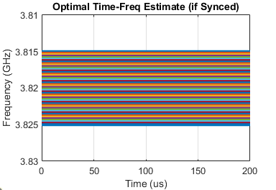
Signal Structures
The 3 transmitters generate rather different time-domain signals as illustrated below
The LFM and Random FM (RFM) signals each have a single instantaneous frequency that changes as a function of time
In contrast, the OFDM signal is comprised of 500 weighted subcarriers
LFM
OFDM
RFM
Notes:
First let’s examine the baseline case of TF analysis without antecedent DF.

Slide 10
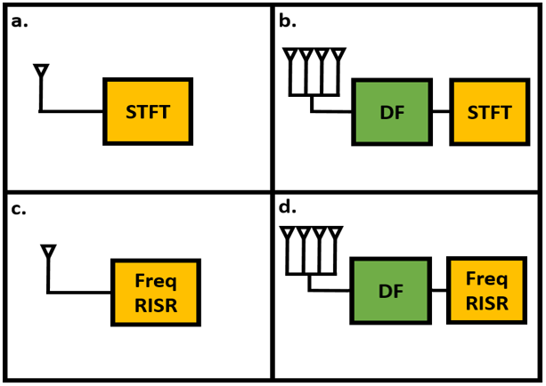
Experimental Validation - Overview
Experimental results categorized into four stages to examine impact of DF and TF aspects of RISR

Slide 11
Experimental Validation - Overview
Experimental results categorized into four stages to examine impact of DF and TF aspects of RISR
First, we establish the baseline case of no DF and no adaptive spectrogram

Slide 12
Experimental Validation - Overview
Experimental results categorized into four stages to examine impact of DF and TF aspects of RISR
First, we establish the baseline case of no DF and no adaptive spectrogram
Then we compare signal isolation for various DF approaches

Slide 13
Experimental Validation - Overview
Experimental results categorized into four stages to examine impact of DF and TF aspects of RISR
First, we establish the baseline case of no DF and no adaptive spectrogram
Then we compare signal isolation for various DF approaches
The RISR adaptive spectrogram is then examined with no DF

Slide 14
Experimental Validation - Overview
Experimental results categorized into four stages to examine impact of DF and TF aspects of RISR
First, we establish the baseline case of no DF and no adaptive spectrogram
Then we compare signal isolation for various DF approaches
The RISR adaptive spectrogram is then examined with no DF
Finally, DF-RISR and Freq-RISR are combined

Slide 15
Baseline Case
For the baseline case, we use the aggregated TF response of the receive-captured signal for a single antenna element
  No DF isolation or adaptive enhancement
Here N=10, M=200 and a Taylor window is applied to reduce sidelobes
LFM source dominates (due to higher Rx power)
Random variation in frequency noticeable between ~47 and ~57 µs caused by RFM signal
OFDM signal not discernible
This interval was selected because all 3 sources are present

Slide 16
Experimental Validation – DF-RISR
DF was performed using the standard MF, MVDR with 15 snapshots, and DF-RISR with 15 snapshots
To account for angular variation/error an accumulation across angle swath is performed prior to TF analysis
Further DF assessment is discussed in [2]
[2] C.C. Jones, Z.E. Gannon, D. DePardo, J.W. Owen, S.D. Blunt, C.T. Allen, B.H. Kirk, “Development & experimental assessment of robust direction finding and self-calibration” IEEE Radar Conf., New York City, NY, Apr. 2022.

Slide 17
Experimental Validation - DF-RISR
Perform DF to spatially isolate signals
MF w/ Taylor window
MVDR (15 Snapshots)
DF-RISR (15 Snapshots)

Slide 18
Experimental Validation - DF-RISR
Perform DF to spatially isolate signals
MF w/ Taylor window
MVDR (15 Snapshots)
DF-RISR (15 Snapshots)
Accumulate measurements in angle swaths
(sum or max)

Slide 19
Experimental Validation - DF-RISR
Perform DF to spatially isolate signals
Apply STFT
MF w/ Taylor window
MVDR (15 Snapshots)
DF-RISR (15 Snapshots)
Accumulate measurements in angle swaths
(sum or max)

Slide 20
DF-RISR Results: OFDM signal
MF w/ Taylor window
MVDR (15 Snapshots)
DF-RISR (15 Snapshots)
Max across angle
Max across angle
Max across angle
STFT of MF
STFT of MVDR
STFT of DF-RISR

Slide 21
DF-RISR Results: LFM signal
MF w/ Taylor window
MVDR (15 Snapshots)
DF-RISR (15 Snapshots)
Max across angle
Max across angle
Max across angle
STFT of MF
STFT of MVDR
STFT of DF-RISR

Slide 22
DF-RISR Results: RFM signal
MF w/ Taylor window
MVDR (15 Snapshots)
DF-RISR (15 Snapshots)
Max across angle
Max across angle
Max across angle
STFT of MF
STFT of MVDR
STFT of DF-RISR

Slide 23
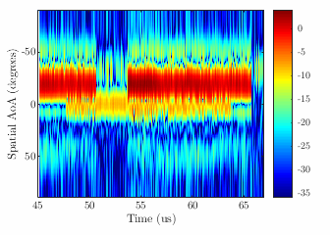
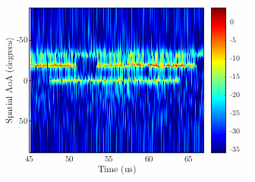
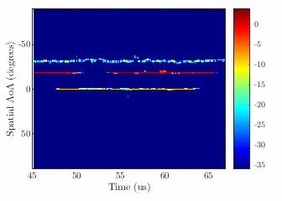
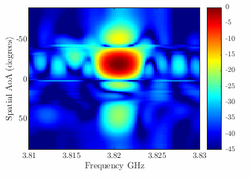
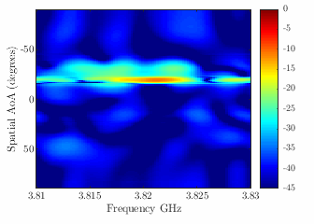
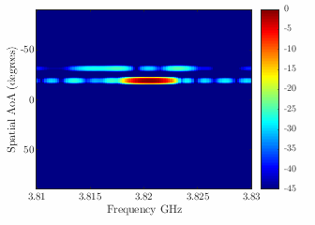
An Alternative Visualization
MF w/ Taylor window
MVDR (15 Snapshots)
DF-RISR (15 Snapshots)
MF Instantaneous
Angle-Freq
MVDR Instantaneous
Angle-Freq
DF-RISR Instantaneous
Angle-Freq
OFDM
LFM
RFM

Slide 24
Experimental Validation – Freq-RISR
Now reexamine the baseline case with no DF, but use Freq-RISR to produce an adaptive spectrogram
Same N=10, M=200 is used as well as 3 overlapping snapshots for smoothing (i.e. L = 1), , 30 iterations, and

Slide 25
Experimental Validation – Freq-RISR
Standard Spectrogram (no DF)
Freq-RISR (no DF)
Even without spatial isolation via DF, we see that Freq-RISR provides significant signal enhancement via super-resolution and sidelobe suppression

Slide 26
Experimental Validation – DF-RISR + Freq-RISR
Finally, we use spatially isolated signals from the DF stage and form the Freq-RISR adaptive spectrogram
MF and MVDR for DF resulted in poor spatial isolation, so their DF-RISR results are not considered
Freq-RISR uses same parameters as previous case

Slide 27
Experimental Validation – DF-RISR + Freq-RISR
STFT of LFM
STFT of RFM
STFT of OFDM
Freq-RISR of LFM
Freq-RISR of RFM
Freq-RISR of OFDM
Combination of DF-RISR and Freq-RISR allows for enhanced characterization of dynamic behavior

Slide 28
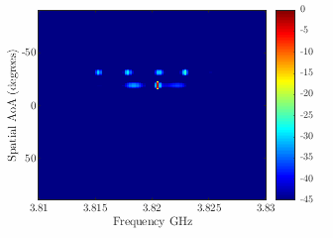
An Alternative Visualization
MF w/ Taylor window
RISR (15 Snapshots)
Now very precise angle and frequency signal characterizations can be made
MF Inst.
Angle-Freq
DF-RISR + STFT
Inst. Angle-Freq
DF-RISR + Freq-RISR
Inst. Angle-Freq
OFDM
LFM
RFM

Slide 29
Conclusions
DF-RISR yields effective signal isolation, which was leveraged here to enhance subsequent time/frequency analysis [2]
Freq-RISR then provides a means to perform adaptive time/frequency estimation with low sample support, with added model uncertainties and a partial constraint providing enhance robustness
The combination of DF-RISR and Freq-RISR yields further enhancement that may aid in signal identification, particularly if combined with emerging machine learning techniques (i.e. better input = better output)
[2] C.C. Jones, Z.E. Gannon, D. DePardo, J.W. Owen, S.D. Blunt, C.T. Allen, B.H. Kirk, “Development & experimental assessment of robust direction finding and self-calibration” IEEE Radar Conf., New York City, NY, Apr. 2022.

