Slide 1
Physically Realizable Multi-User Radar/Communications (MURC)
Brandon Ravenscroft¹, Alfred Fontes¹, Patrick M. McCormick¹, Shannon D. Blunt¹, Cameron Musgrove²
¹Radar Systems Lab (RSL), University of Kansas (KU), Lawrence, KS
²IERUS Technologies, Inc., Huntsville, AL
This work was supported by the Office of Naval Research under Contract #N00014-20-C-1006. DISTRIBUTION STATEMENT A. Approved for Public Release.

Slide 2
Multi-user Radar Communications – Motivation
Spectral efficiency is a growing concern for RF systems due to an increasing density of users
Realizing a dual-function radar communication (DFRC) mode in a single system is a means to improve the spectral efficiency of systems needing to perform both functions
Extending a single-system DFRC concept to a network of multiple systems opens the possibility of multi-user radar/communication (MURC)
  The question we address here is: can multiple proximate DFRC systems operate simultaneously with overlapping spectral content?
Within the MURC context, we propose a DFRC modulation that exhibits the following qualities:
  FM continuous-wave (FMCW) transmission with nonrepeating modulation structure to achieve good spectral containment, high time-bandwidth product (TB), and enhance receive separability
  A communication encoding/decoding scheme that does not degrade radar performance while being resistant to multi-user interference

Slide 3
MURC – Modulation Structure
We leverage the combination of spread-spectrum (SS) multiple access with continuous phase modulation (CPM)
  Previously realized as SS/CPM in [1], but with a reusable set of codes (so insufficient dynamic range not amenable to multi-user radar application)
  Instead, we consider a DFRC-specific form having randomized sets of codes to achieve non-repeating FMCW waveforms having good spectral containment
We leverage the stochastic waveform generation (StoWGe) [2,3] framework to produce our DFRC transmission
  Produces random FM (RFM) waveforms having desired power spectrum template in the expectation given a stochastic input (e.g., data sequence)
  Modulation structure guarantees a transmission that is constant amplitude and continuous phase

Slide 4


Brief Overview of CPM Communications
CPM is a nonlinear communication modulation scheme that maps a symbol stream into a constant amplitude digital FM signal having good spectral containment
Mathematically, the CPM signal is defined as:
$$s\left(t;β\right)=\exp\left\{j\left(θ\left(t;β\right)\right)\right\}$$
for
$$θ\left(t;β\right)=2πh\int_{0}^{t}{\left[\sum_{m}{β\left[m\right]}​b\left(τ−mT_{s}\right)\right]dτ}$$
CPM Phase function
Symbol sequence
Modulation index
Frequency shaping filter (duration $LT_{s}$)
Symbol time

Slide 5

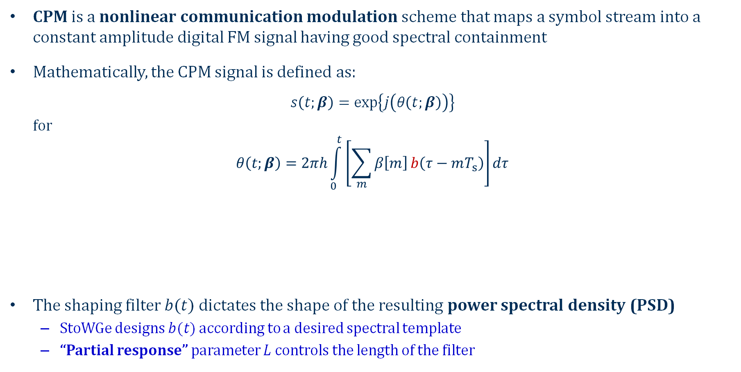
Brief Overview of CPM Communications
CPM is a nonlinear communication modulation scheme that maps a symbol stream into a constant amplitude digital FM signal having good spectral containment
Mathematically, the CPM signal is defined as:
$$s\left(t;β\right)=\exp\left\{j\left(θ\left(t;β\right)\right)\right\}$$
for
$$θ\left(t;β\right)=2πh\int_{0}^{t}{\left[\sum_{m}{β\left[m\right]}​b\left(τ−mT_{s}\right)\right]dτ}$$
The shaping filter $b(t)$ dictates the shape of the resulting power spectral density (PSD)
  StoWGe designs $b(t)$ according to a desired spectral template
  “Partial response” parameter $L$ controls the length of the filter
CPM Phase function
Symbol sequence
Modulation index (subsumed into StoWGe filter)
StoWGe Frequency shaping filter (duration $LT_{s}$)
Symbol time

Slide 6
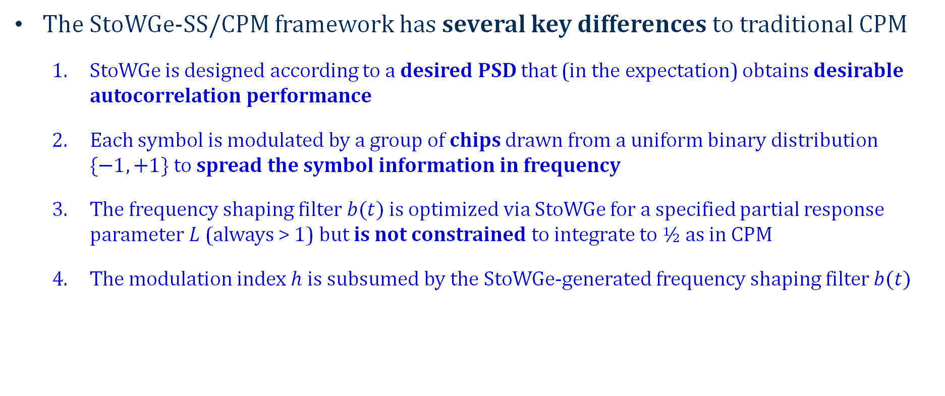
StoWGe-based SS/CPM
The StoWGe-SS/CPM framework has several key differences to traditional CPM
  StoWGe is designed according to a desired PSD that (in the expectation) obtains desirable autocorrelation performance
  Each symbol is modulated by a group of chips drawn from a uniform binary distribution $\{−1,+1\}$ to spread the symbol information in frequency
  The frequency shaping filter $b(t)$ is optimized via StoWGe for a specified partial response parameter $L$ (always > 1) but is not constrained to integrate to ½ as in CPM
  The modulation index $h$ is subsumed by the StoWGe-generated frequency shaping filter $b(t)$

Slide 7
StoWGe-based SS/CPM – Shaping filters
Frequency shaping filter comparison – StoWGe & common CPM filters
  Optimized StoWGe shaping filter (blue) with L = 8
  Raised cosine (RC) shaping filter (black) with L = 4
  Rectangular (REC) shaping filter (red) with L = 1
While CPM filters integrate to ½, the StoWGe optimized filter does not

Slide 8
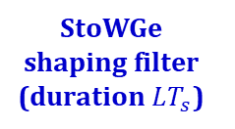


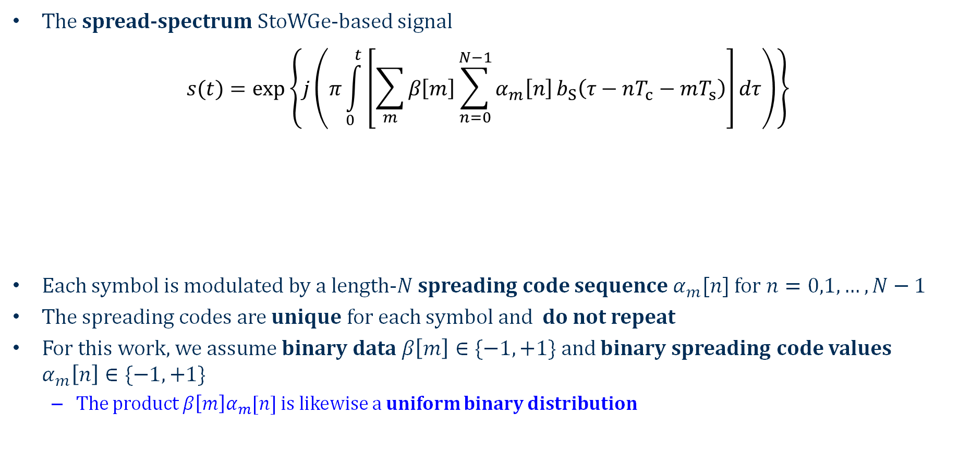

StoWGe-based SS/CPM – Signal structure
The spread-spectrum StoWGe-based signal
$$s(t)=\exp\left\{j\left(π\int_{0}^{t}{\left[\sum_{m}{​β​​\left[m\right]\sum_{n=0}^{N−1}{α_{m}​​\left[n\right]}}b_{​S}​\left(τ−nT_{c}−mT_{s}​\right)\right]}​dτ\right)\right\}$$
Each symbol is modulated by a length-$N$ spreading code sequence $α_{m}[n]$ for $n=0,1,…,N−1$
The spreading codes are unique for each symbol and do not repeat
For this work, we assume binary data $β\left[m\right]∈\{−1,+1\}$ and binary spreading code values $α_{m}\left[n\right]∈\{−1,+1\}$
  The product $β\left[m\right]α_{m}[n]$ is likewise a uniform binary distribution
$m$th symbol
$$β\left[m\right]∈\{−1,+1\}$$
Chip time
$$T_{s}/N$$
StoWGe-based SS/CPM signal
Symbol time
$n$th chip of $m$th spreading code
length-$N$
$$α_{m}\left[n\right]∈\left\{−1,+1\right\}$$
StoWGe shaping filter (duration $LT_{s}$)

Slide 9
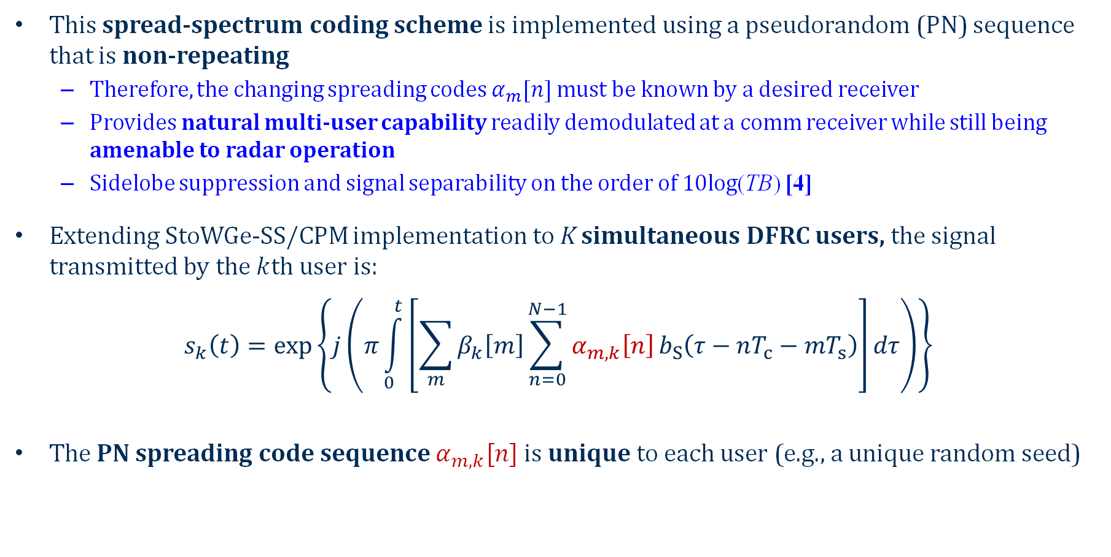
Multi-user StoWGe-based SS/CPM
This spread-spectrum coding scheme is implemented using a pseudorandom (PN) sequence that is non-repeating
  Therefore, the changing spreading codes $α_{m}[n]$ must be known by a desired receiver
  Provides natural multi-user capability readily demodulated at a comm receiver while still being amenable to radar operation
  Sidelobe suppression and signal separability on the order of 10log(TB) [4]
Extending StoWGe-SS/CPM implementation to K simultaneous DFRC users, the signal transmitted by the $k$th user is:
$$s_{k}​\left(t\right)=\exp\left\{j\left(π\int_{0}^{t}{\left[\sum_{m}{​β_{k}​\left[m\right]\sum_{n=0}^{N−1}{α_{m,k}​\left[n\right]}}b_{​S}​\left(τ−nT_{c}−mT_{s}​\right)\right]}​dτ\right)\right\}$$
The PN spreading code sequence $α_{m,k}[n]$ is unique to each user (e.g., a unique random seed)

Slide 10

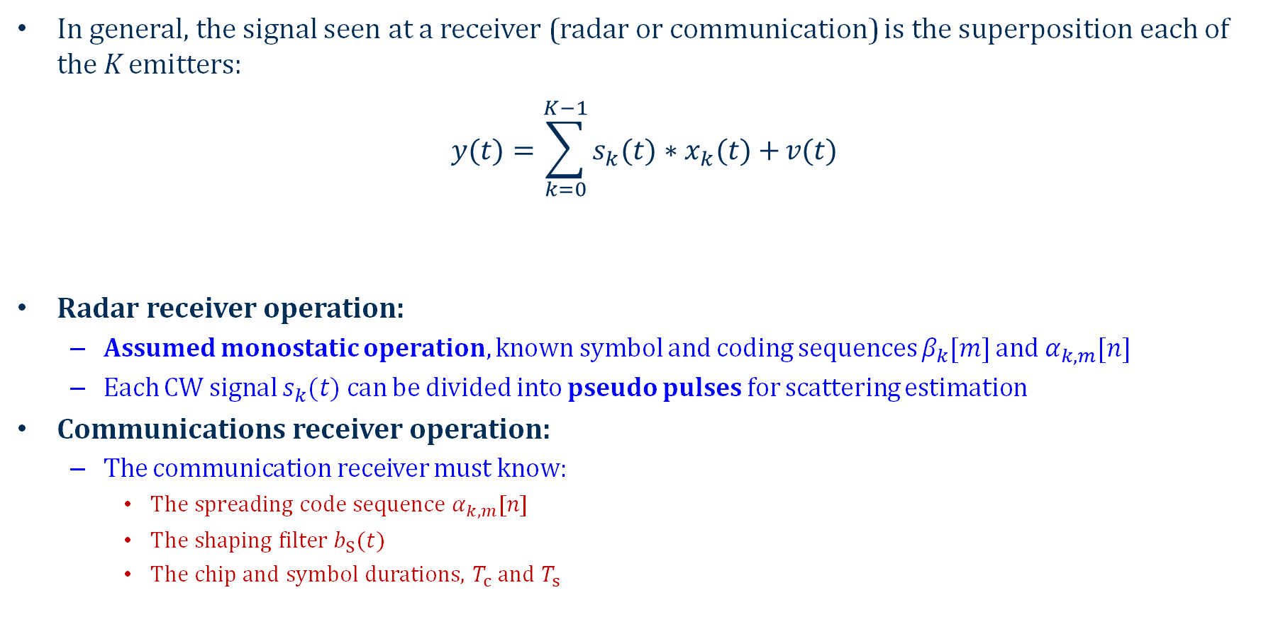
Receive Processing
In general, the signal seen at a receiver (radar or communication) is the superposition each of the K emitters:
$$y​(t)=\sum_{k=0}^{K−1}{s_{k}​(t)∗x_{​​k}​(t)+}​v​(t)$$
Radar receiver operation:
  Assumed monostatic operation, known symbol and coding sequences $β_{k}[m]$ and $α_{k,m}[n]$
  Each CW signal $s_{k}(t)$ can be divided into pseudo pulses for scattering estimation
Communications receiver operation:
  The communication receiver must know:
    The spreading code sequence $α_{k,m}[n]$
    The shaping filter $b_{S}(t)$
    The chip and symbol durations, $T_{c}$ and $T_{s}$
Additive noise
Scattering profile for $k$th transmitter

Slide 11
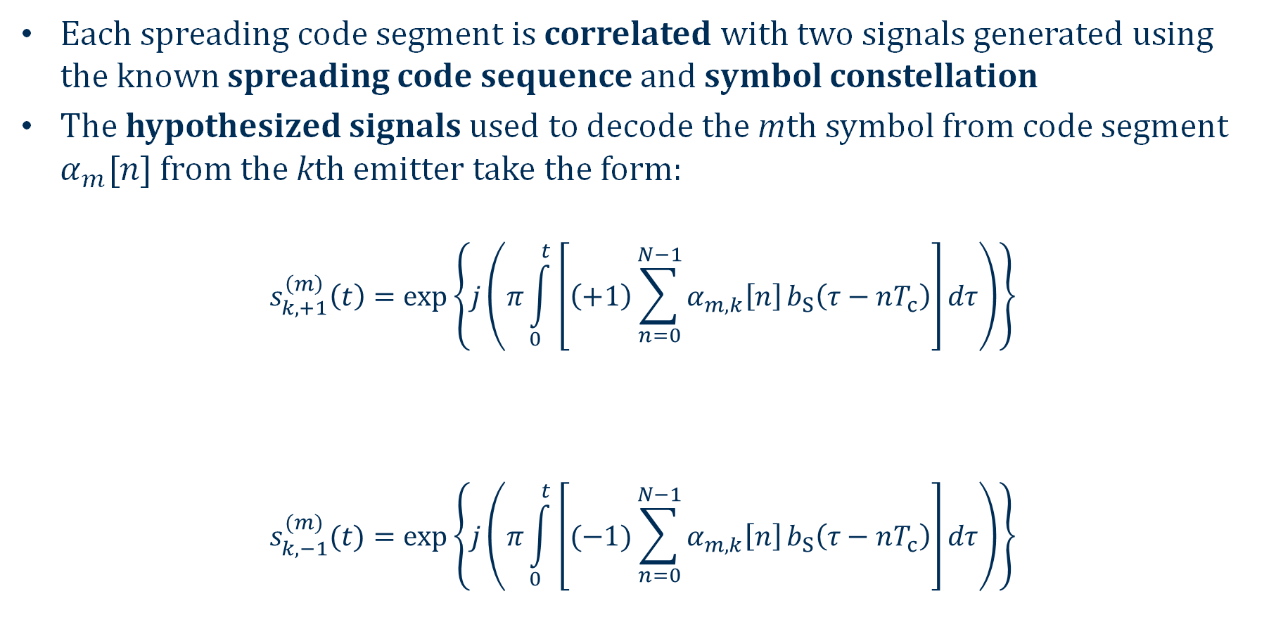
Communications Receive Processing
Each spreading code segment is correlated with two signals generated using the known spreading code sequence and symbol constellation
The hypothesized signals used to decode the mth symbol from code segment $α_{m}[n]$ from the kth emitter take the form:
$$s_{k​,+1}^{\left(m\right)}​\left(t\right)=\exp\left\{j\left(π\int_{0}^{t}{\left[\left(+1\right)\sum_{n=0}^{N−1}{α_{m,k}​​\left[n\right]}b_{​S}​\left(τ−nT_{c}​\right)\right]}​dτ\right)\right\}$$
$$s_{k​,−1}^{(m)}​(t)=\exp\left\{j\left(π\int_{0}^{t}{\left[(−1)\sum_{n=0}^{N−1}{α_{m,k}​​\left[n\right]}b_{​S}​\left(τ−nT_{c}​\right)\right]}​dτ\right)\right\}$$
β[m] = +1
complex conjugate
signals
β[m] = -1

Slide 12

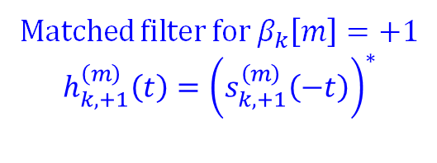

Comms Receive Processing – Hypothesis test
The hypothesis test can be posed as:
$$\left(\max_{t}\left|h_{​k,+1}^{\left(m\right)}(t)∗{\overline{y}}_{m}​(t)\right|\right)\begin{matrix}H_{+1} \\ > \\ < \\ H_{−1}\end{matrix}\left(\max_{t}\left|h_{k​,−1}^{\left(m\right)}(t)∗{\overline{y}}_{m}​(t)\right|\right)$$
Matched filter for $β_{k}\left[m\right]=+1$
$$h_{k,+1}^{\left(m\right)}\left(t\right)={\left(s_{k,+1}^{\left(m\right)}\left(−t\right)\right)}^{∗}$$
  Portion of the received communications signal that encompasses the interval of the mth symbol
Matched filter for $β_{k}\left[m\right]=−1$
$$h_{k,−1}^{\left(m\right)}\left(t\right)={\left(s_{k,−1}^{\left(m\right)}\left(−t\right)\right)}^{∗}$$

Slide 13
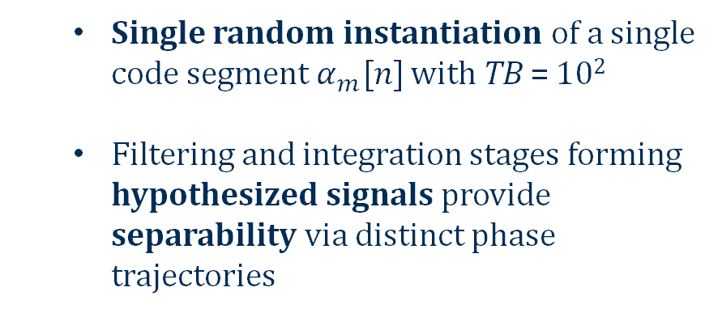
Comms Receive Processing – Correlation performance
Auto and cross-correlation between “hypothesized” signals
  Single random instantiation of a single code segment $α_{m}[n]$ with TB = 10²
  Filtering and integration stages forming hypothesized signals provide separability via distinct phase trajectories
Cross-correlation on the order of 10log₁₀(10²)

Slide 14
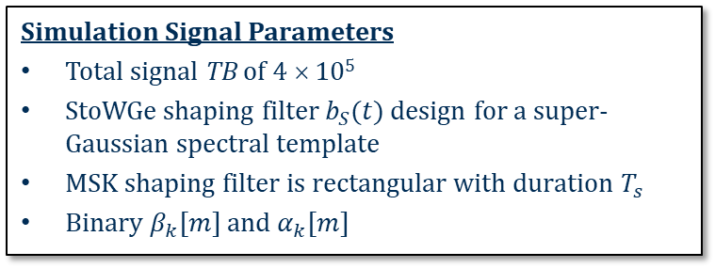
MURC Simulation Analysis
RMS Power Spectra
Simulations were conducted to show the efficacy of StoWGe-SS/CPM for DFRC in a MURC scenario
The StoWGe shaping filter used a super-Gaussian [5] power spectrum density (PSD) template
  Sharper spectral roll-off than standard Gaussian (particularly useful for wideband)
For comparison, minimum shift keying (MSK) waveforms were generated via SS/CPM by replacing StoWGe shaping filter with a rectangular filter
Noise and multipath were not included as part of the simulations (to isolate interference contribution)
  Simulation Signal Parameters
  Total signal TB of 4 × 10⁵
  StoWGe shaping filter $b_{S}(t)$ design for a super-Gaussian spectral template
  MSK shaping filter is rectangular with duration $T_{s}$
  Binary $β_{k}[m]$ and $α_{k}[m]$

Slide 15
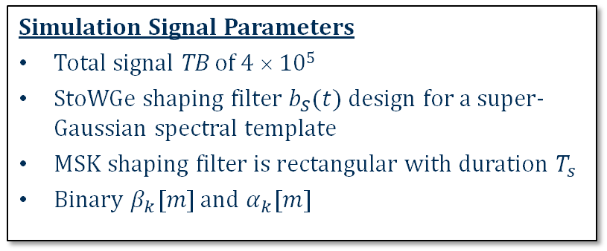
Radar Analysis - Autocorrelation
RMS & Mean Autocorrelations
  Simulation Signal Parameters
  Total signal TB of 4 × 10⁵
  StoWGe shaping filter $b_{S}(t)$ design for a super-Gaussian spectral template
  MSK shaping filter is rectangular with duration $T_{s}$
  Binary $β_{k}[m]$ and $α_{k}[m]$
≈ 10log₁₀(10³) = 30 dB floor
≈ 10log₁₀(400) = 26 dB suppression from slow-time processing
StoWGe has a slightly lower (~2 dB) correlation floor

Slide 16
Radar Analysis - Autocorrelation
RMS & Mean Autocorrelation (detail)
  Simulation Signal Parameters
  Total signal TB of 4 × 10⁵
  StoWGe shaping filter $b_{S}(t)$ design for a super-Gaussian spectral template
  MSK shaping filter is rectangular with duration $T_{s}$
  Binary $β_{k}[m]$ and $α_{k}[m]$
≈ 10log₁₀(10³) = 30 dB floor
≈ 10log₁₀(400) = 26 dB suppression from slow-time processing
StoWGe has narrower mainlobe and near-in shoulder lobes due to super-Gaussian design template

Slide 17
Radar Analysis – Point Spread Function
StoWGe
MSK
≈ 1.3 dB lower floor
Standard Doppler processing - windowing/tapering not used

Slide 18
Communication Analysis – Symbol Error Rate
  Communication Modulation Parameters
  Communication symbol TB tested: 20, 40, 60, 80, 100
  For 3 dB bandwidth of 50 MHz, these correspond to data rates of 2.5, 1.25, 0.83, 0.63 and 0.50 Mb/s
  K = 1, 2, …, 10 simultaneous users for each TB
  Monte Carlo simulations performed for 10⁴ trials at each data point
  Communication channel has direct path only (no multipath) and no additive noise
  Simulation isolates symbol error rate (SER) performance due solely to multi-user interference and shaping filter (StoWGe’s partial response vs. MSK’s full response)
StoWGe SER Plot
Obvious performance tradeoff with data rate and number of users

Slide 19
Communication Analysis – Symbol Error Rate
  Communication Modulation Parameters
  Communication symbol TB tested: 20, 40, 60, 80, 100
  For 3 dB bandwidth of 50 MHz, these correspond to data rates of 2.5, 1.25, 0.83, 0.63 and 0.50 Mb/s
  K = 1, 2, …, 10 simultaneous users for each TB
  Monte Carlo simulations performed for 10⁴ trials at each data point
  Communication channel has direct path only (no multipath) and no additive noise
  Simulation isolates symbol error rate (SER) performance due solely to multi-user interference and shaping filter (StoWGe’s partial response vs. MSK’s full response)
MSK SER Plot
- Better SER performance
- No errors for single user case

Slide 20
MURC Conclusions – StoWGe-SS/CPM
Efficacy of StoWGe-SS/CPM for a multi-user DFRC mode was shown through simulation analysis for radar and communications functions
Performance of StoWGe-SS/CPM waveform for radar operation is not impacted by the presence of embedded communications symbols
Communication performance of the StoWGe-SS/CPM waveform is impacted by the partial response shaping filter
  A shaping filter duration longer than a symbol time cause inter-symbol interference (optimal demodulation via Viterbi algorithm)
    StoWGe should achieve performance of MSK results with this demodulator
  Low-complexity correlation-based demodulation is acceptable for high TB and low number of simultaneous users
Future work will focus on optimal communications demodulation via Viterbi algorithm and open-air experimental analysis to assess practical behavior/scenarios

Slide 21
Thank You
[1] T.M. Lok, J.S. Lehnert, "DS/SSMA communication system with trellis coding and CPM," IEEE J. Selected Areas Comm., vol. 12, no. 4, pp. 716-722, May 1994.
[2] C.A. Mohr, S.D. Blunt, “Design and generation of stochastically defined, pulsed FM noise waveforms,” Intl. Radar Conf., Toulon, France, Sept. 2019.
[3] C.A. Mohr, “Design and evaluation of stochastic processes as physical radar waveforms,” PhD dissertation, University of Kansas, June 2021.
[4] S.D. Blunt, et al., "Principles and applications of random FM radar waveform design," IEEE Aerospace & Electronic Systems Mag., vol. 35, no. 10, pp. 20-28, Oct. 2020.
[5] M.B. Heintzelman, T.J. Kramer, S.D. Blunt, "Experimental evaluation of super-Gaussian-shaped random FM waveforms," IEEE Radar Conf., New York City, NY, Mar. 2022.

