Slide 1

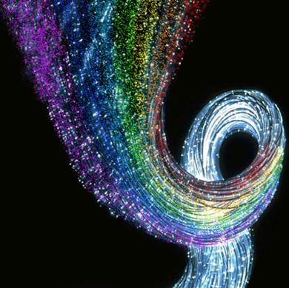


Tunable Nano-Photonic Devices
Susobhan Das

Slide 2
Outline
Motivation
Material Characterization
  Graphene
    Experimental Setup
    Result and Discussion
  Indium Tin Oxide
  Vanadium di-Oxide
    Transmission Characteristics
    Experimental Setup
    Result and discussion
Optical Devices
  NIR Electro Optic Modulator based on Graphene
  Mode-Multiplexed Modulator
  Metamaterial Assisted Coupler
Conclusion
Future work
  Exploration of novel photonic structures based on surface plasmonics
  Metamaerial assisted optical devices
  Tunability in Terahertz region with patterned Graphene configuration

Slide 3
Motivation
Photonic Integration → Compactness, high efficiency
Need for optical interconnects
Building Blocks : waveguide, modulator, coupler, router, switch, detector.
Integration → High Bandwidth, speed enhancement, Low Loss, Functionality per Area , Cost Effective, Immune to EMI
Photonic circuit based on silicon technology , its deficiency (electro optic properties) and limitation of device size by diffraction limit.
M. J. Kobrinsky et al., Intel Technol. J., 8, 2004.
Contd.

Slide 4
Plasmonic effect → metal dielectric interface ( Au, Ag → very high negative permittivity)
New material in NIR region Graphene, ITO, VΟ₂
New photonic device development with plasmonic effect.
P. G. Etchegoin et al. J. Chem. Phys. 127, 164705

Slide 5
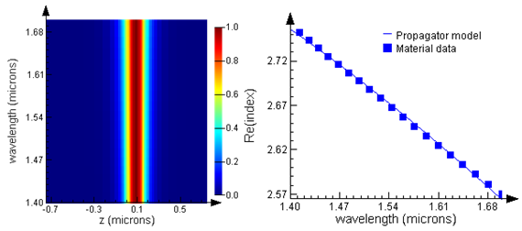
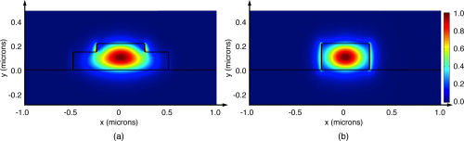
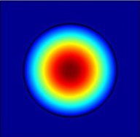
Optical Waveguide
Total Internal Reflection (n_{core} > n_{clad})
n_{clad}
A C
d
n_{core}
n_{clad}
Phase change due to TIR
Planar Waveguide
Ridge Waveguide
Optical fiber
Fundamental Mode profile
Device size limited by diffraction limit !!!
K. Okamoto, Fundamental of Optical Waveguides (2nd eddition), Academic Press, 2006

Slide 6
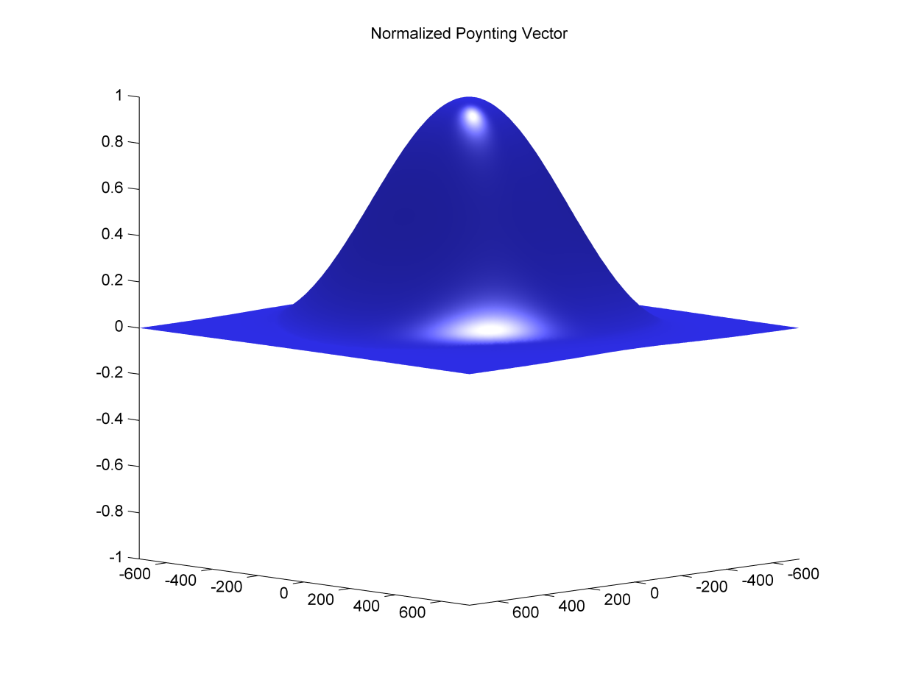

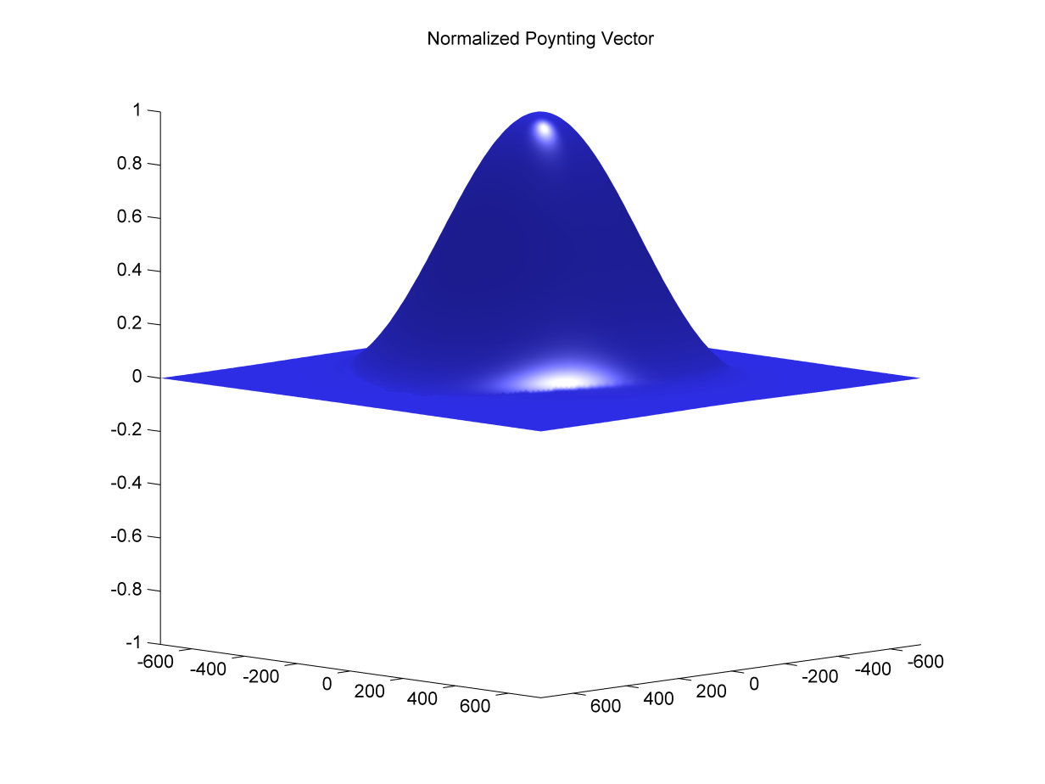

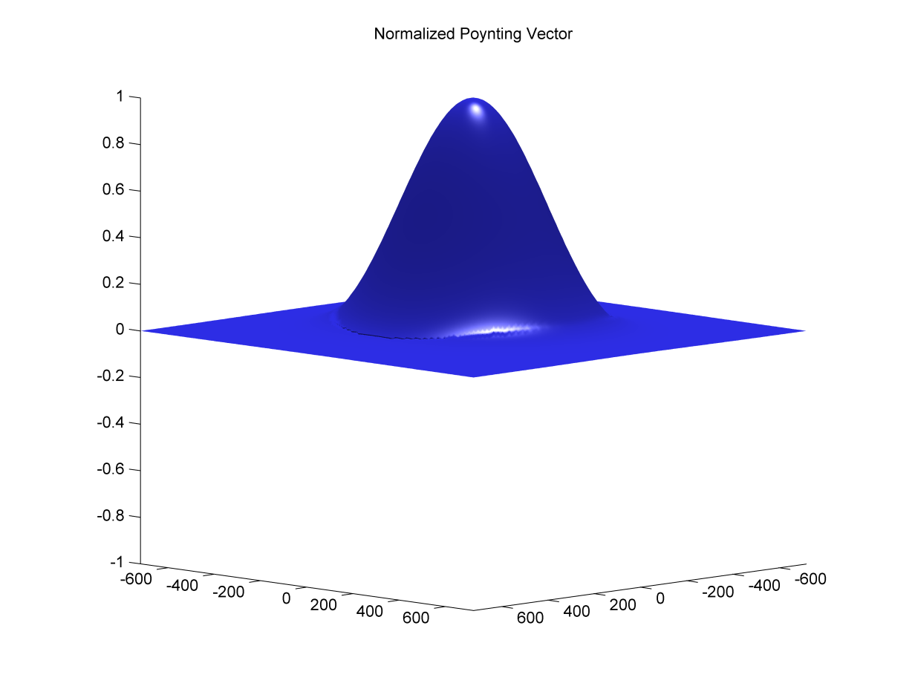
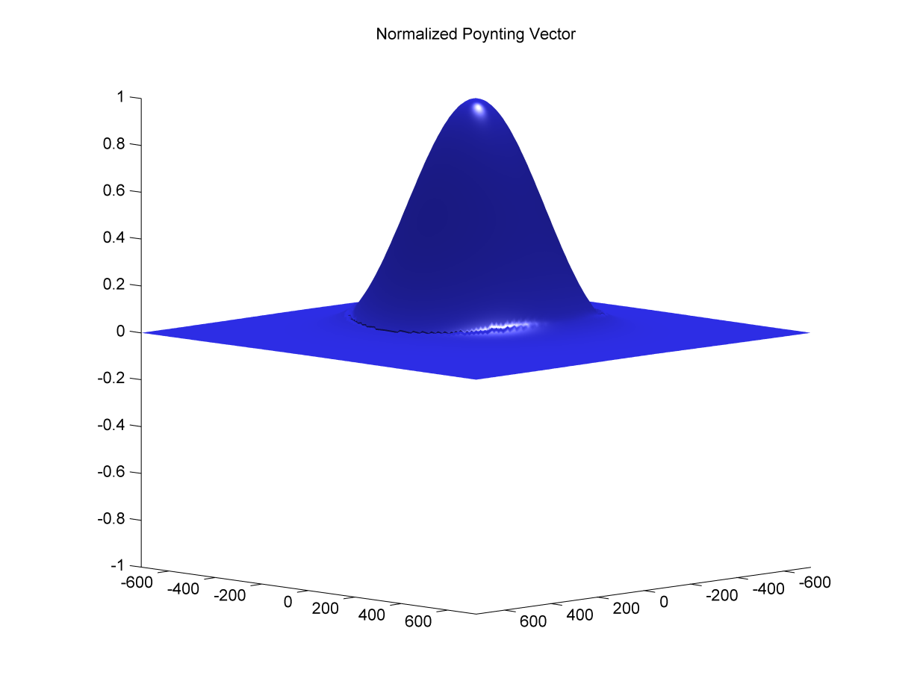
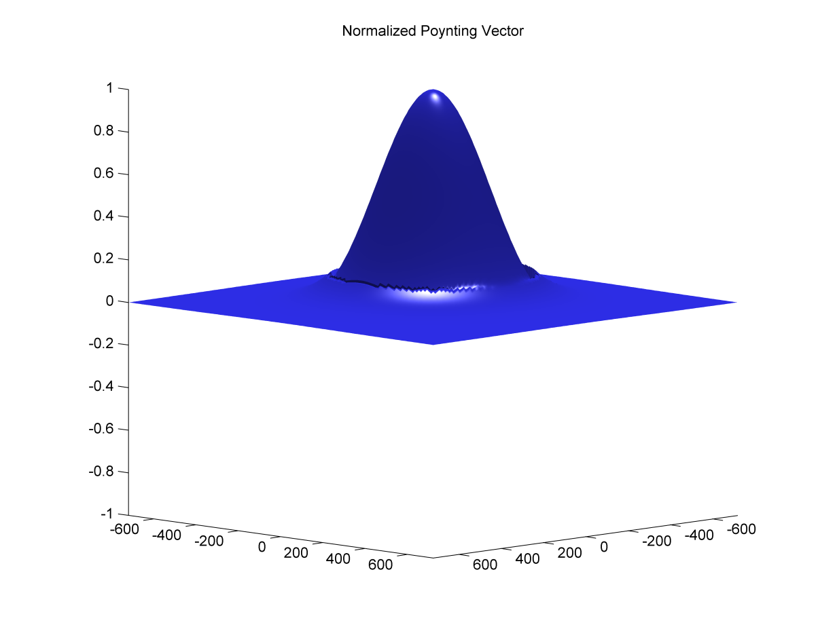
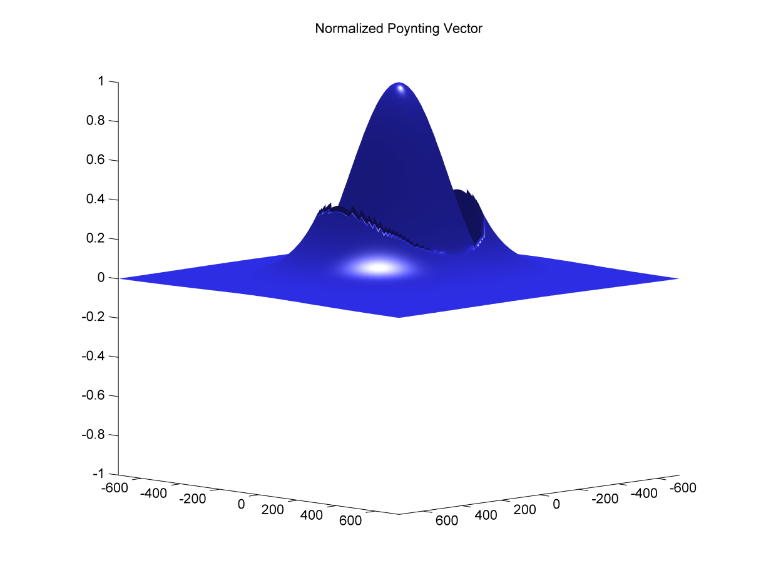
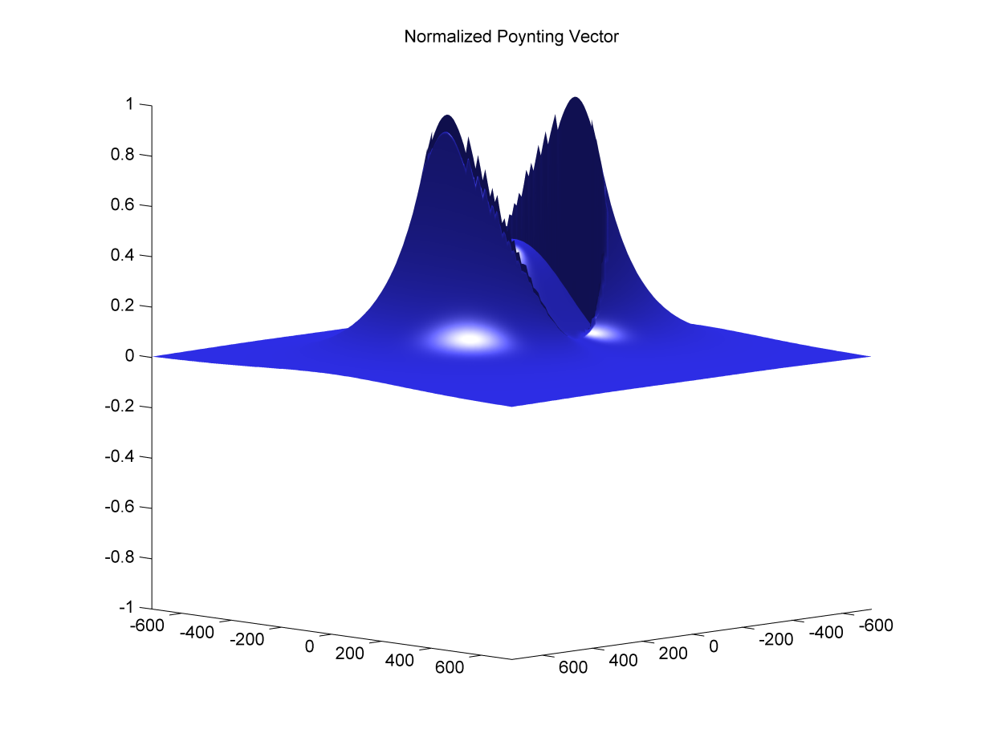
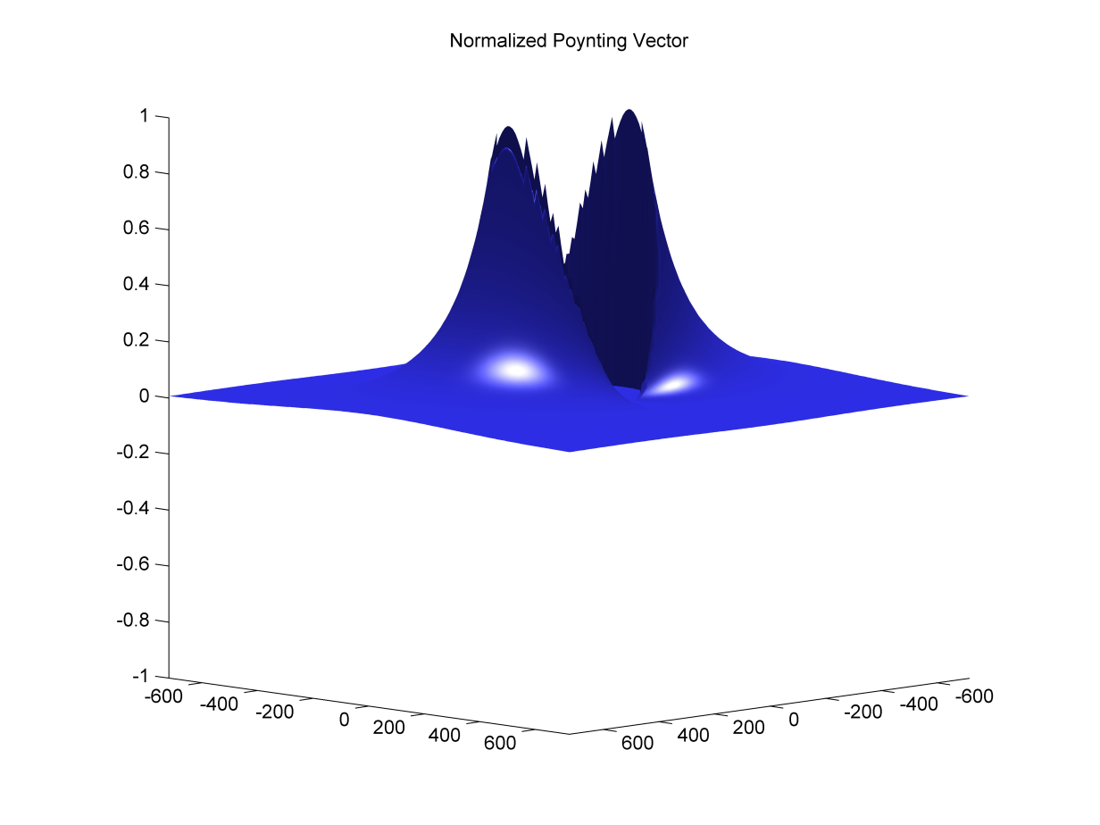
Silica glass nanowaveguides
HE_{11x}
x

Slide 7
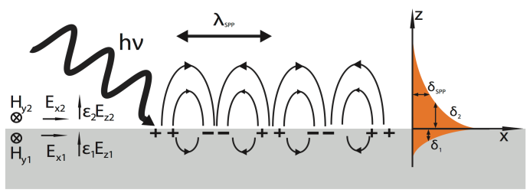
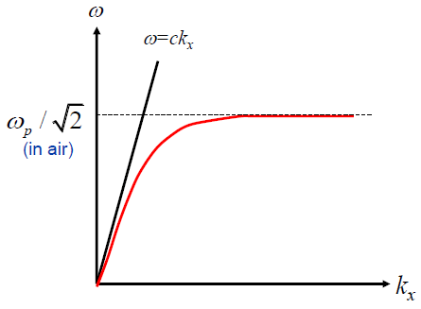
Surface Plasmon
The Drude Model
Confine electromagnetic field below diffraction limit
Dielectric
e → electronic charge ;
m_{e} →the effective mass of free electrons;
Г → damping Coefficient ;
E →amplitude of the incident electric field
ω→frequency of incident field
Metal
plasmons are collective oscillations of the free electron as density.
Surface Plasmon polariton: coupling between the EM wave & free electron movement on the metal surface.
Surface plasmon polaritons only exist for TM polarization.
Polarization =
N →free electron concentration
S. A. Maier, Plasmonics : Fundamentals and applications , Springer, 2007

Slide 8
Optical Interconnects at Telecom Wavelength
Major Goals
Miniaturization of Devices
Tunable Device
Problems
Poor EO of Si
Diffraction Limit
Solutions
Graphene

Slide 9
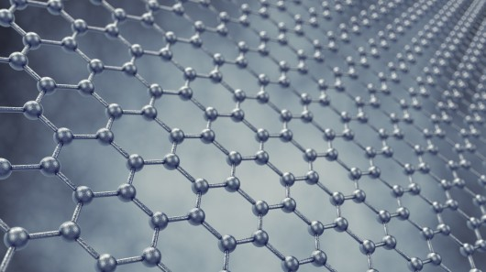
Energy Band Diagram of Graphene
Energy (E)
n-doped
p-doped
Momentum (k)
Fermi level
Chemical Potential
Kubo’s formula
Fermi-Dirac distribution
=0.34 nm, thickness of mono layer graphene
Intraband Contribution
Interband Contribution
V
ε_{ox}
d_{ox}
Chemical Potential
Chemical Potential (eV)
e_{ox} dielectric constant
d_{ox} thickness of SiO₂ layer
V_{D} Dirac voltage
Fermi velocity
V-V_{dirc}
G. W. Hanson, J. Appl. Phys, 103, 064302.

Slide 10
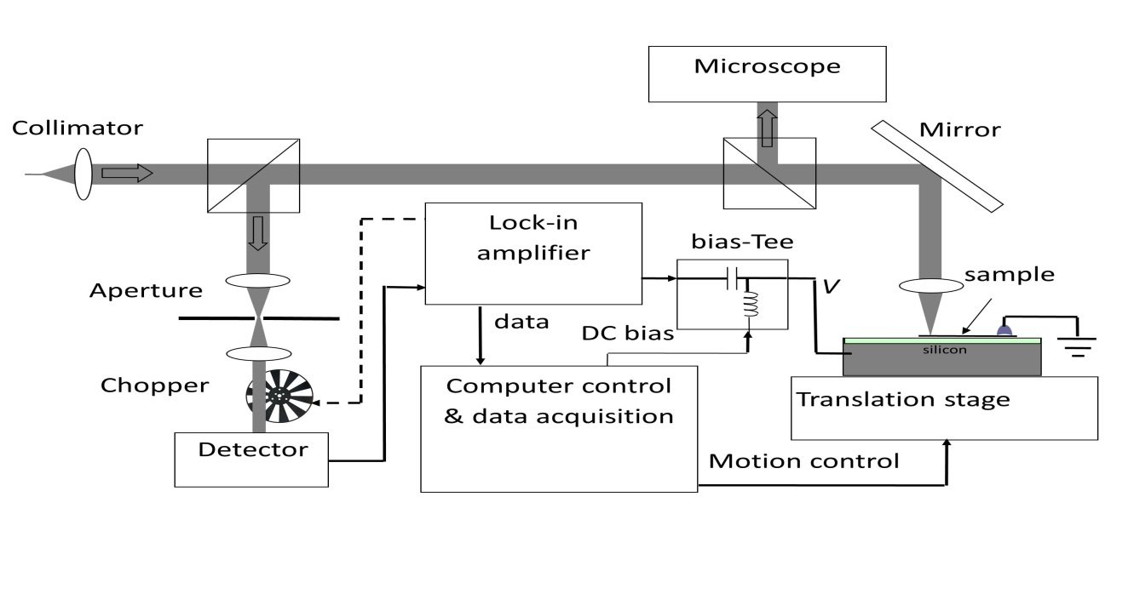
Experimental Setup for Graphene Characterization
n_{ox}
n_{s}
d_{ox}=95 nm
V

Slide 11
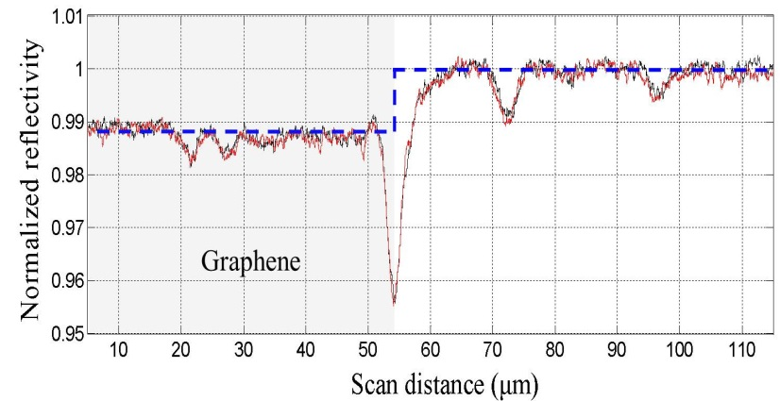
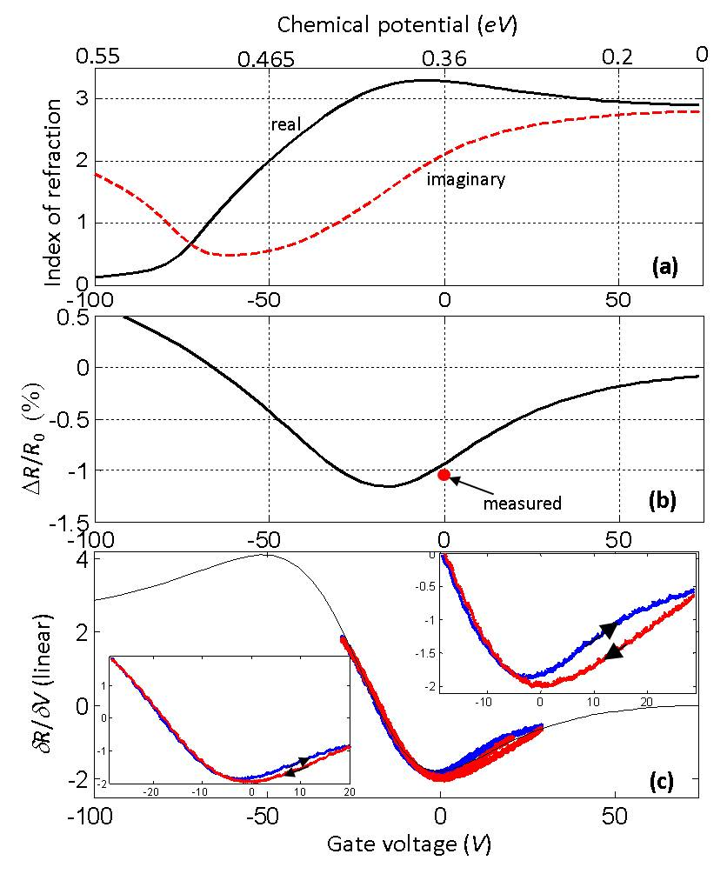
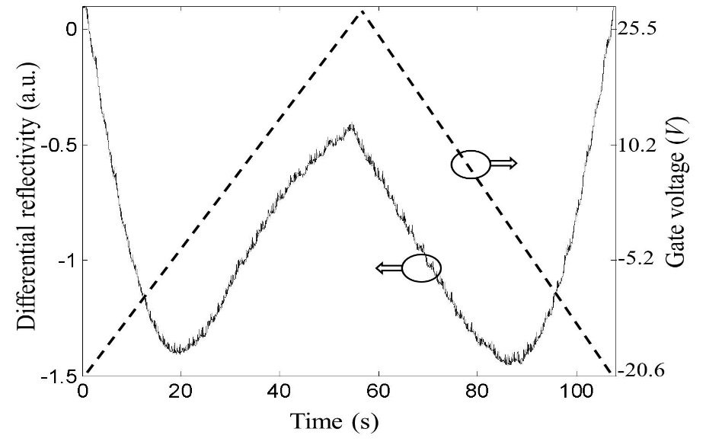
Result and Discussion
n_{ox}
n_{s}
d_{ox}

Slide 12
Optical Interconnects at Telecom Wavelength
Major Goals
Miniaturization of Devices
Tunable Device
Problems
Poor EO of Si
Diffraction Limit
Solutions
Graphene
Field Enhancement
Other Material
Vanadium di-Oxide

Slide 13
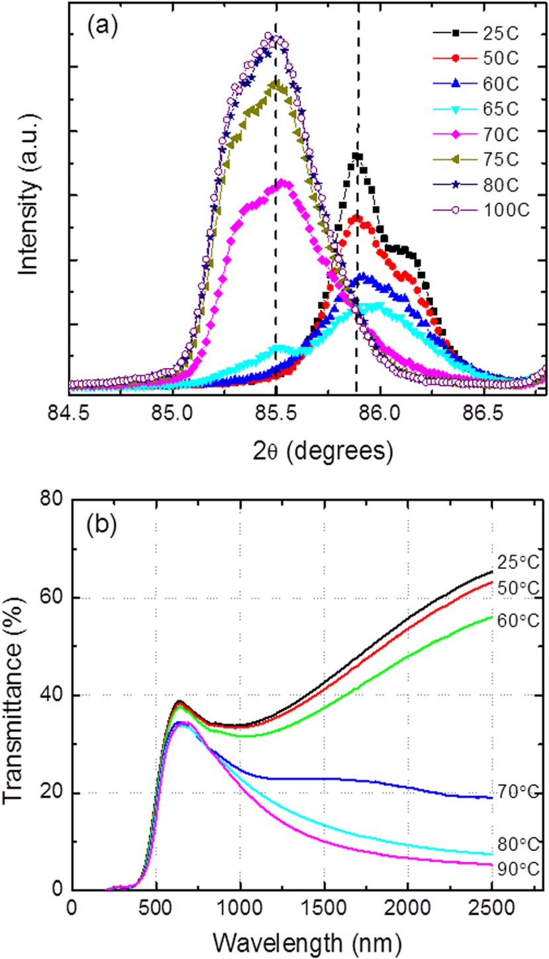
Transmission Characteristics
Kim, H., et al., Applied Physics Letters, 104, 081913

Slide 14
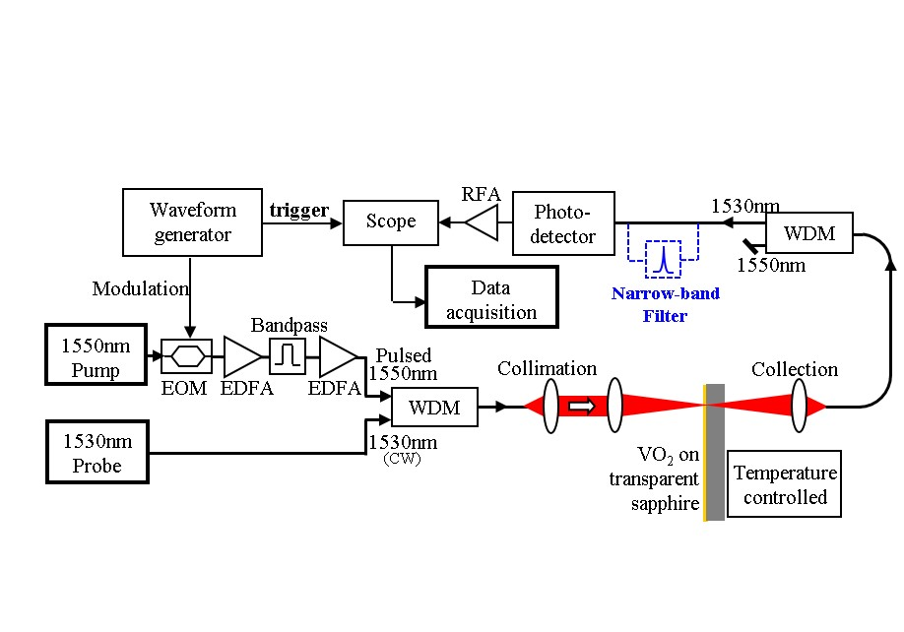
Experimental Setup for Vanadium di-Oxide
WDM: Wavelength division multiplexer/demultiplexer between 1530nm and 1550nm.
EOM: electro-optic modulator,
EDFA: erbium-doped optical amplifier,
RFA: radio frequency amplifier

Slide 15
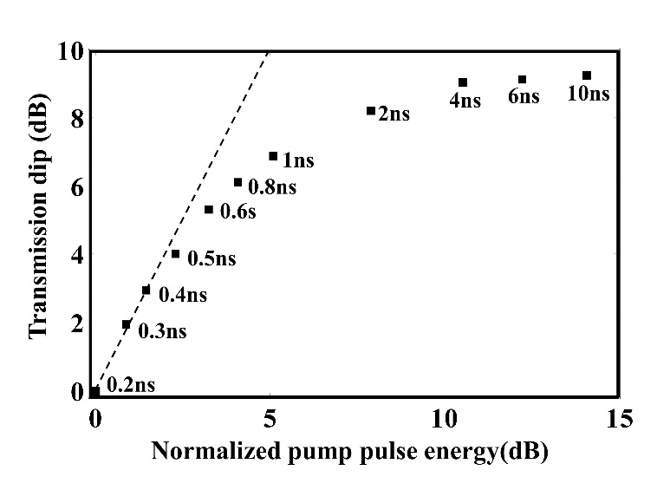
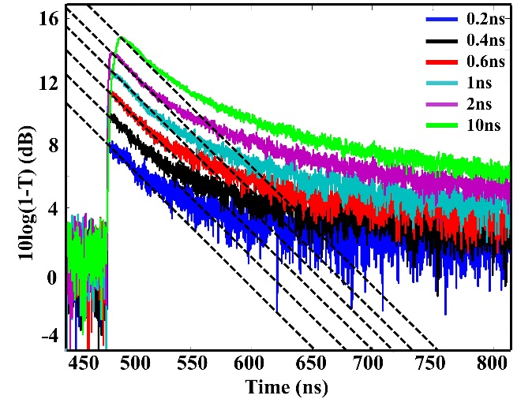
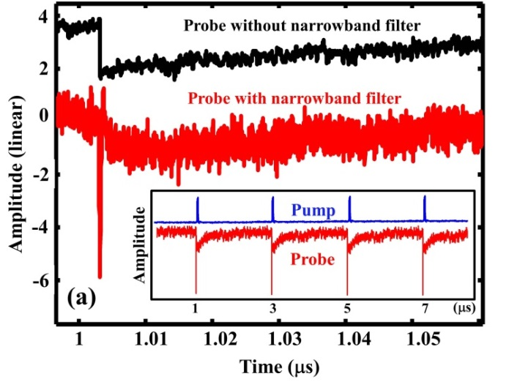
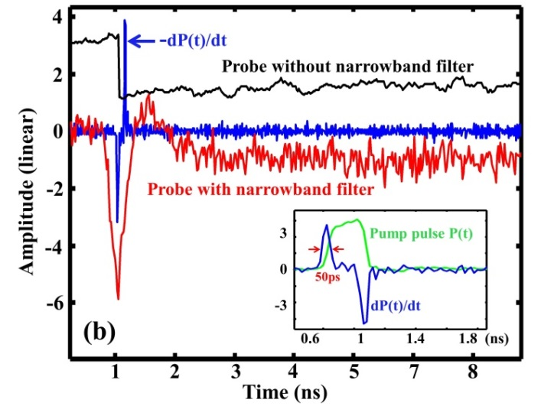
Result and Discussion
d = 200nm
n_{m} = 1.977+j2.53
n_{s} = 3.243+j0.346
Notes:
Recovery time

Slide 16
Optical Interconnects at Telecom Wavelength
Major Goals
Miniaturization of Devices
Tunable Device
Problems
Poor EO of Si
Diffraction Limit
Solutions
Graphene
Vanadium dioxide
Solutions → Plasmonics
Field Enhancement
Problem → Too high ε_{r} NIR (Au/Ag)
Solution → ITO

Slide 17
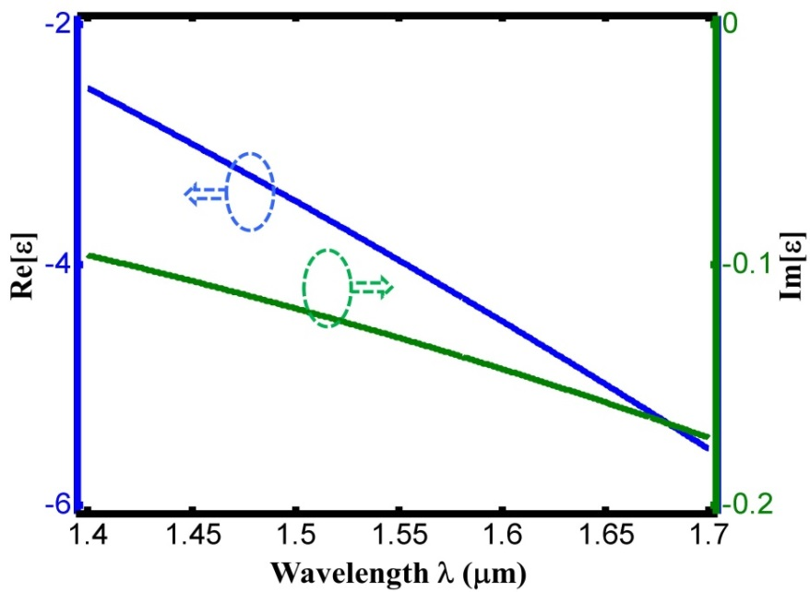
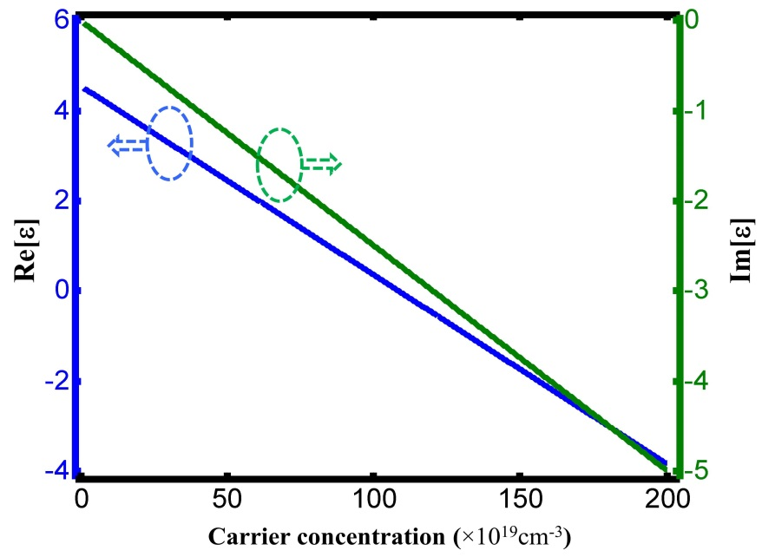
Indium Tin Oxide
/m³, with modeling parameters
eV
THz
E. Feignbaum, K. Diest, and H. A. Atwater, Nano Letters, 10, 2111.

Slide 18
Optical Interconnects at Telecom Wavelength
Major Goals
Miniaturization of Devices
Tunable Device
Problems
Poor EO of Si
Diffraction Limit
Solutions
Graphene
Vanadium dioxide
Solutions → Plasmonics
Problem → Too high ε_{r} NIR (Au/Ag)
Solution → ITO
Field Enhancement
Optical Devices
  NIR Electro Optic Modulator based on Graphene

Slide 19
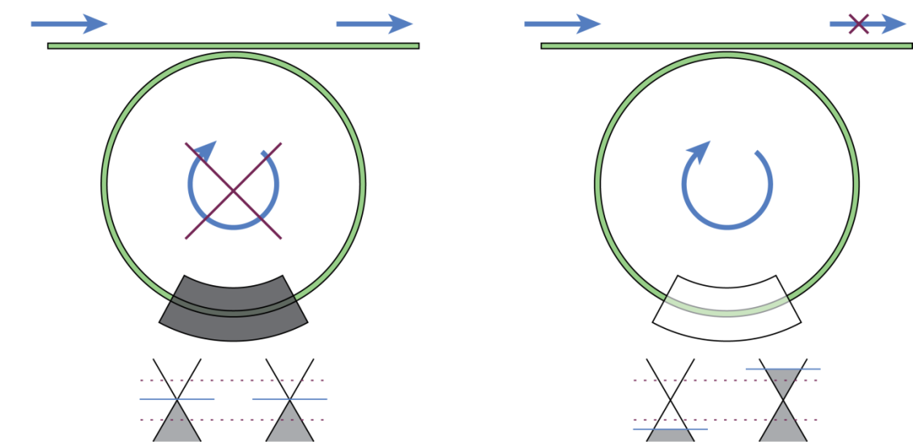
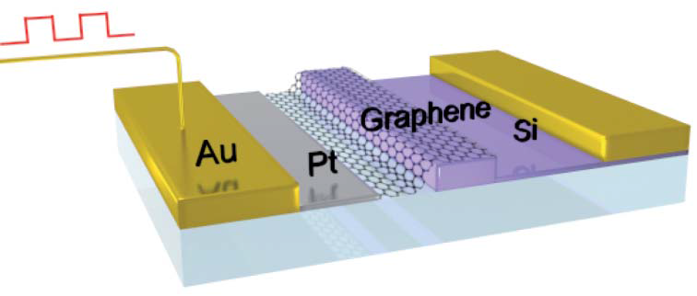
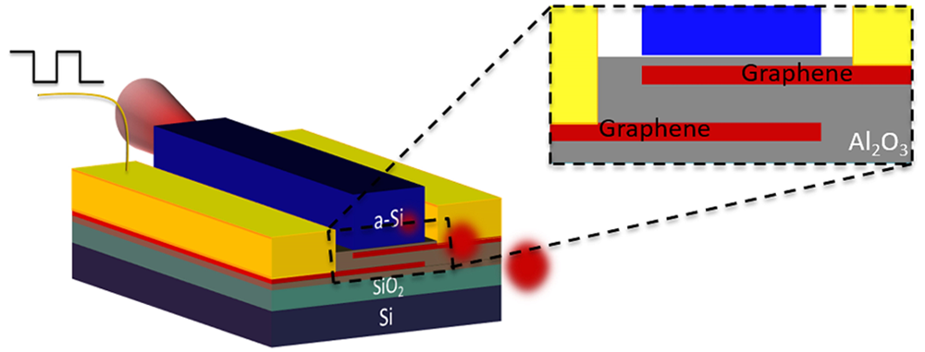
Review of ongoing trend
M. Liu, et. al. Nat. 474,64-67( 2011)
C. T. Phare, ,et al, Nat. Photonics, 9,2015
H. Dalir, ,et al, ACS . Photonics, 3,2016

Slide 20
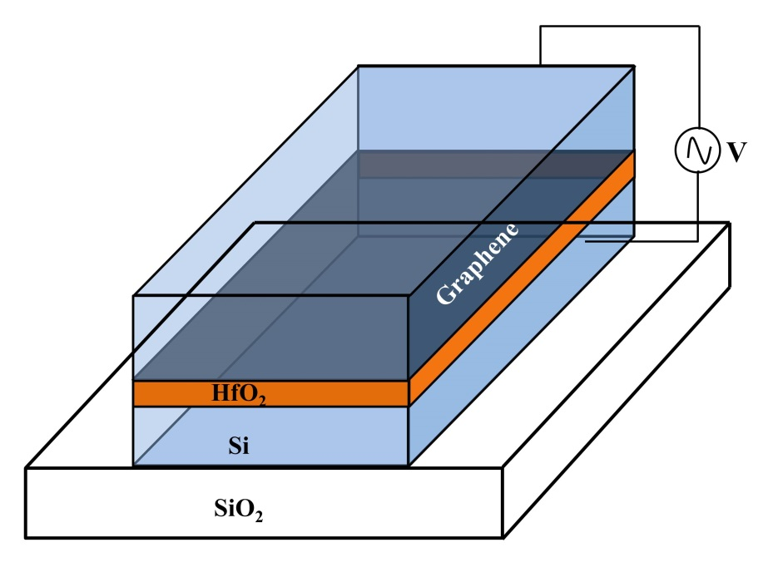
Graphene -waveguide
0.5eV
at 1550 nm
0eV

Slide 21
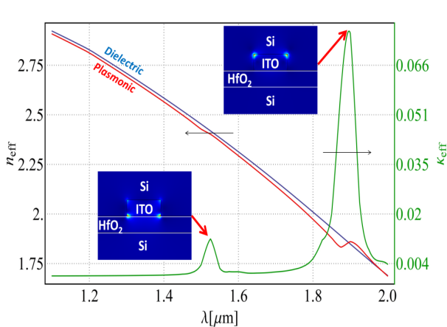
Schematic Diagram
420 nm x 300nm
10nm HfO₂
Separation between ITO bars = 10nm
Mode Profile

Slide 22
Optimization
Performance

Slide 23
Optical Interconnects at Telecom Wavelength
Major Goals
Miniaturization of Devices
Tunable Device
Problems
Poor EO of Si
Diffraction Limit
Solutions
Graphene
Vanadium dioxide
Solutions → Plasmonics
Problem → Too high ε_{r} NIR (Au/Ag)
Solution → ITO
Optical Devices
  NIR Electro Optic Modulator based on Graphene
  Mode-Multiplexed Modulator

Slide 24
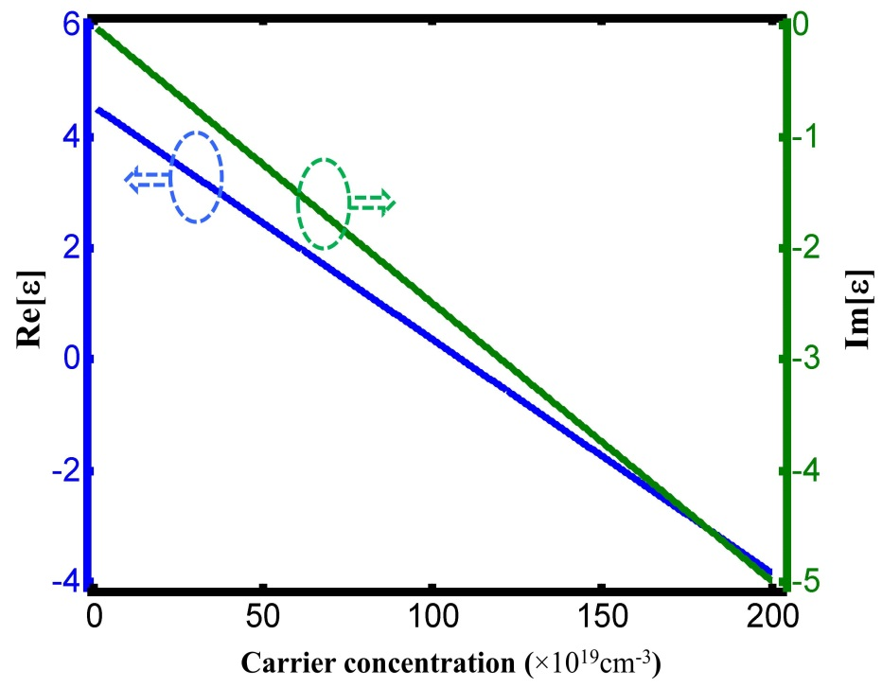
ENZ- field enhancement
ITO
ε₂
D₂
ε₁
D₁
Electric displacement
D₁=D₂
ε₁ E₁ = ε₂ E₂

Slide 25
Review of ongoing trend
A. Melikyan, et. al. Optics Express, 19 (9), 8855-8869 (2011).
H. Zhao, et. al., IEEE JSTQE, 21 (4), PP. 3300207 (2015).
V. J. Sorger, et. al., Nanophotonics. 1 (1),17–22 (2012).

Slide 26
Modal Dichroism
Mode 1
Mode 2
Spatially Localized Absorption Mechanism
Only TE Mode
Max with Min

Slide 27
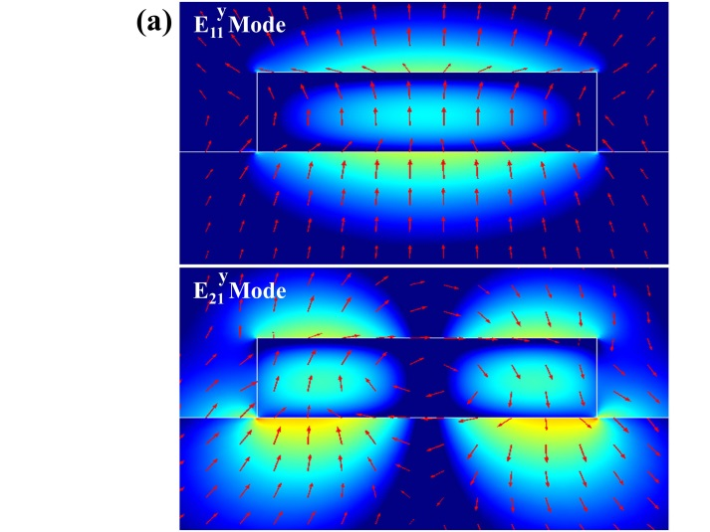
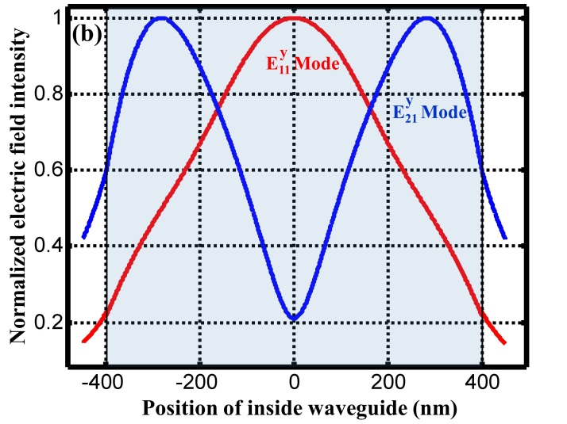
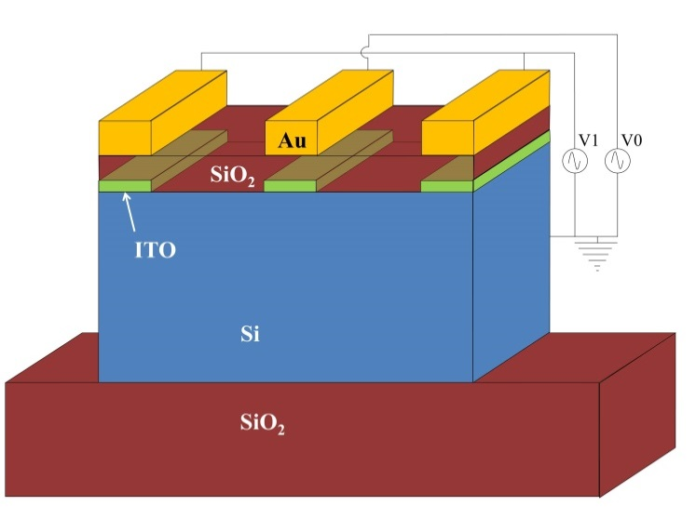
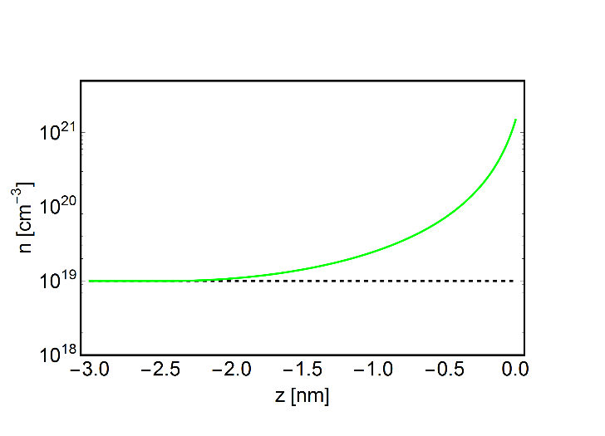
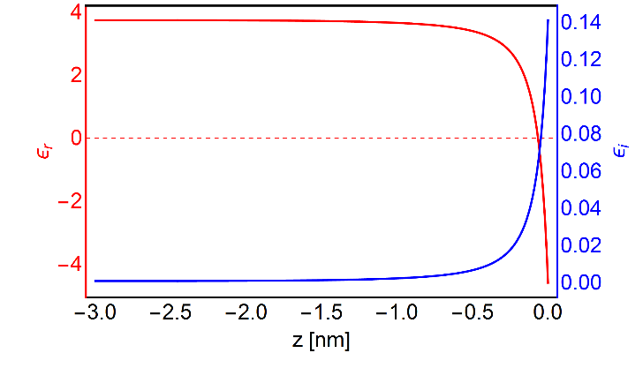
Schematic Diagram and Mode profile
800 nm x 240nm
20nm SiO2
ITO bars
thickness= 10nm
ITO under Potential
Accumulated electron concentration
Space dependent permittivity

Slide 28
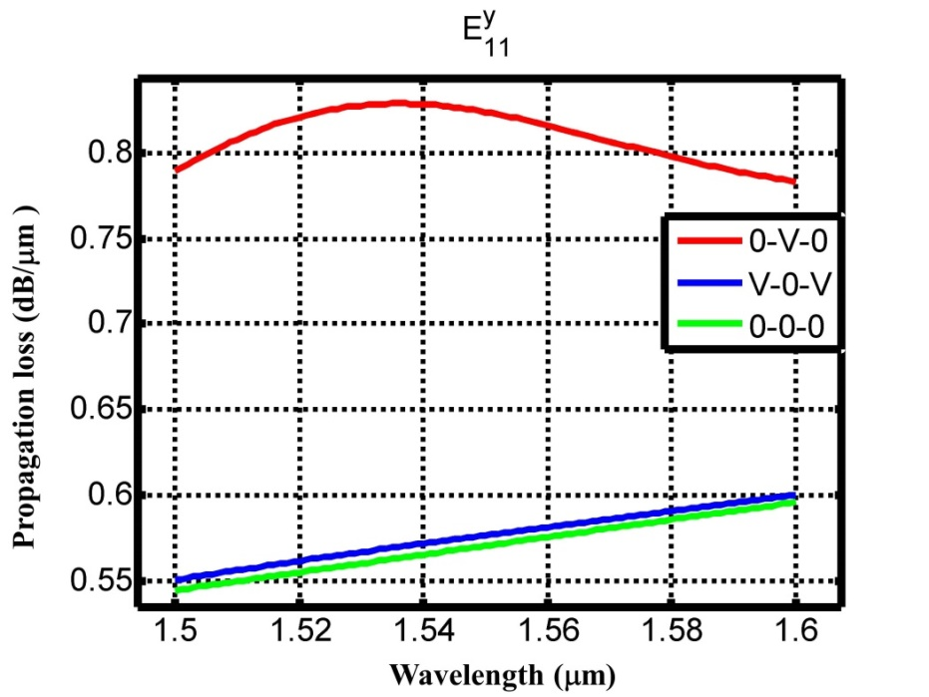
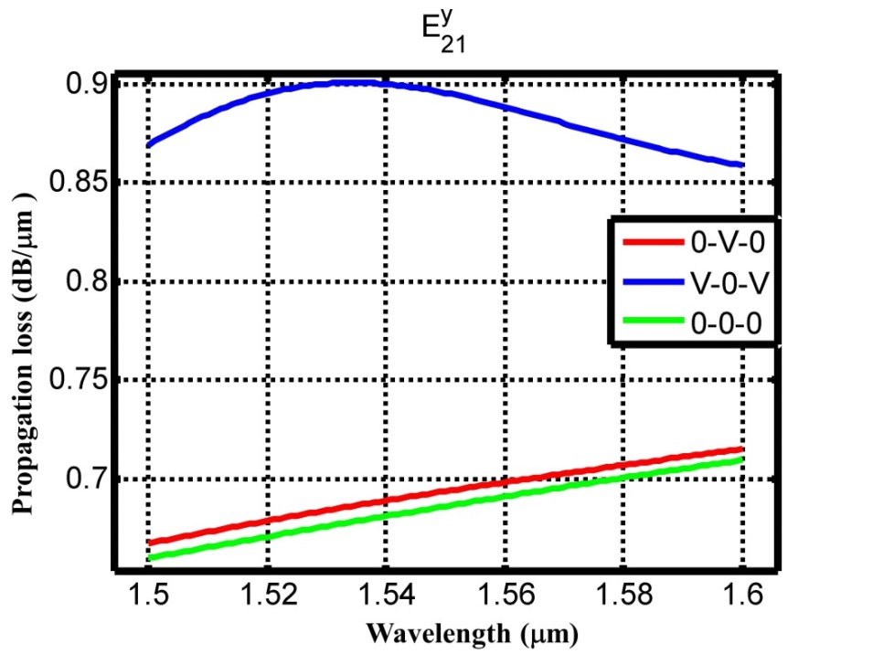
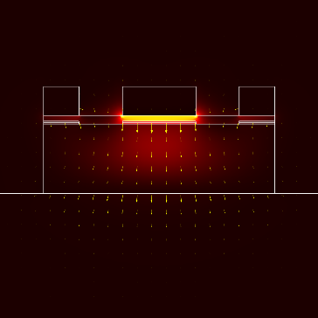
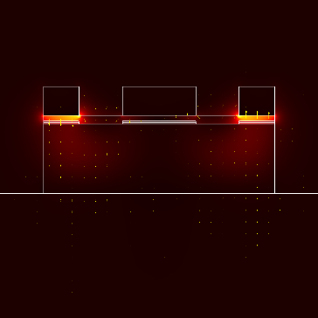
Modulation Scheme
Field Distribution

Slide 29
Optical Interconnects at Telecom Wavelength
Major Goals
Miniaturization of Devices
Tunable Device
Problems
Poor EO of Si
Diffraction Limit
Solutions
Graphene
Vanadium dioxide
Solutions → Plasmonics
Problem → Too high ε_{r} NIR (Au/Ag)
Solution → ITO
  NIR Electro Optic Modulator based on Graphene
Optical Devices
  Mode-Multiplexed Modulator
  Metamaterial Assisted Coupler

Slide 30
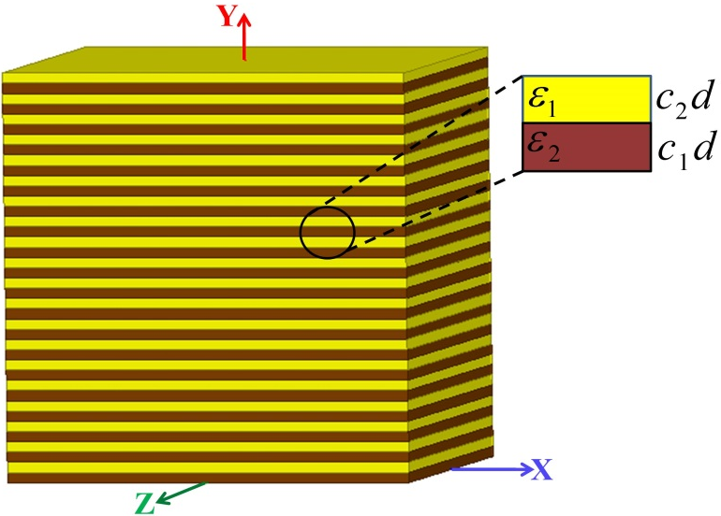
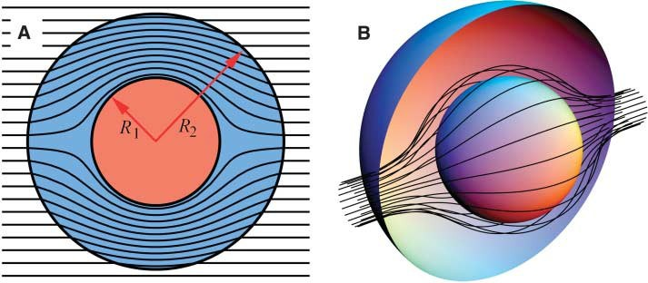
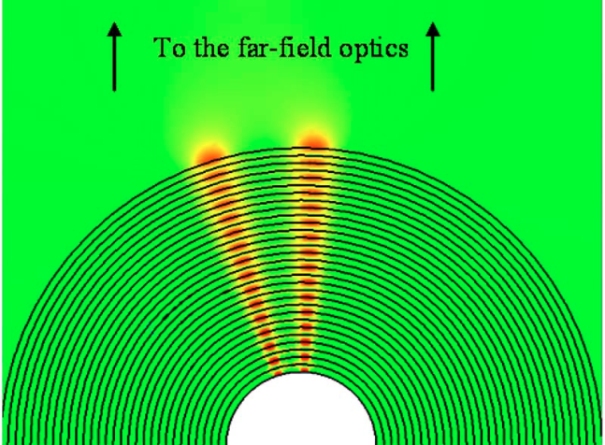
Complex Media
Review of ongoing trend
J. B. Pendry et.. al. Science , 3121, 780 (2006)
A. Salandrino, N. Engheta, PRB, 74, 075103 (2006)

Slide 31
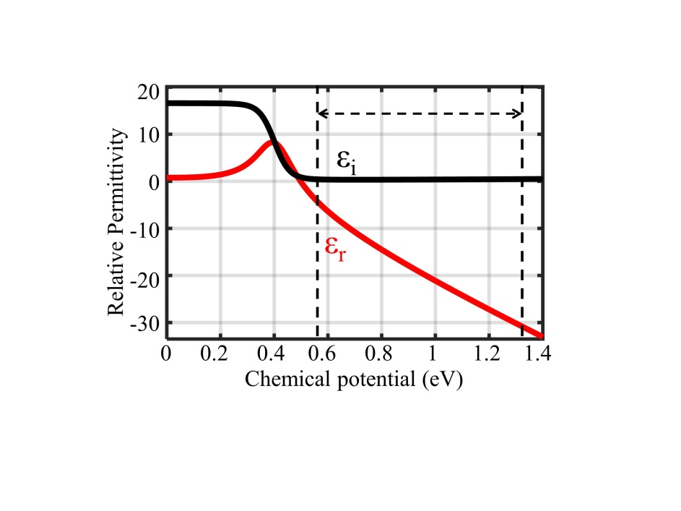
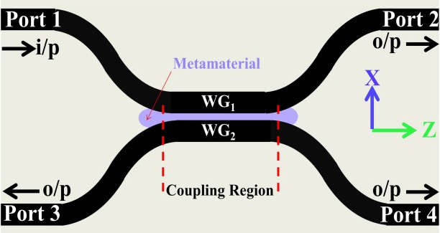
Tunable Metamaterial
Graphene permittivity
at 1550 nm
Periodicity: 3nm
HfO₂/Graphene
Schematic of Coupler

Slide 32
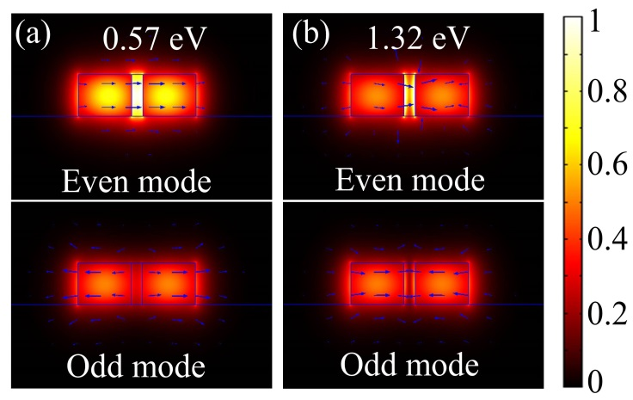
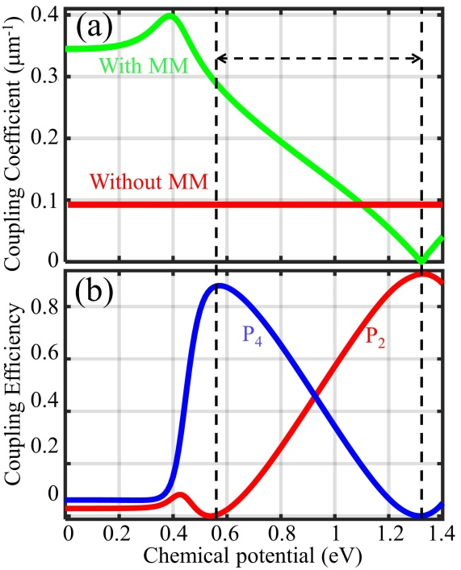
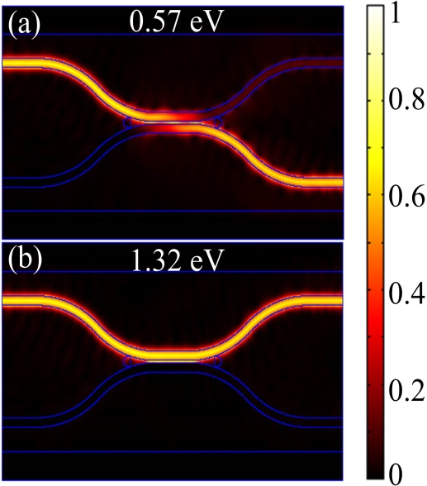
Coupling Scheme
Field Distribution

Slide 33
Outline
Material Characterization
  Graphene
    Experimental Setup
    Result and Discussion
  Indium Tin Oxide
  Vanadium di-Oxide
    Transmission Characteristics
    Experimental Setup
    Result and discussion
Optical Devices
  NIR Electro Optic Modulator based on Graphene
  Mode-Multiplexed Modulator
  Metamaterial Assisted Coupler
Conclusion
Future work
  Exploration of novel photonic structures based on surface plasmonics
  Metamaerial assisted optical devices
  Tunability in Terahertz region with patterned Graphene configuration

Slide 34

Conclusion
Tunability of graphene with applied external voltage
DMT of VO₂ and optical short pulse conversion
  NIR Electro Optic Modulator based on Graphene
  Mode-Multiplexed Modulator
  Metamaterial Assisted Coupler

Slide 35
Outline
Material Characterization
  Graphene
    Experimental Setup
    Result and Discussion
  Indium Tin Oxide
  Vanadium di-Oxide
    Transmission Characteristics
    Experimental Setup
    Result and discussion
Optical Devices
  NIR Electro Optic Modulator based on Graphene
  Mode-Multiplexed Modulator
  Metamaterial Assisted Coupler
Conclusion
Future work
  Exploration of novel photonic structures based on surface plasmonics
  Metamaerial assisted optical devices
  Tunability in Terahertz region with patterned Graphene configuration

Slide 36
Future Work
  Exploration of novel photonic structures based on surface plasmonics
  Metamaerial assisted optical devices
  Tunability in Terahertz region with patterned Graphene configuration

Slide 37
Publication
JOURNAL ARTICLES
R. Goul, S. Das, Q. Liu, et al, “Quantitative analysis of surface enhanced Raman spectroscopy of Rhodamine 6G using a composite graphene and plasmonic Au nanoparticle substrate” Carbon, Vol. 111, pp. 386-392, 2017
S. Das, S. Fardad, I. Kim, J. Rho, R. Hui, and A. salandrino, “ Nanophotonic Modal Dichroism: Mode-Multiplexed Modulators Optics Letters, Vol. 41, No. 18, pp. 4394-4397, 2016.
S. Fardad, S. Das, A. salandrino, E. Breckenfeld, H Kim, J. wu, and R. Hui1,”All-optical short pulse translation through cross-phase modulation in a VO₂ thin film” , Optics Letters, Vol. 41, No. 2, pp. 238-241, 2016.
X. Wang, S. Fardad, S. Das, A. Salandrino, and R. Hui, “Direct Observation of Bulk Second Harmonic Generation inside a Glass Slide with Tightly Focused Optical Fields” Physical Review B 93, 161109(R), 2016
S. Das, A. Salandrino, J. Z. Wu,and R. Hui,”Near-infrared electro-optic modulator based on plasmonic graphene” Optics letters ,Vol. 40, No. 7 , pp. 1516-1519, 2015.
F. Xu, S. Das, Y. Gong, Q. Liu, H. C. Chien, H. Y. Chiu, et al., "Complex refractive index tunability of graphene at 1550 nm wavelength," Applied Physics Letters, vol. 106, p. 031109, 2015.
S.Das, J. Li and R. Hui, “Simulation of the Impact of Si Shell Thickness on the Performance of Si-Coated Vertically Aligned Carbon Nanofiber as Li-Ion Battery Anode” Nanomaterials, Vol. 5, pp. 2268-2278, 2015.
CONFERENCES PRESENTATIONS
S.Das, J. Li and R. Hui, “Impact of Electrode Surface/Volume Ratio on Li-ion Battery Performance” the Proceedings of the 2014 COMSOL Conference in Boston.

Slide 38


Slide 39


