Slide 1
Embracing Uncertainty to Enable Physically Meaningful Signal Processing
Shannon D. Blunt
Roy A. Roberts Distinguished Professor of EECS
Director, Radar Systems & Remote Sensing Lab (RSL)
Director, Kansas Applied Research Lab (KARL)
University of Kansas, Lawrence, KS
www.eecs.ku.edu/shannon-blunt

Slide 2
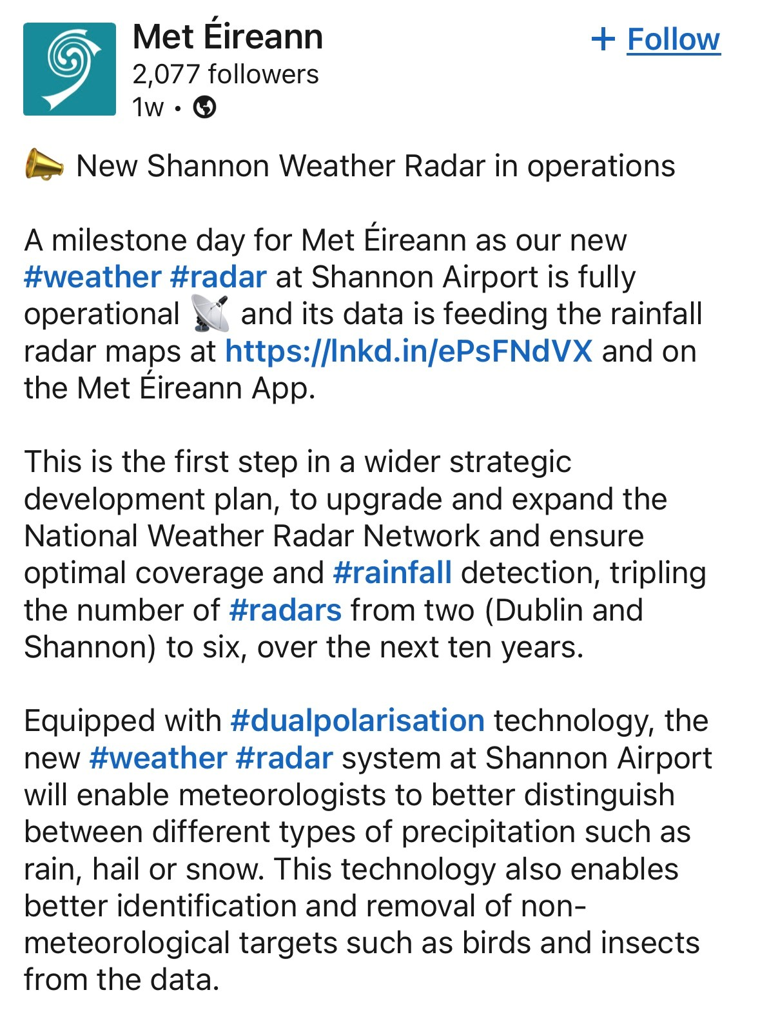
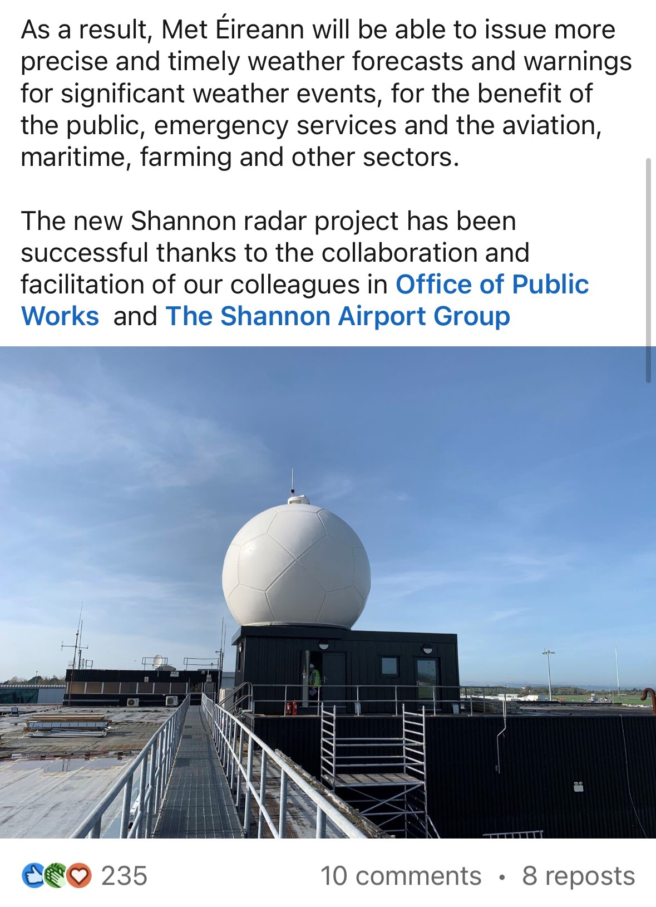
Thank you, Ireland

Slide 3
Some thanks are in order …
To KU administration for continued support of defense research

Slide 4
Some thanks are in order …
To KU administration for continued support of defense research
To mentors & colleagues @ KU and beyond

Slide 5
Some thanks are in order …
To KU administration for continued support of defense research
To mentors & colleagues @ KU and beyond
To our incredible staff – “above & beyond” is their status quo

Slide 6
Some thanks are in order …
To KU administration for continued support of defense research
To mentors & colleagues @ KU and beyond
To our incredible staff – “above & beyond” is their status quo
To our students – making me look good since 2005

Slide 7
Some thanks are in order …
To KU administration for continued support of defense research
To mentors & colleagues @ KU and beyond
To our incredible staff – “above & beyond” is their status quo
To our students – making me look good since 2005
To my family – for unending patience with this gEEk

Slide 8
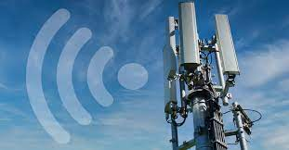
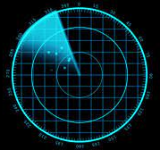
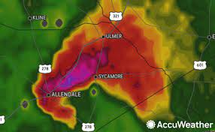
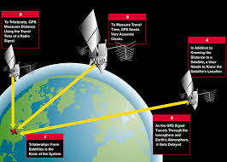
Signal processing:
“Operationalizing” of applied mathematics in hardware, often with a real-time requirement
Borrows from linear systems theory, optimization theory, estimation/detection theory, control theory, and more
A fundamental enabler of cellular communications, many forms of sensing, GPS navigation, and much more

Slide 9

Uncertainty:
The mathematical way of saying “I think so, but am not completely sure”
A formal area of research in applied math
In the engineering context, the generalization of component/subsystem “tolerances”

Slide 10
Uncertainty:
The mathematical way of saying “I think so, but am not completely sure”
A formal area of research in applied math
In the engineering context, the generalization of component/subsystem “tolerances”
Given far too little attention in signal processing (especially in research)

Slide 11
Wise words that influenced me (per Arvin’s expectation of “wise things”)

Slide 12
“You are all ignorant”
− Mr. Medling, 7th grade Social Studies
New Madrid Junior High

Slide 13
“You are all ignorant”
− Mr. Medling, 7th grade Social Studies
New Madrid Junior High

Slide 14
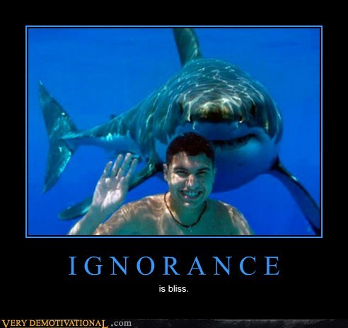
“You are all ignorant”
− Mr. Medling, 7th grade Social Studies
New Madrid Junior High
is bliss
His point: strive to become less so

Slide 15
“I don’t understand this magic you are doing … but it won’t work”
− Vilhelm Gregers-Hansen,
Radar Division, Naval Research Lab
(in 2003)

Slide 16
“I don’t understand this magic you are doing … but it won’t work”
− Vilhelm Gregers-Hansen,
Radar Division, Naval Research Lab
(in 2003)
Years later, led to several 1st-of-their kind research demos … after determining how to replace said “magic” with reality

Slide 17
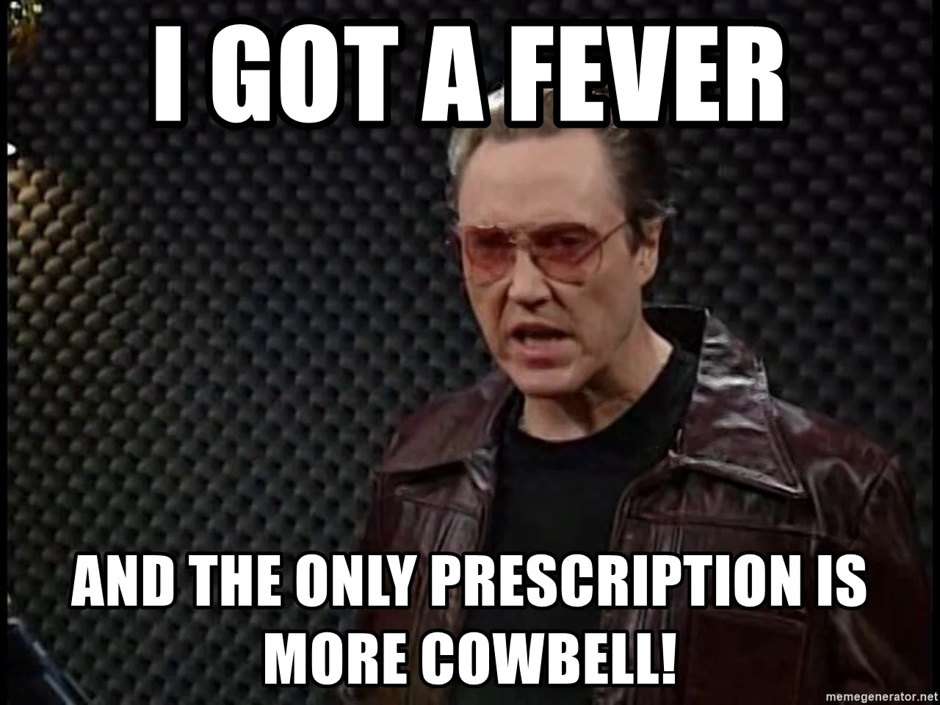
“Needs more cowbell”
“Few, but ripe”
(personal motto of famed mathematician Carl Friedrich Gauss)
− Dr. Karl Gerlach,
Radar Division, Naval Research Lab

Slide 18
“Needs more cowbell”
“Few, but ripe”
(personal motto of famed mathematician Carl Friedrich Gauss)
− Dr. Karl Gerlach,
Radar Division, Naval Research Lab
More ≠ better.
Research impact is not a numbers game.

Slide 19
Into the weeds
In recent years, KU RSL has made numerous advances on:
Complex waveforms
Embedding communications into radar emissions
Adaptive receive signal processing
Experimentally validated
with open-air measurements
19

Slide 20
Into the weeds
In recent years, KU RSL has made numerous advances on:
Complex waveforms
Embedding communications into radar emissions
Adaptive receive signal processing
Enabled by more tightly coupling theoretical signal processing (SP) to hardware experimentation → physically-meaningful SP
Expanding & accelerating transitions into operational radar/sonar systems, and even realizing new sensing modes
Experimentally validated
with open-air measurements
Innovate
faster!
20

Slide 21
On knowing (or not)

Slide 22
A wee bit of math
A simple linear algebra model (that shows up everywhere)
y = A x + v
22

Slide 23
A wee bit of math
y = A x + v
Known model
Based on prior data, physics, modeling
“Unknowables”
Model error / noise
Observations
the data we see / collect
Unknowns
The variables we seek to estimate (i.e. an inverse problem)
23

Slide 24
A wee bit of math
y = A x + v
Known model
Based on prior data, physics, modeling
“Unknowables”
Model error / noise
Observations
the data we see / collect
Unknowns
The variables we seek to estimate (i.e. an inverse problem)
While problems/semantics may vary, this form is ubiquitous
24

Slide 25
Just one little issue
“All models are wrong, but some are useful”
Prof. George Box, Statistician
University of Wisconsin
25

Slide 26
A smidge more math
y = A x + v
Our model:
26

Slide 27
A smidge more math
y = A x + v
Our model:
~
y = A x + v
A
Reality:
27

Slide 28
A smidge more math
y = A x + v
Our model:
~
~
y = A x + v
A
x
Reality:
28

Slide 29
A smidge more math
y = A x + v
Our model:
~
~
y = A x + v
A
x
Reality:
But this last term already represented “unknowable” model error, so what’s the big deal?
29

Slide 30
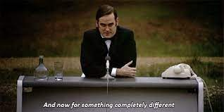
Interlude: a matter of perspective
And now for something completely different

Slide 31

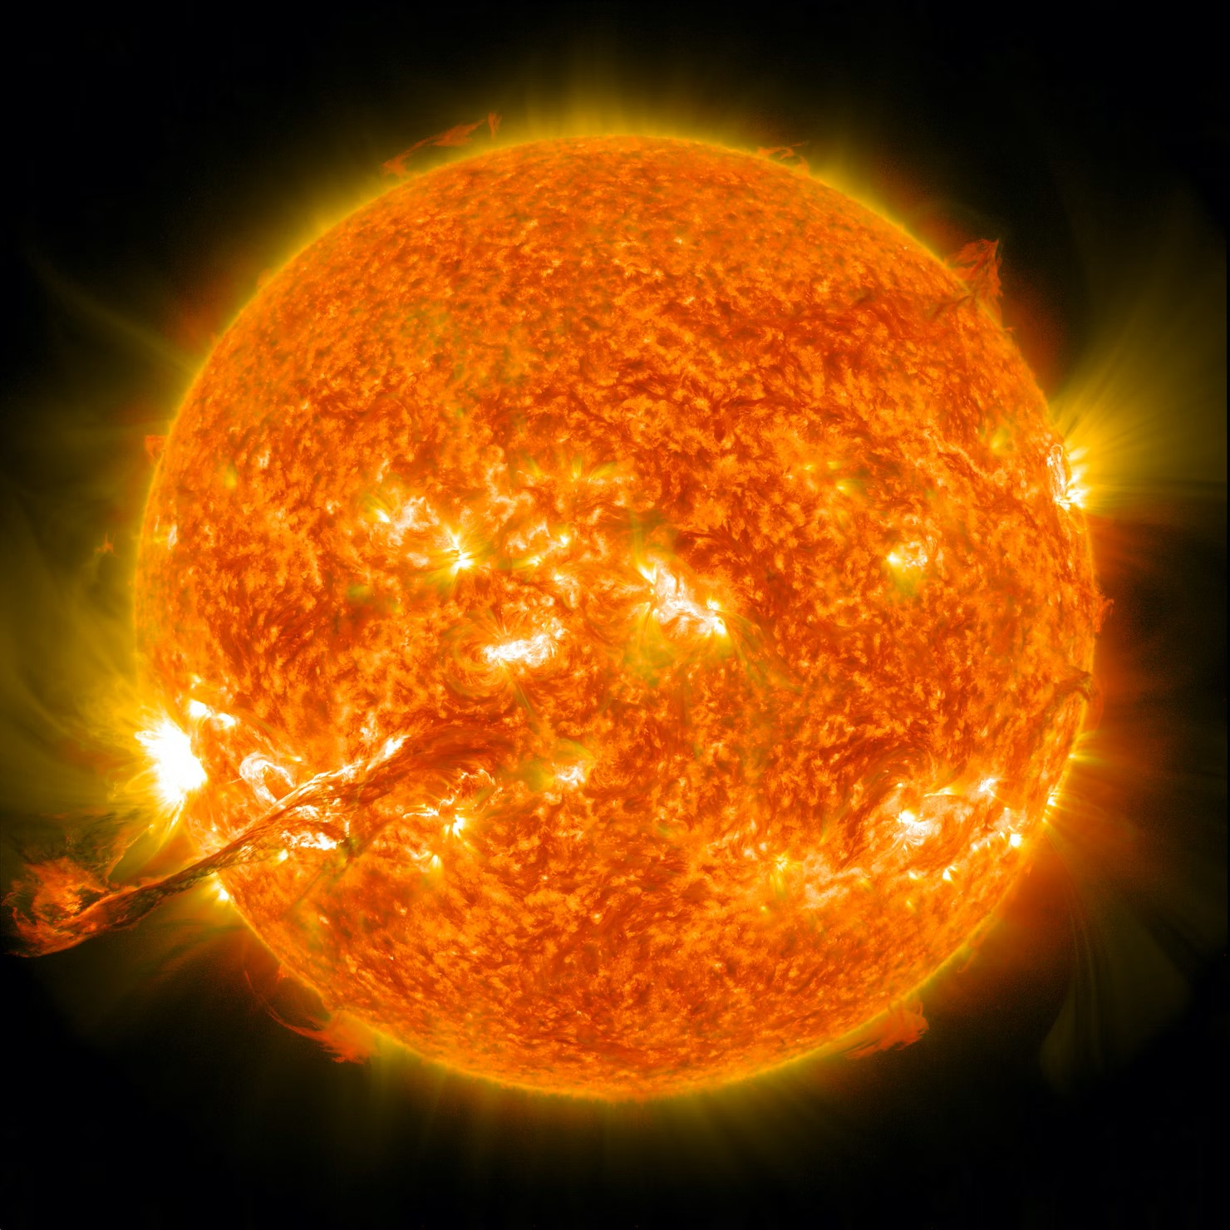

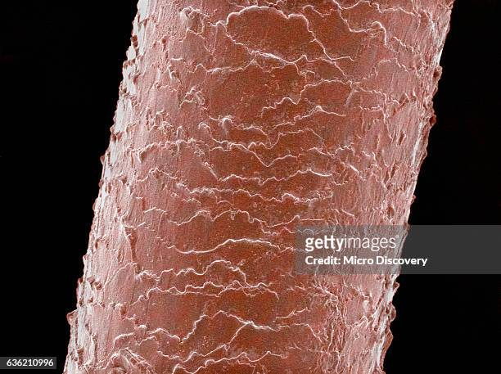
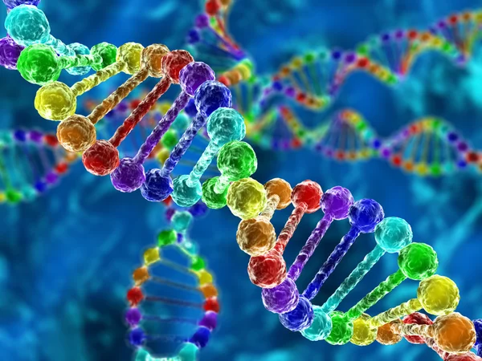

Observable universe: ~10²⁶ m
Milky Way galaxy: ~10²¹ m
Our solar system: ~10¹³ m
Diameter of the sun: ~10⁹ m
Diameter of Earth: ~10⁷ m
10⁴⁴
KU campus: ~10³ m
Height of a person: ~10⁰ m
Thickness human hair: ~10 ⁻⁵ m
Diameter of DNA: ~10 ⁻⁹ m
Nucleus of an atom: ~10 ⁻¹⁵ m
Size of an electron: ~10 ⁻¹⁸ m

Slide 32
By comparison, the power span for radar is barely gigantic
Observable universe: ~10²⁶ m
Milky Way galaxy: ~10²¹ m
Our solar system: ~10¹³ m
Diameter of the sun: ~10⁹ m
Highest radar transmit power: ~10⁶ W
Diameter of Earth: ~10⁷ m
10⁴⁴
KU campus: ~10³ m
Height of a person: ~10⁰ m
10²⁴
Thickness human hair: ~10 ⁻⁵ m
Diameter of DNA: ~10 ⁻⁹ m
Nucleus of an atom: ~10 ⁻¹⁵ m
Lowest radar receive power: ~10⁻¹⁸ W
Size of an electron: ~10 ⁻¹⁸ m

Slide 33
… and “only” 12 orders of magnitude may be needed on receive …
Observable universe: ~10²⁶ m
Milky Way galaxy: ~10²¹ m
Our solar system: ~10¹³ m
Diameter of the sun: ~10⁹ m
Highest radar transmit power: ~10⁶ W
Diameter of Earth: ~10⁷ m
10⁴⁴
KU campus: ~10³ m
Height of a person: ~10⁰ m
10²⁴
Thickness human hair: ~10 ⁻⁵ m
10¹²
Receiver “dynamic range” (without distortion)
Diameter of DNA: ~10 ⁻⁹ m
Nucleus of an atom: ~10 ⁻¹⁵ m
Lowest radar receive power: ~10⁻¹⁸ W
Size of an electron: ~10 ⁻¹⁸ m

Slide 34
Observable universe: ~10²⁶ m
Milky Way galaxy: ~10²¹ m
… and “only” 12 orders of magnitude may be needed on receive …
Our solar system: ~10¹³ m
Diameter of the sun: ~10⁹ m
Highest radar transmit power: ~10⁶ W
Diameter of Earth: ~10⁷ m
10⁴⁴
KU campus: ~10³ m
Height of a person: ~10⁰ m
10²⁴
Thickness human hair: ~10 ⁻⁵ m
10¹²
Receiver “dynamic range” (without distortion)
Diameter of DNA: ~10 ⁻⁹ m
Nucleus of an atom: ~10 ⁻¹⁵ m
Lowest radar receive power: ~10⁻¹⁸ W
Size of an electron: ~10 ⁻¹⁸ m
10¹² is one trillion … well less than the 33 trillion U.S. national debt (in $)

Slide 35
Though there is growing interference in the same frequency bands.
Observable universe: ~10²⁶ m
Milky Way galaxy: ~10²¹ m
Our solar system: ~10¹³ m
Diameter of the sun: ~10⁹ m
Highest radar transmit power: ~10⁶ W
Diameter of Earth: ~10⁷ m
10⁴⁴
Cellular base-station transmit power: ~10¹ W
KU campus: ~10³ m
Cell phone transmit power: ~10 ⁻¹ W
Height of a person: ~10⁰ m
10²⁴
Thickness human hair: ~10 ⁻⁵ m
10¹²
Receiver “dynamic range” (without distortion)
Diameter of DNA: ~10 ⁻⁹ m
Nucleus of an atom: ~10 ⁻¹⁵ m
Lowest radar receive power: ~10⁻¹⁸ W
Size of an electron: ~10 ⁻¹⁸ m

Slide 36
Though there is growing interference in the same frequency bands.
Observable universe: ~10²⁶ m
Milky Way galaxy: ~10²¹ m
Our solar system: ~10¹³ m
Diameter of the sun: ~10⁹ m
Highest radar transmit power: ~10⁶ W
Diameter of Earth: ~10⁷ m
10⁴⁴
Cellular base-station transmit power: ~10¹ W
KU campus: ~10³ m
Cell phone transmit power: ~10 ⁻¹ W
Height of a person: ~10⁰ m
10²⁴
Thickness human hair: ~10 ⁻⁵ m
10¹²
Receiver “dynamic range” (without distortion)
Diameter of DNA: ~10 ⁻⁹ m
Nucleus of an atom: ~10 ⁻¹⁵ m
Lowest radar receive power: ~10⁻¹⁸ W
Size of an electron: ~10 ⁻¹⁸ m
But at least there’s no distortion …

Slide 37
… umm …
Transmit/Receive distortion effects
Finite precision ADC/DAC effects
Power amplifier nonlinearities
Polarization (im)purity
Array gain/phase errors
Receiver nonlinearities & saturation effects
etc…
37

Slide 38
… umm …
Transmit/Receive distortion effects
Finite precision ADC/DAC effects
Power amplifier nonlinearities
Polarization (im)purity
Array gain/phase errors
Receiver nonlinearities & saturation effects
etc…
Student translation: JOB SECURITY!
38

Slide 39
Now that we have some perspective

Slide 40
The aftermath
y = A x + v
Our model:
~
~
y = A x + v
A
x
Reality:
Simple model error is not sufficient for advanced radar due to high dynamic range & distortion effects.
40

Slide 41
The aftermath
y = A x + v
Our model:
~
~
~
v
y = A x + v
A
x
Reality:
This uncertainty needs more careful consideration
41

Slide 42
The aftermath
y = A x + v
Our model:
~
~
~
v
y = A x + v
A
x
Reality:
And even the ‘addition’ is over-simplified
42

Slide 43
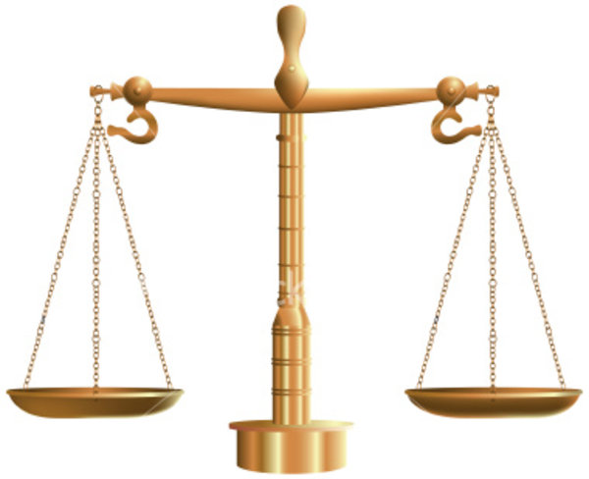
Put another way, signal processing algorithms “believe” the provided model (i.e. they are naïve)
Accounting for model uncertainty can therefore be viewed as incorporating prior ignorance
prior knowledge
prior ignorance

Slide 44
Put another way, signal processing algorithms “believe” the provided model (i.e. they are naïve)
Accounting for model uncertainty can therefore be viewed as incorporating prior ignorance
BTW, machine learning is signal processing with nonlinearities
prior knowledge
prior ignorance

Slide 45
For those more technically inclined
Model uncertainty approaches (some used in combination)
Over-sampling (reduce unavoidable aliasing)
Diagonal loading / regularization
Dynamic beamspoiling to address straddling & super-resolution
Enforce phase continuity (or at least minimize phase jumps)
Leverage hardware tolerances in the signal processing
RSL’s contribution: technical rigor for practical solutions
(i.e. connecting signal processing theory to physical reality)
45

Slide 46

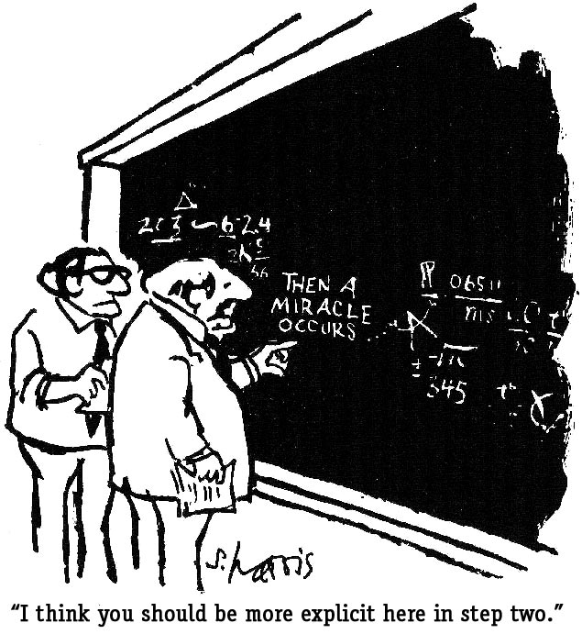

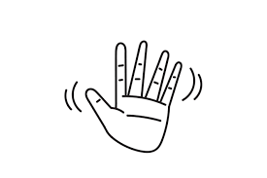
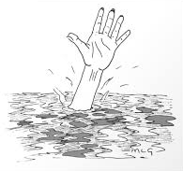
For the details … see papers
46

Slide 47
Does it work?

Slide 48
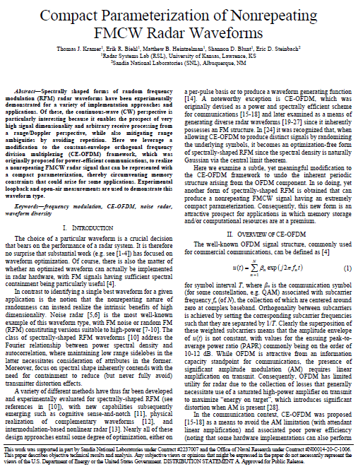
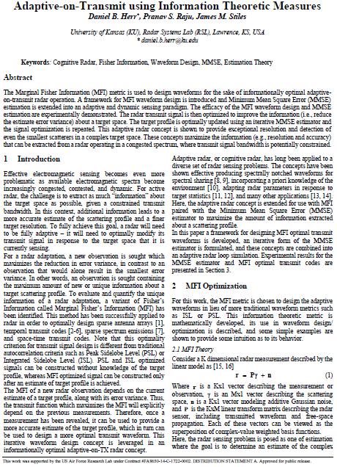
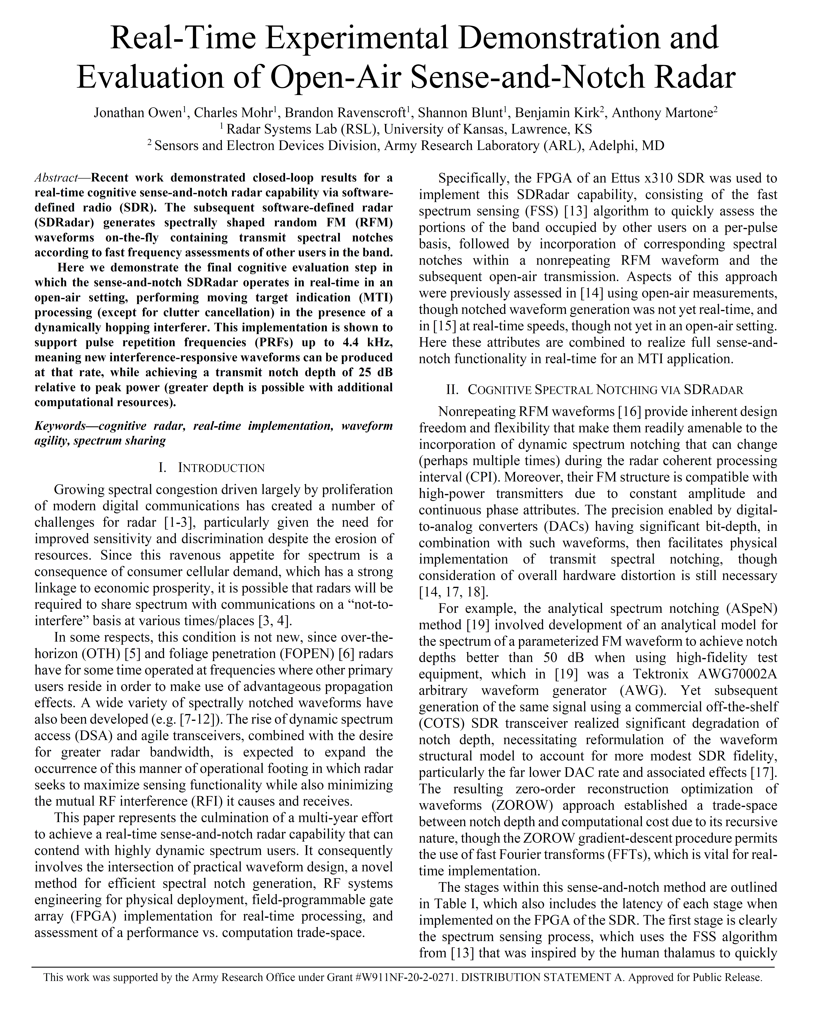
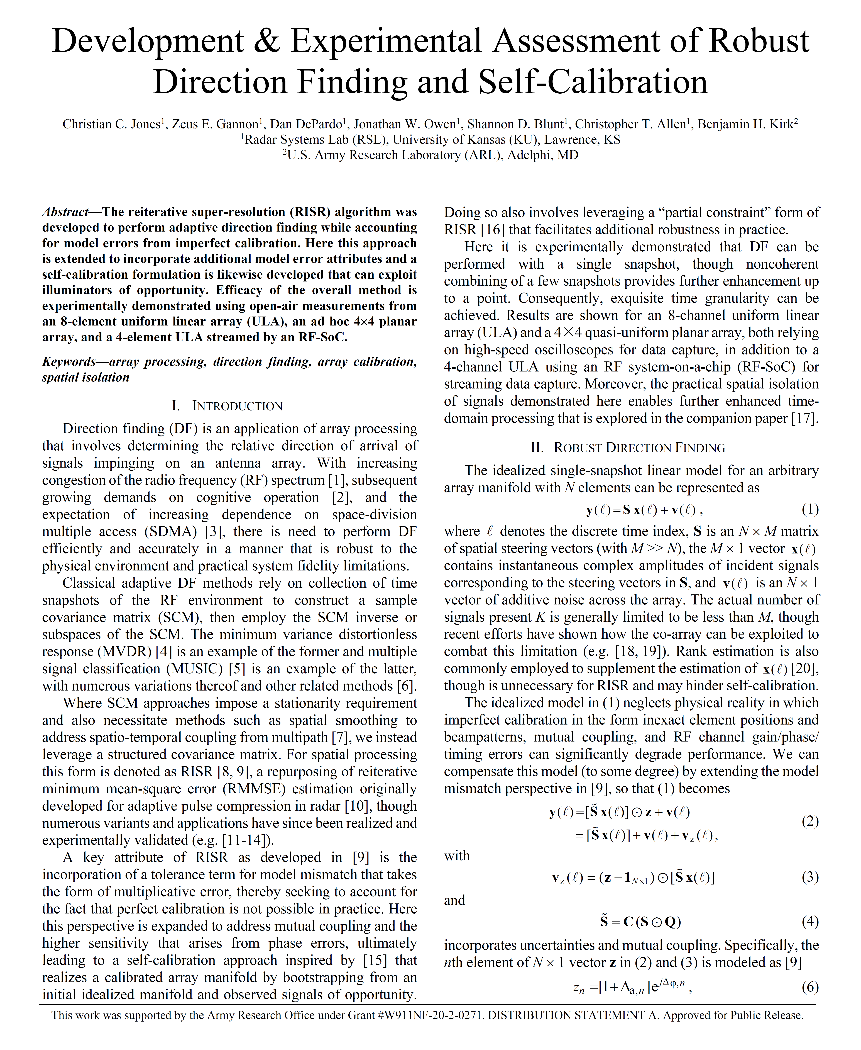
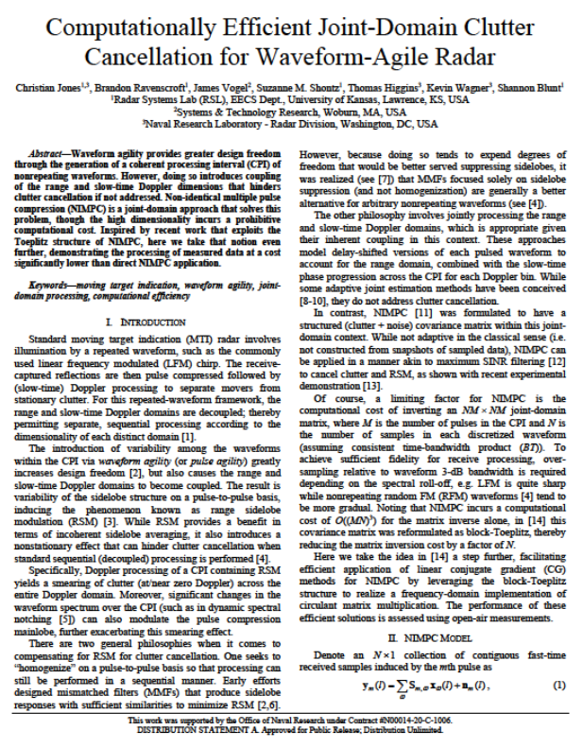
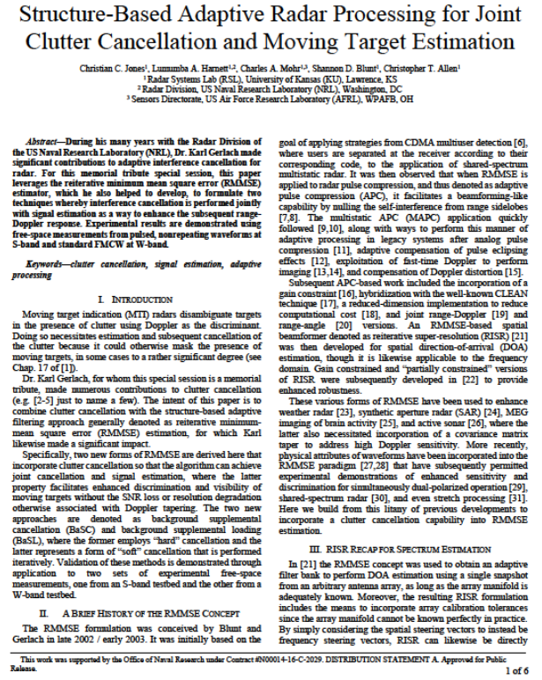
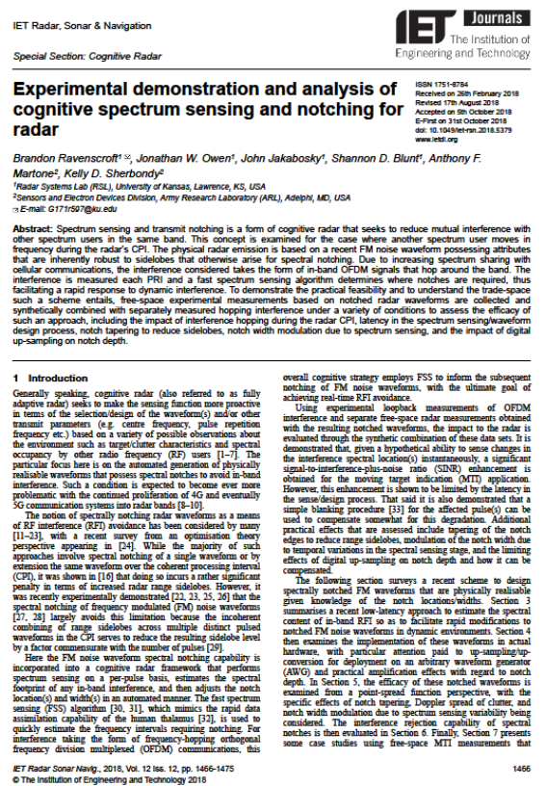
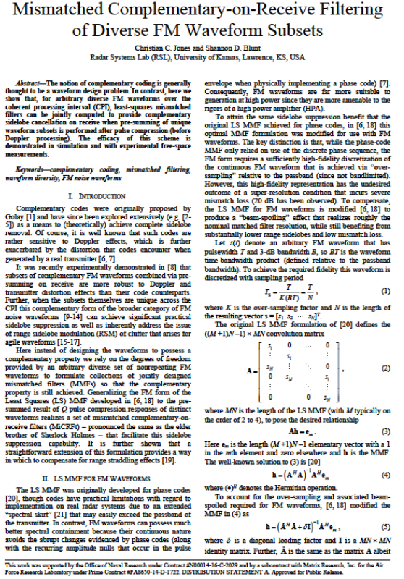
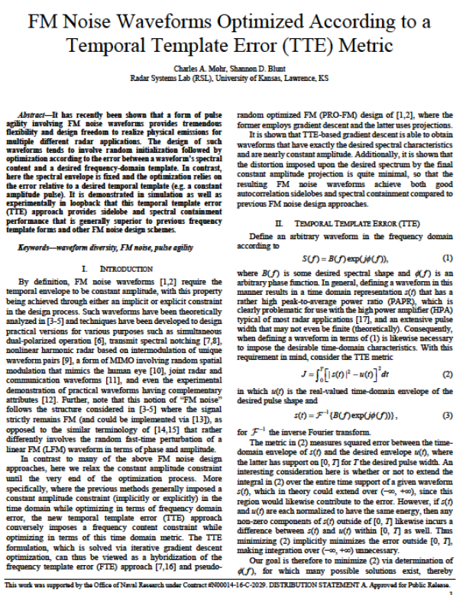
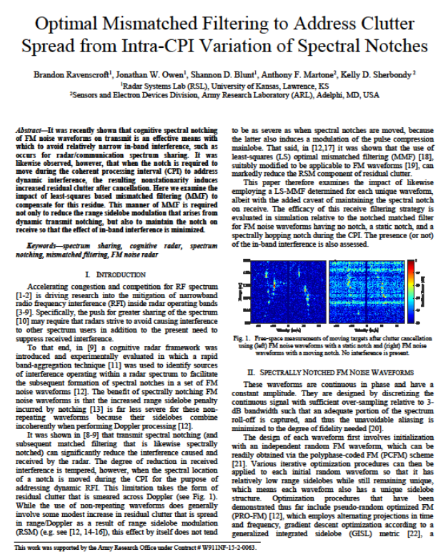
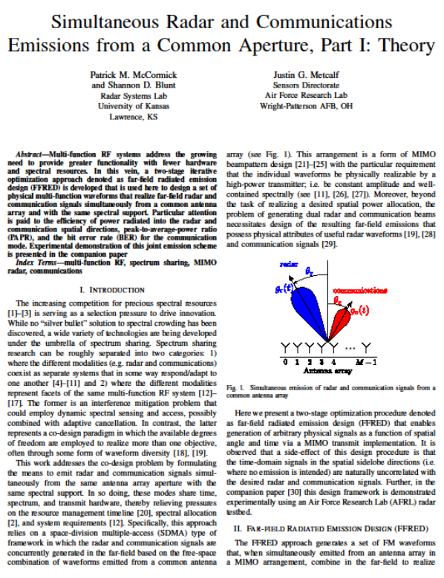
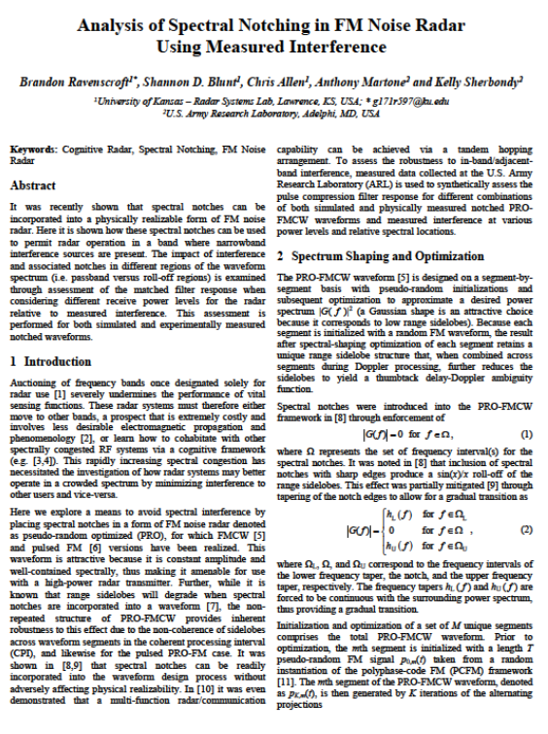
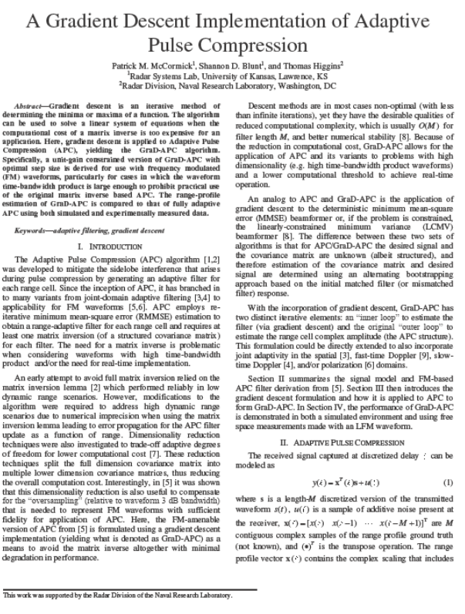
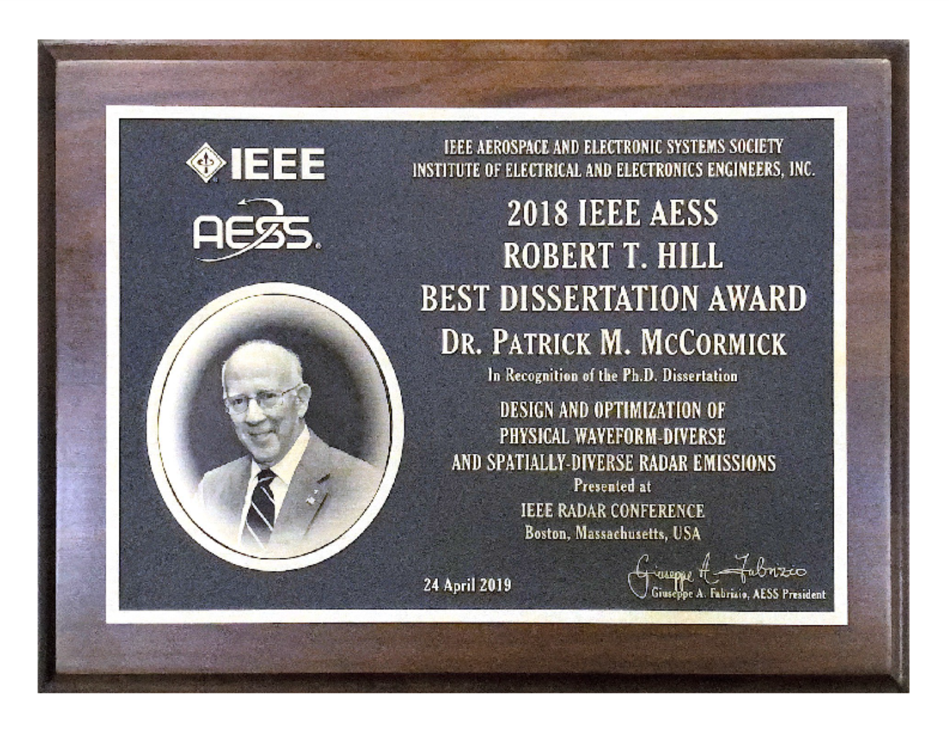
Let’s first ask the RSL students
@ top global venues for radar research … students have received numerous research awards
2023, 2nd place
(San Antonio)
2022, top-5 finalist
(Edinburgh, Scotland)
2022, 1st place
(New York City)
2022, 2nd place
(New York City)
2021, 1st place
(Atlanta)
2020, 2nd place
(Wash. DC)
2020 IET Premium Award
IEEE AESS Robert Hill Dissertation Award for Radar (2018)
2017, 1st place
(Seattle)
2017, top-5 finalist
(Belfast, UK)
2016, 3rd place
(Philadelphia)
2019, top-5 finalist
(Toulon, France)
2019, 2nd place
(Boston)
2019, top-5 finalist
(Boston)
* Plus 3 few more “top finalist” papers that wouldn’t fit on the slide
48

Slide 49
Proof via eye candy … (caveat: I had to pick/choose what would be meaningful to non-experts)

Slide 50
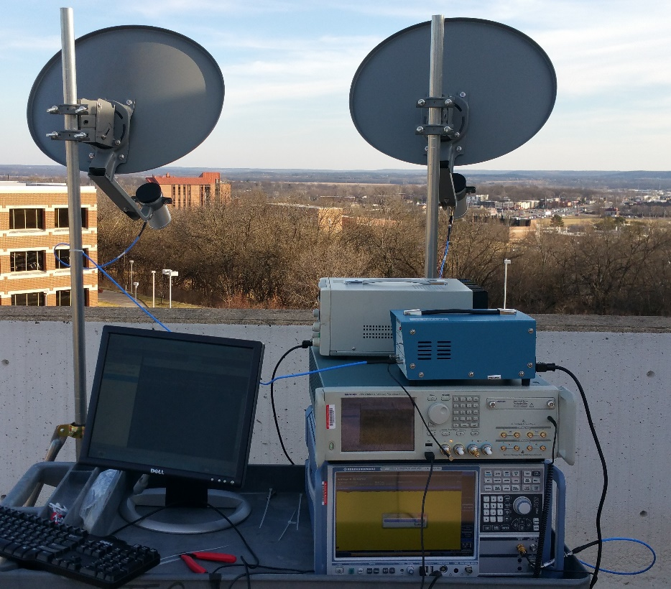
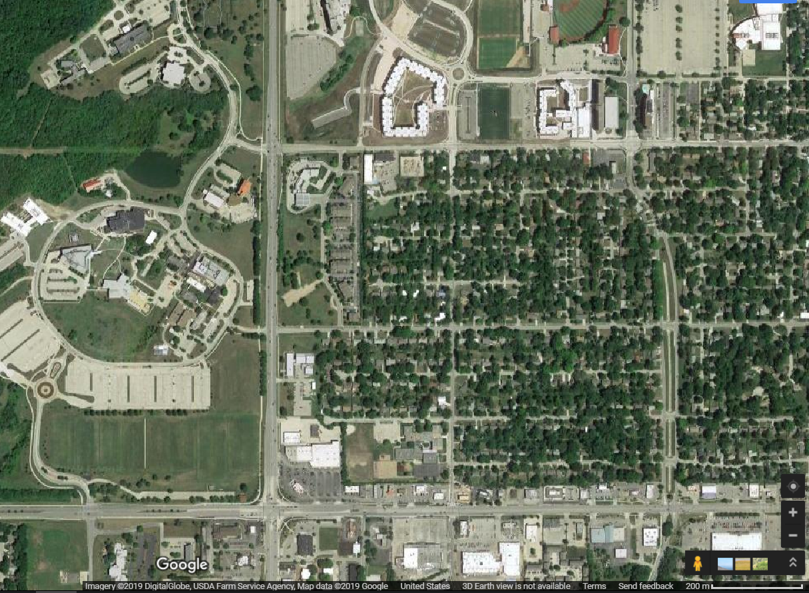
For context
S-band testbed on Nichols Hall
Annotated field of view
Nichols Hall
Intersection of
23rd & Iowa streets
Transmit power on par with your cell phone

Slide 51
Optimizing diverse radar waveforms (most recent example thereof)
f
t
Students:
Bahozhoni White (now @ Sandia National Labs)
Matthew Heintzelman (PhD student)

Slide 52
Detecting “movers” with diverse waveforms
The red blobs are reflections from cars/trucks traversing the intersection of 23rd & Iowa
The blue background is the “noise floor”
The darker blue vertical strip in the center is where we have suppressed “ground clutter” scattering (buildings, trees, etc)
Not shown: a complicated gradient derivation to enable design of these waveforms

Slide 53
Real-time “cognitive” radar
Students:
Dr. Jon Owen (now KU Research Asst. Prof.)
Dr. Brandon Ravenscroft (now @ Johns Hopkins APL)
Dr. Charles Mohr (now @ AFRL Sensors Directorate)

Slide 54
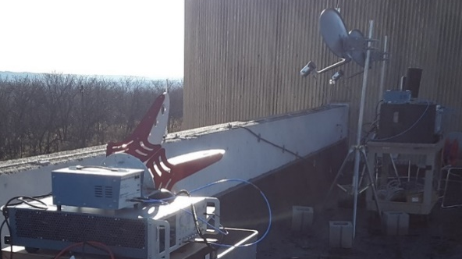
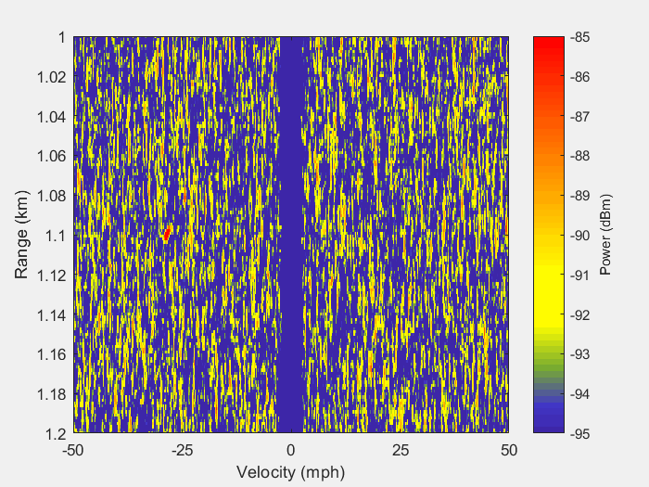
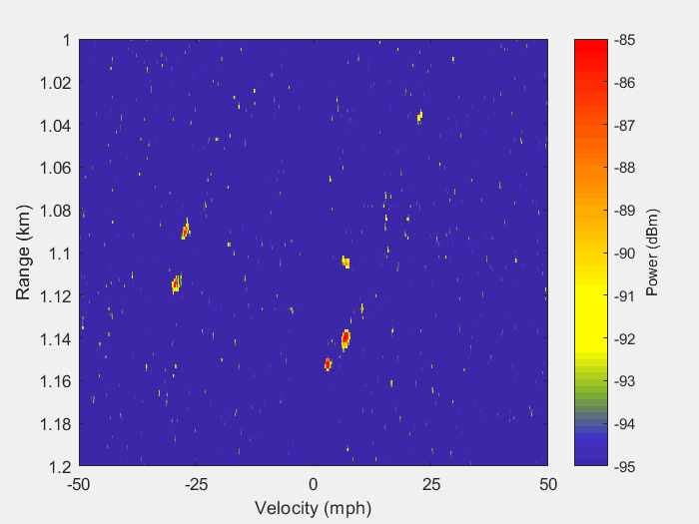
1st real-time sense-and-notch demo
radar
transmitter & receiver
(SDR not visible)
responsive waveform design/generation for up to 4.4 kHz PRF
interference source
standard operation
using dynamic transmit spectral notching
Our first demo to OUSD(R&E)
Can see the moving cars/trucks

Slide 55
Embedding information into radar emissions
Students:
Dr. Brandon Ravenscroft (now @ Johns Hopkins APL)
Prof. Patrick McCormick (now KU Asst. Prof.)

Slide 56
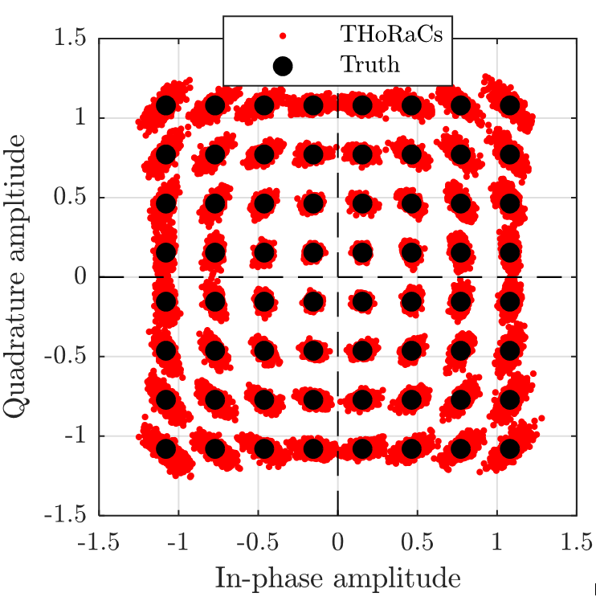
Dual-Function Radar & Communications
Embedding standard OFDM comms into FM radar structure (after optimization) @ 300 bits/pulse
Radar range-Doppler response
open-air demodulation of 64-QAM
after sync & equalization (every 50th pulse used as pilot)
We’ve developed & demonstrated several other dual-function radar/comms methods

Slide 57
Structure-based adaptive cancellation / estimation (“canstellmation” didn’t catch on)
Students:
Levi Goodman (now @ Northrop-Grumman)
(soon to be Dr.) Christian Jones (now @ NRL Radar Division)
Dr. Lumumba Harnett (now @ Leidos)
Dr. Charles Mohr (now @ AFRL Sensors Directorate)

Slide 58
Blink and you’ll miss it
W-band radar concept develop by Prof. Chris Allen to detect/track high-speed objects
here a reusable paintball (or “re-ball”)
Free-space capture inside high-clutter environment (Apollo room of Nichols Hall)
standard stretch processing
adaptive processing
fans in
ductwork
sheet vibration
re-ball

Slide 59
Single Pulse Imaging (SPI)
Students:
David Felton (PhD student)
(soon to be Dr.) Christian Jones (now @ NRL Radar Division)
(soon to be Dr.) Daniel Herr (being recruited by MIT Lincoln Lab)

Slide 60
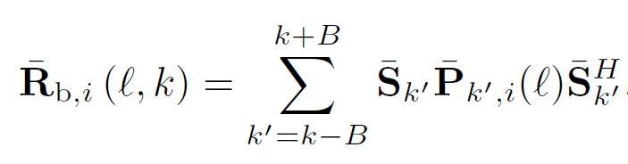
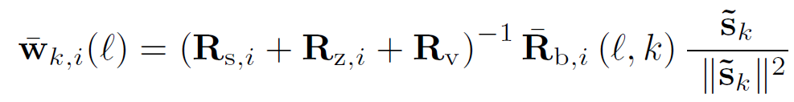








Dynamic Beamspoiling
This localized covariance is incorporated into the RMMSE filter to “spoil” excessive super-resolution of components in the localized covariance
By selecting A and B to correspond to the matched filter response mainlobe in range & Doppler, we prevent collapse of the estimated response into non-physical point scatterers
Ambiguity function mainlobe
Localized Covariance
$$A=2$$
$$θ_{k+1}$$
$$B=1$$
$$θ_{k}$$
$$θ_{k−1}$$
Beamspoiled SPI filter
0
$$ℓ−2$$
$$ℓ$$
$$ℓ+2$$

Slide 61
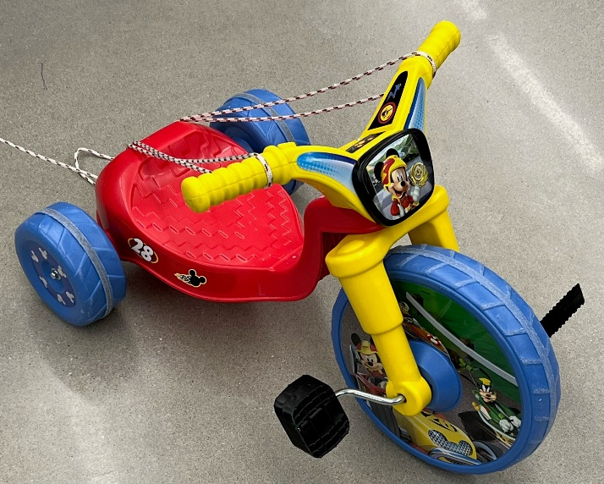
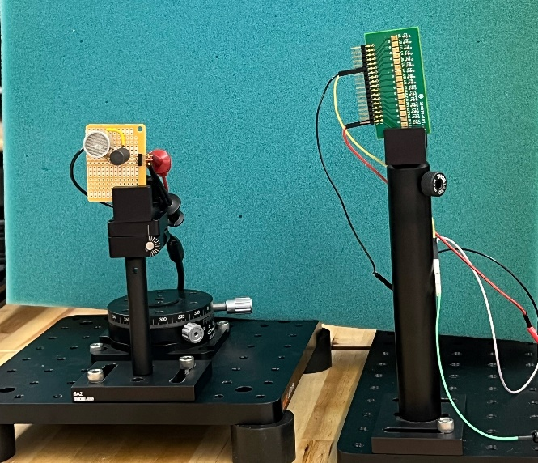
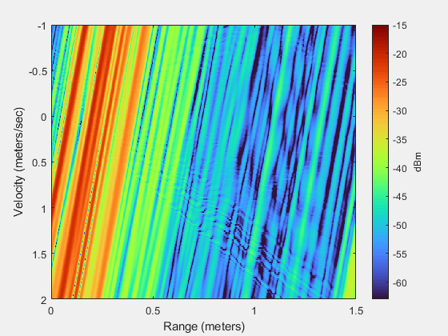
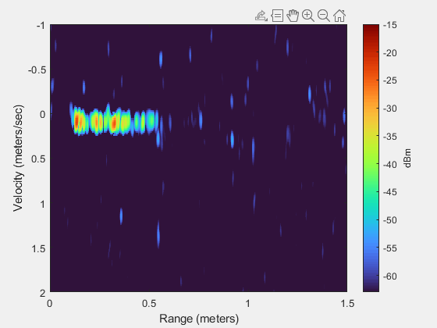
Experimental results via ultrasonic testbed
Compare Doppler tolerant waveform + standard processing against Doppler sensitive waveform (PRO) + SPI processing
47.5 kHz ultrasonic operation emulates RF @ 41.5 GHz
“high-speed” tricycle
Tx
Rx
standard waveform / processing
advanced waveform + SPI processing
Can see dynamic micro-Doppler features
Little is discernible

Slide 62
Optimization of pseudo-random PRI staggering
Students:
Rachel Chang (MS student)
(soon to be Dr.) Christian Jones (now @ NRL Radar Division)
Dr. Jon Owen (now KU Research Asst. Prof.)

Slide 63
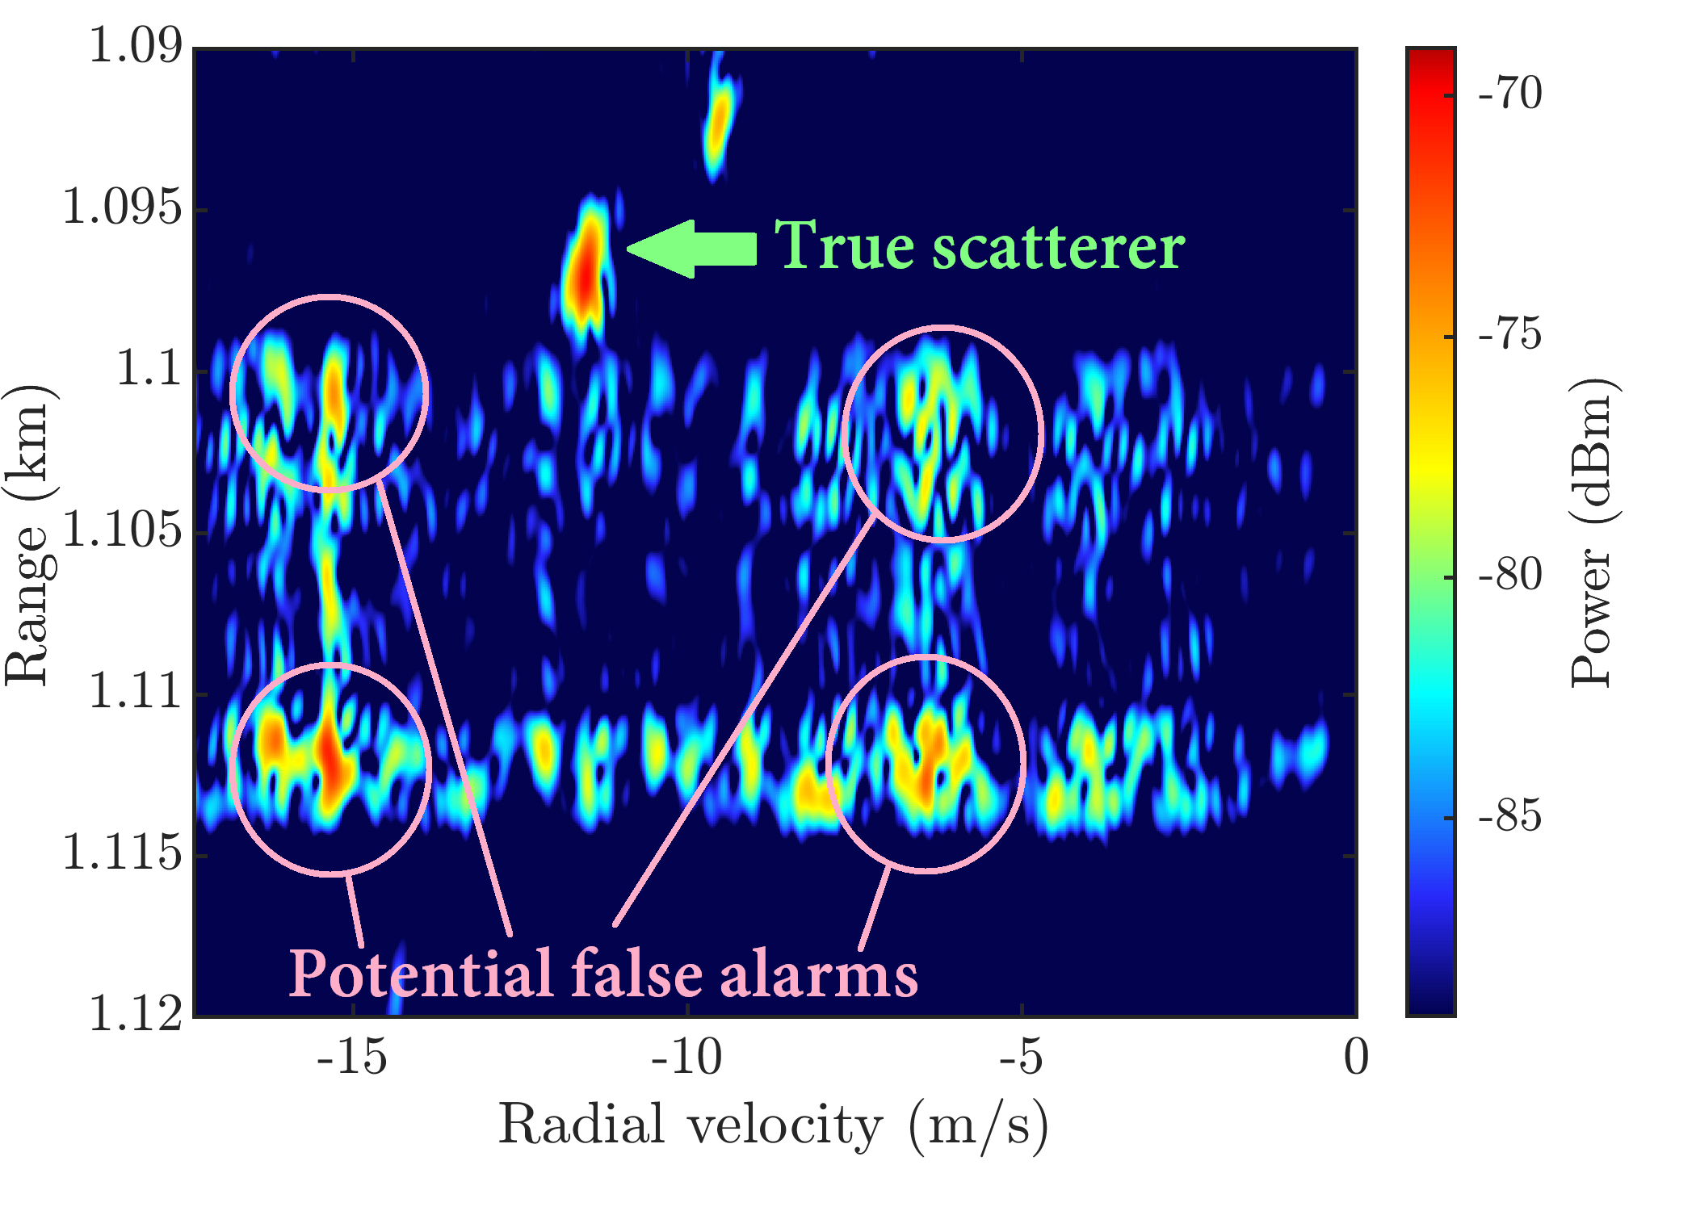
Optimized Pseudo-Random PRI Staggering
Improvement from optimization
Open-air measurement for random PRI
spurious “sidelobes” from passing tractor-trailer

Slide 64
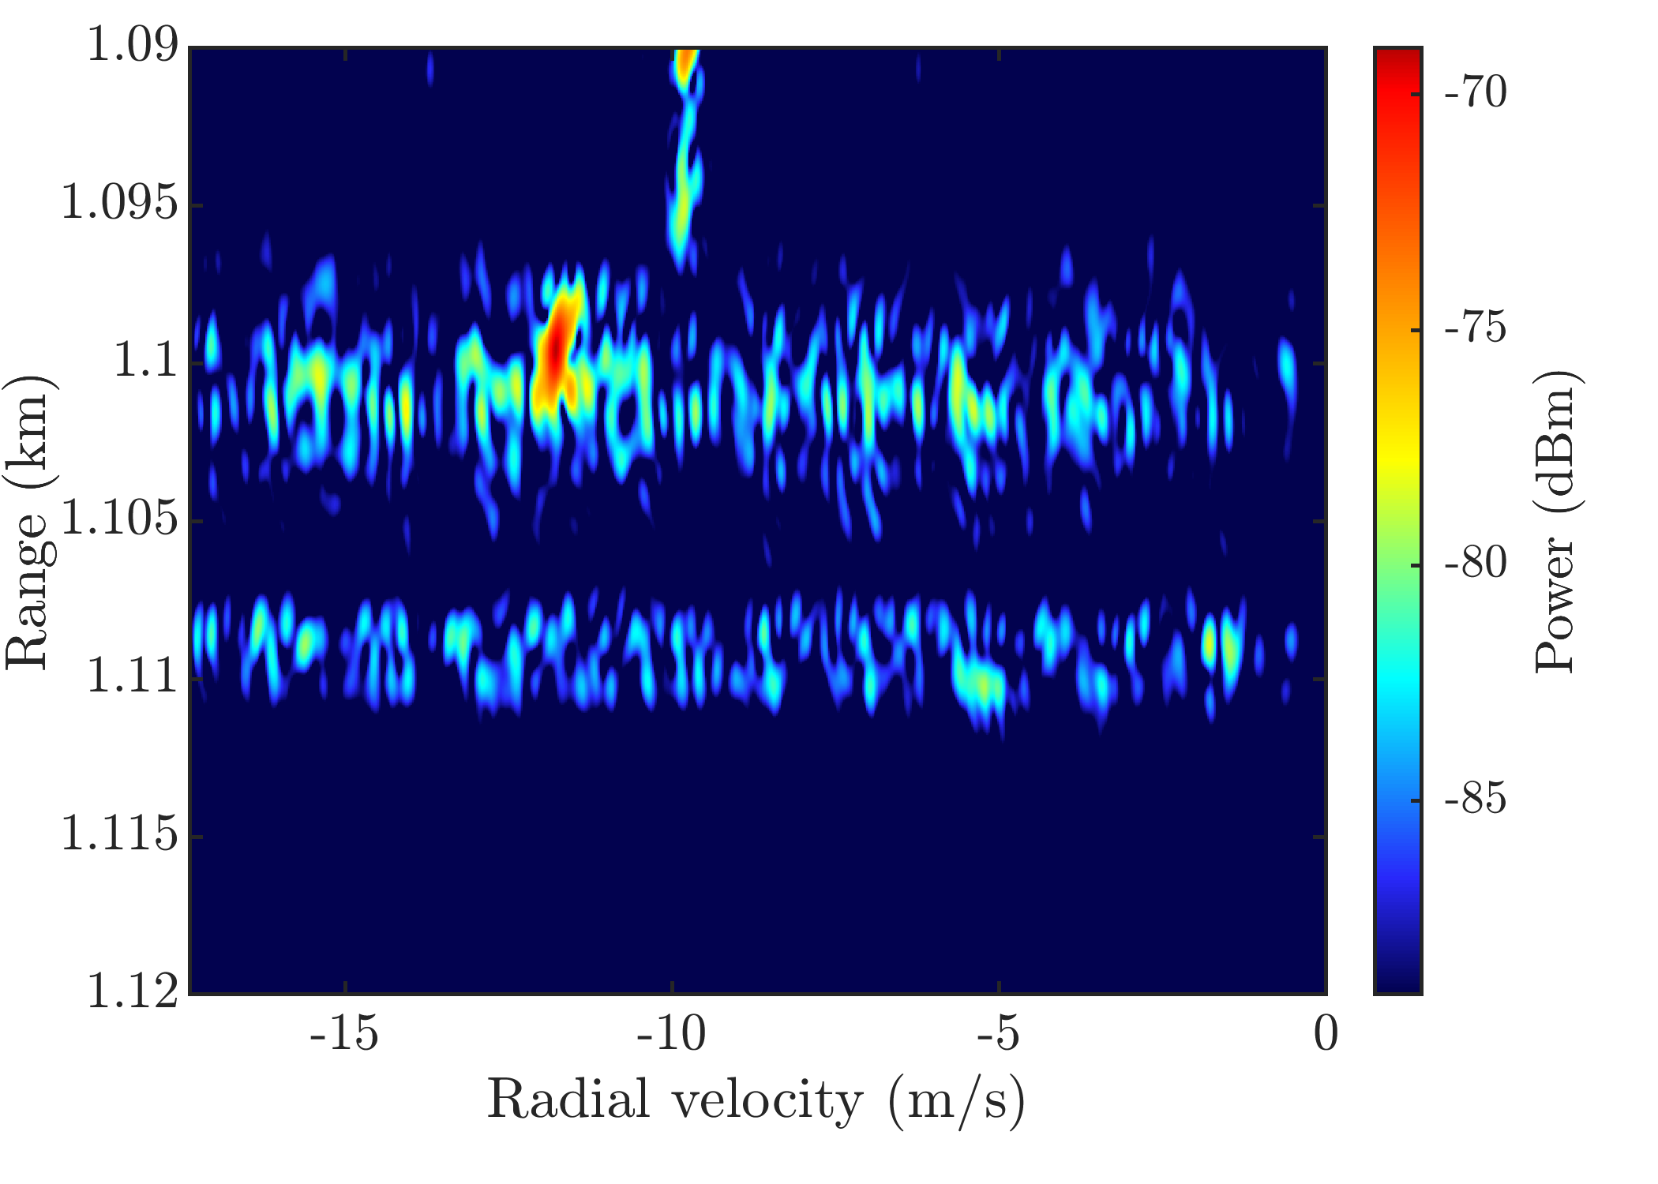
Optimized Pseudo-Random PRI Staggering
Improvement from optimization
Open-air measurement for random PRI
Open-air measurement for optimized pseudo-random PRI
spurious “sidelobes” from passing tractor-trailer
Potential false alarms are flattened … but there’s still a “smeared” residue

Slide 65
Optimized Pseudo-Random PRI Staggering
Improvement from optimization
Open-air measurement for random PRI
Open-air measurement for optimized pseudo-random PRI
spurious “sidelobes” from passing tractor-trailer
Potential false alarms are flattened … but there’s still a “smeared” residue
But the residual flattened smearing can be addressed via …

Slide 66
Adaptive receive processing for random PRI staggering
Students:
Dr. Lumumba Harnett (now @ Leidos)
Dr. Brandon Ravenscroft (now @ Johns Hopkins APL)

Slide 67
Adaptive Processing for Random PRI Staggering
Open-air capture of random PRI
(same data for both figures)
standard Doppler processing
adaptive Doppler processing
moving cars/trucks
stationary ground “clutter”

Slide 68
Adaptive Processing for Random PRI Staggering
Open-air capture of random PRI
(same data for both figures)
standard Doppler processing
adaptive Doppler processing
moving cars/trucks
stationary ground “clutter”
Now part of the DARPA BLiP program

Slide 69
Adaptive direction finding & array calibration
Students:
(soon to be Dr.) Christian Jones (now @ NRL Radar Division)
Zeus Gannon (now PhD student @ UCF in optics)
Dr. Jon Owen (now KU Research Asst. Prof.)

Slide 70
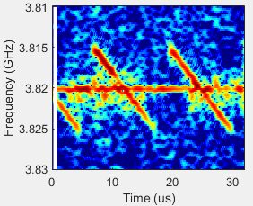
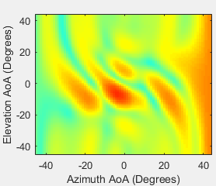
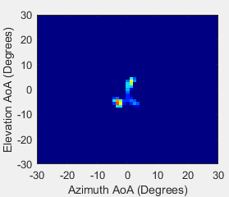
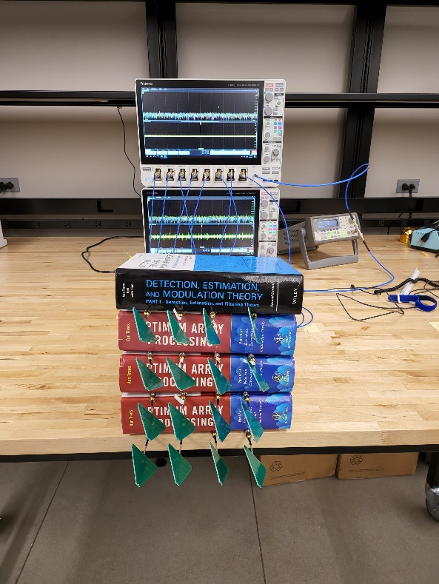
Adaptive Direction Finding
Another demo to OUSD(R&E)
3 signals sharing spectrum
spectrogram
of received data
standard processing
adaptive processing
The “Van Trees” ad hoc array
Tone
LFM
RFM
Notes:
Yet another form of waveform agility.

Slide 71
Common thread
All of those experimental demonstrations were achieved by properly incorporating uncertainty into the signal processing
Physically meaningful SP → account for both knowledge & ignorance
In short, for systems engineering: know thy fidelity
71

Slide 72
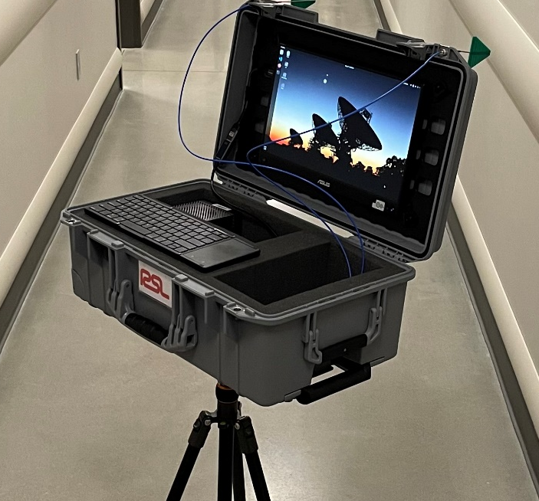
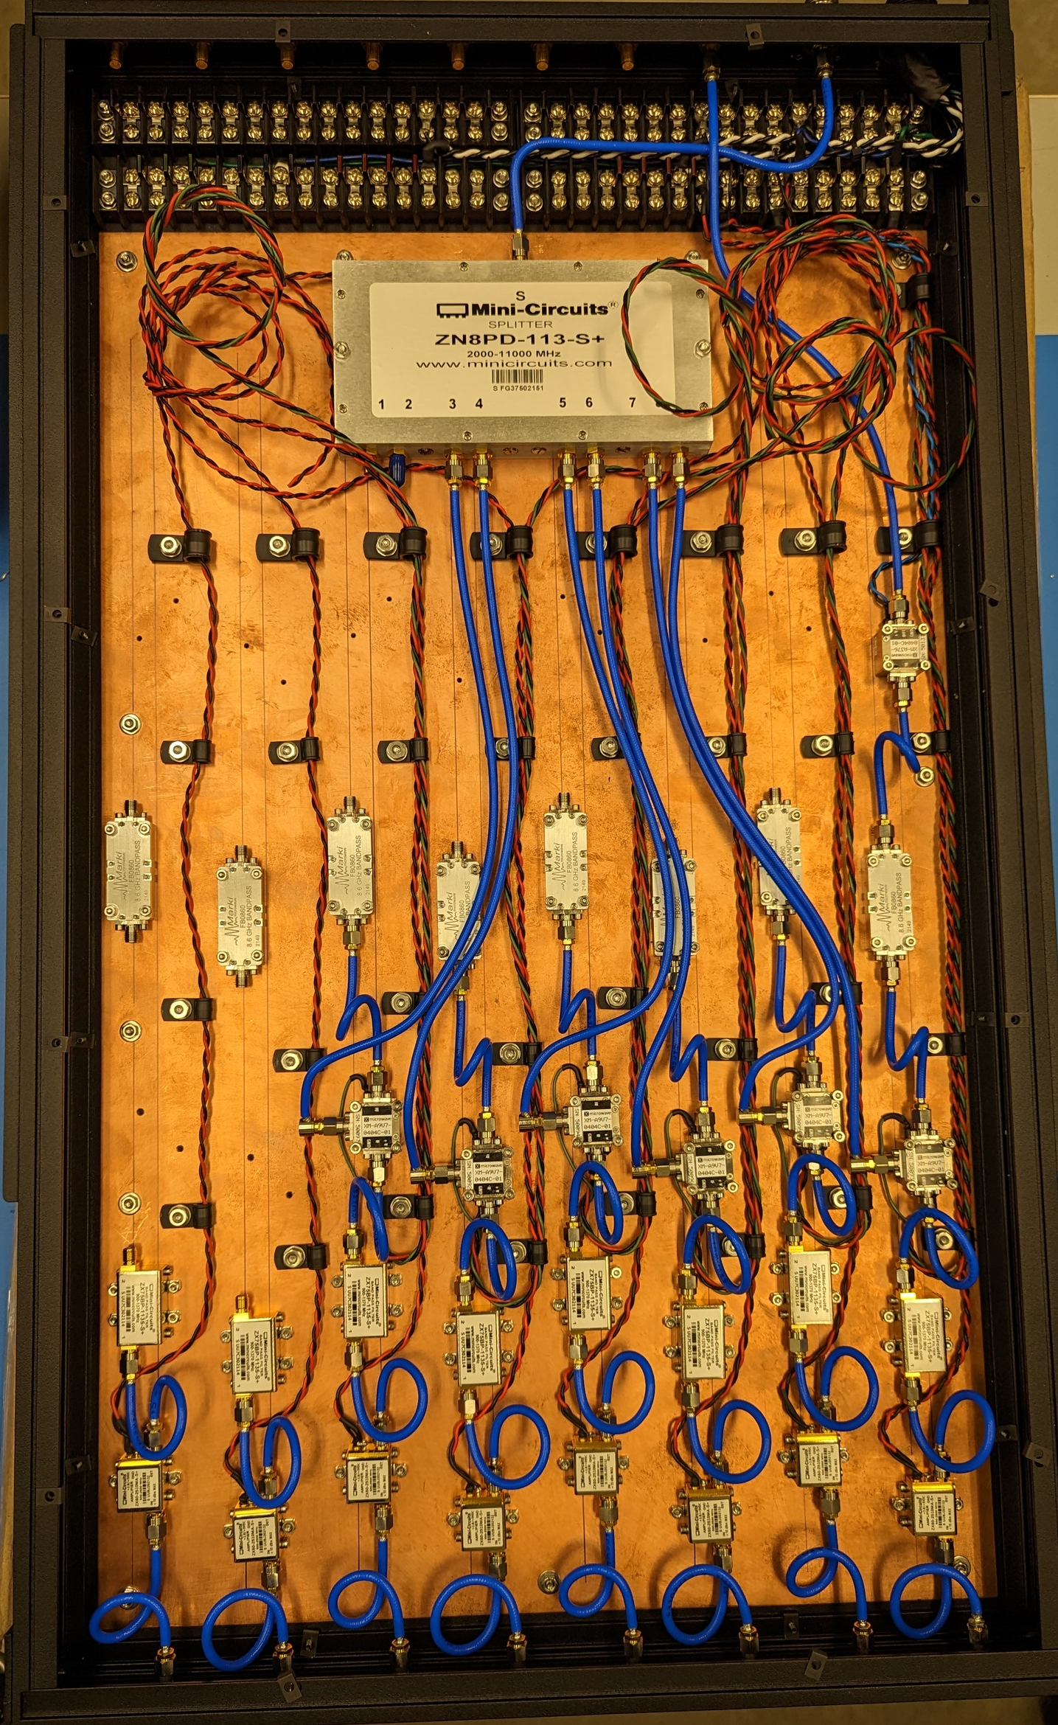



New RSL radar testbeds
WADES X-band MIMO radar testbed (ONR DURIP)
(thanks to Chris Allen,
Dan DePardo, & Patrick
McCormick, & several
students)
MicRiB mobile radar testbed
(thanks to Jon Owen)
Transmit up-conversion
Receive cart
WADES X-band antenna array

Slide 73

Some final “wise words”
(now that I have the pulpit)

Slide 74


“Listen to Cassandra (Jim Stiles)”
− Yours truly
from Greek mythology
Made perfect predictions …
… but cursed to never be believed
from KU EECS
Ditto

Slide 75


“To err is human, to fixate on error is engineering”
− Yours truly

Slide 76


“Graduate students are NOT CHEAP LABOR. They are researchers-in-training. Treat them as such.”
− Yours truly
(YOU will be more successful too)

Slide 77


“Take pride in your humility, lest hubris will get the better of you”
− Yours truly
(yes, a bit tongue-in-cheek)

Slide 78

Example of rapid beam-steering that mimics fixational eye movement
Will soon experimentally validate using new WADES testbed
Instantaneous
antenna beampattern
Think Etch-a-SketchTM
Students:
Garrett Zook (now @ L3/Harris)
Prof. Patrick McCormick (now KU Asst. Prof.)

Slide 79


Aggregate beampattern over a pulse
Questions?

